Slide 1
Supporting Internet Development
Philip Smith, Learning and Development Director

Slide 2
Overview
Training
APNIC Conferences
Policy
APNIC Labs
Root Servers
Information Society Innovation Fund

Slide 3
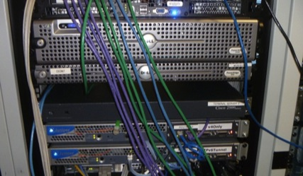
Training in 2011
Became part of Learning and Development Area
Increased focus on IPv6 Deployment
Introduced eLearning sessions (using WebEx)
One-hour modules
Delivered fortnightly to three time zones
Schedule changing in 2012
Training Lab infrastructure upgraded
Now supports 4-byte AS Numbers
Topology resembles ISP with multiple operating regions
Hands on environment with core, edge, and access networks

Slide 4
Courses Offered
Internet Resource Management
Internet Routing Registry
Internet Technologies
Routing
OSPF and BGP
IPv4 and IPv6
DNS and DNSSEC
Network Security
IPv6
eLearning (1-hour modules)
IPv6 Overview
Addressing and Subnetting
IPv4 – IPv6 Transition
Workshop
Two days, hands-on
Tutorial
Full day at APNIC 32

Slide 5
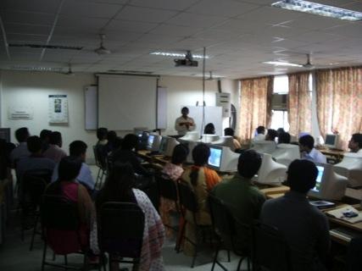
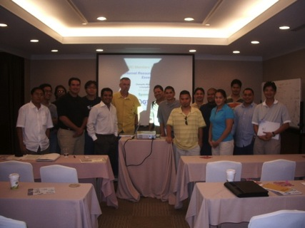
Training Delivered in 2011
Face-to-Face
67 courses in 36 locations
1,813 total participants
eLearning
76 courses
786 total participants
IPv6 courses
27 locations in 20 economies
1,147 total participants

Slide 6
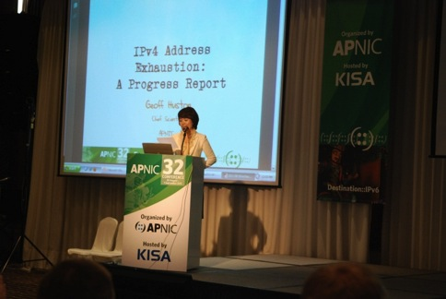
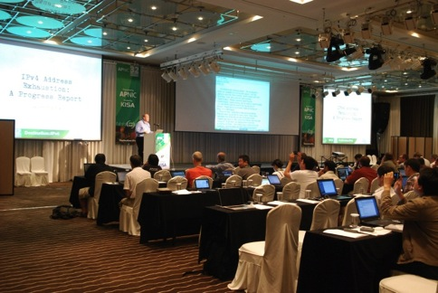
APNIC Conferences
APNIC 32
Total delegates: 244
Economies represented: 35
APNIC Member organizations represented: 62
Participants at APNIC Remote Hub in Phnom Penh: 25
Total remote participants: 506

Slide 7
2011 Policy Outcomes
APNIC implemented the following policy proposals:
May
prop-088: Distribution of IPv4 addresses once the Final /8 period starts
prop-093: Reducing the minimum delegation size for the Final /8 policy
prop-094: Removing renumbering requirement from Final /8 policy
August
prop-083: Alternative criteria for subsequent IPv6 allocations
prop-095: Inter-RIR address transfer proposal
November
prop-096: Maintaining demonstrated needs requirement in transfer policy after the Final /8 phase

Slide 8
Policies at APNIC 32
Did not reach consensus:
prop-100: National IP address plan – Allocation of country-wide IP address blocks
prop-099: IPv6 reservation for large networks
prop-098: Optimizing IPv6 allocation strategies (simplified)
These proposals were returned to the mailing list for further discussion

Slide 9
APNIC Labs
Launched in 2011, focusing on several activities
IPv6 Capability Tracker
Google Analytics Tracking Tool to allow website operators to measure client IPv6 capabilities
Measuring IPv6
Measuring the end-to-end capability of IPv6 clients per economy
IPv6 preference by ASN
Measures IPv6 client capability per autonomous system
IPv4 address report
Measuring IPv4 free pool address exhaustion
Website: labs.apnic.net
Blog: blabs.apnic.net

Slide 10
Root Server Deployment
APNIC helped launch two additional root server instances in 2011:
Bhutan
Operator: I-root
Local host: Bhutan Telecom
Location: Thimphu
Status: Operational from April 2011
Mongolia
Operator: F-root
Local host: ICTPA and MobiNet
Location: Ulaanbaatar
Status: Operational from September 2011

Slide 11
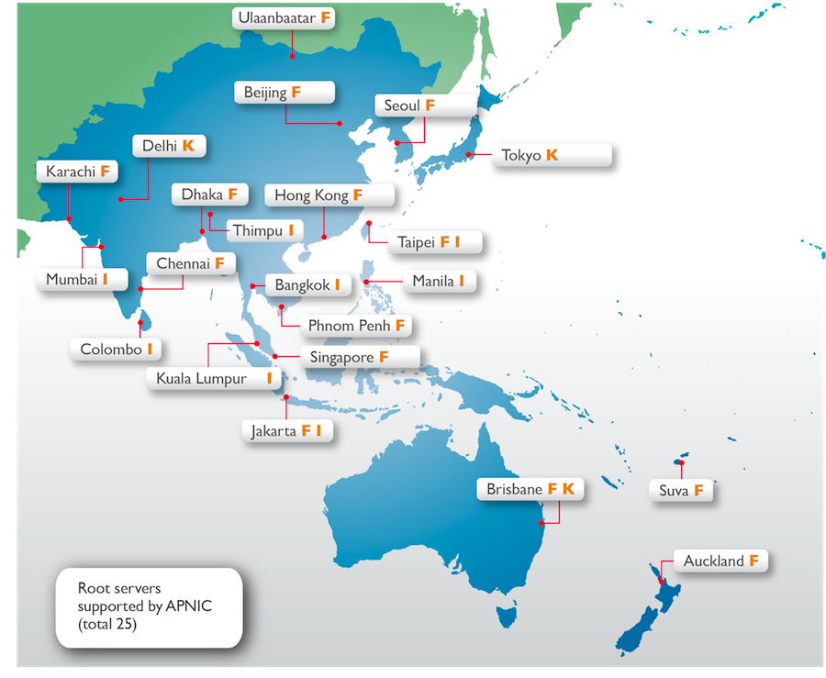
Root Servers in the Region

Slide 12
Information Society Innovation Fund
ISIF is a grants program aimed at stimulating creative solutions to ICT development needs in the Asia Pacific region
From 2009, 23 initiatives in 12 AP economies showcasing innovation, cooperation, and technical knowledge have been supported through grants and awards
In 2011:
47 nominations from across the region
4 winning projects presented during Kenya IGF

Slide 13
Information Society Innovation Fund
ISIF is now part of the Seed Alliance
Alliance for Internet development and digital innovation
Joint effort with LACNIC and AfriNIC, with generous support from the IDRC
New round of funding to be launched late March 2012
Final reports from 2010 grant recipients now published
Website: www.isif.asia

Slide 14
Thank you

