Slide 1

Delivering Value
Sanjaya,
Services and
Operations Director

Slide 2
Overview
IPv4 exhaustion
Resource delegation
Resource Quality Assurance
Member services

Slide 3
IPv4 Exhaustion
APNIC reached its final /8 IPv4 block on 15 April 2011
Now delegating from the final /8 - 103/8
  Maximum of a /22 per account holder
IPv4 transfers
  Pre-approvals
    Implementation of prop-096
    Recipient of transferred resources may apply for for preapproval by demonstrating need before finding a source
  http://www.apnic.net/ipv4-stage3-faq

Slide 4
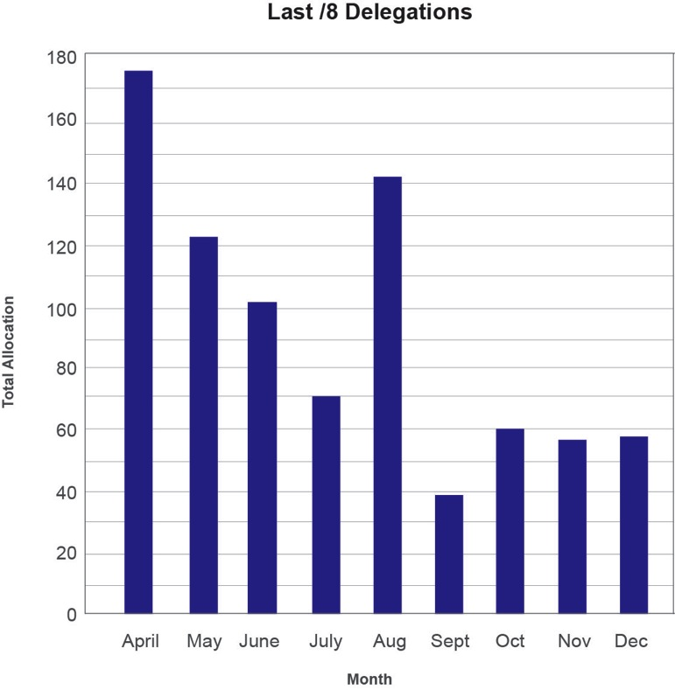
Final /8 Delegations 2011

Slide 5
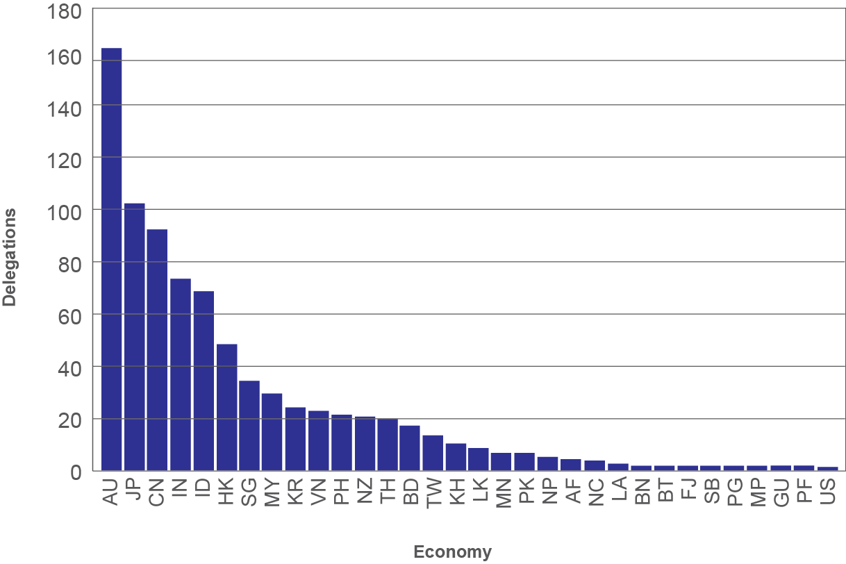
Final /8 Delegations by Economy
As of 31 December 2011

Slide 6
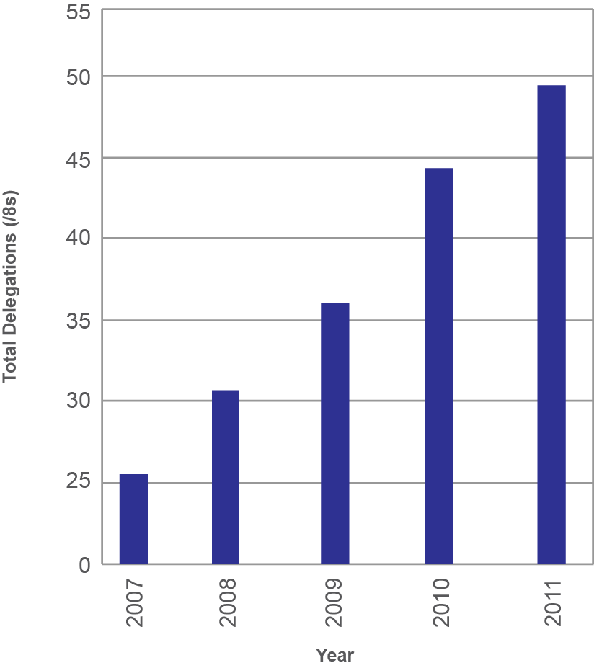
IPv4 Delegations 2011
As of 31 December 2011
Notes:
* Predictable levels of delegation pre-exhaustion

Slide 7
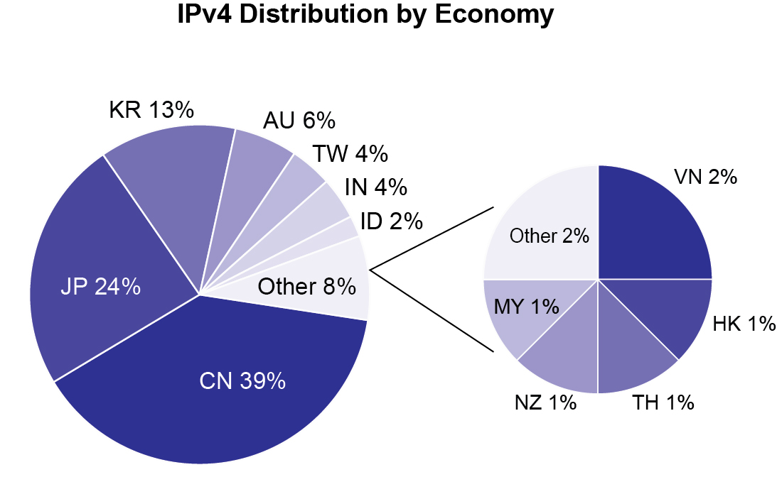
Total IPv4 Distribution
As of 31 December 2011

Slide 8
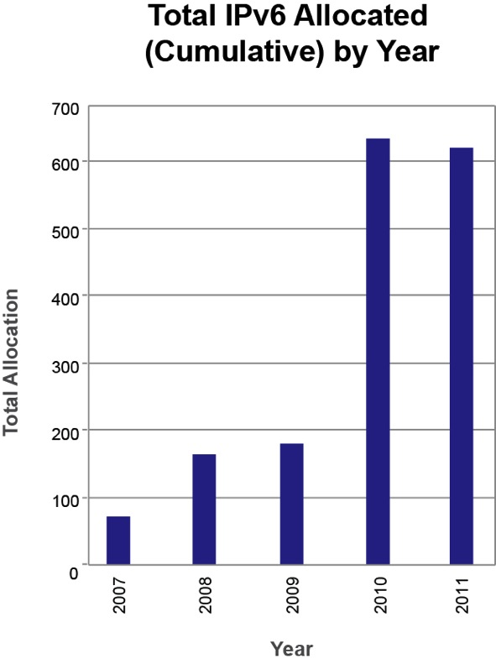
IPv6 Delegations 2011
As of 31 December 2011
Notes:
* Continued strong growth in IPv6

Slide 9
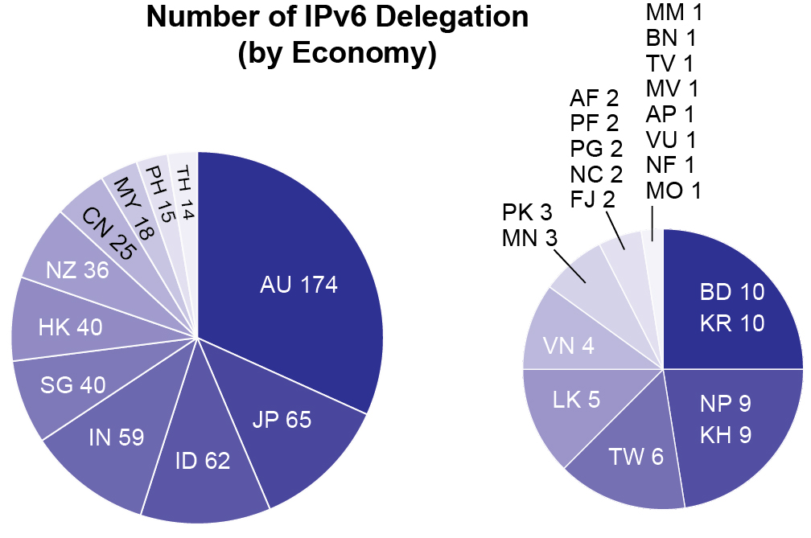
Total IPv6 Distribution
As of 31 December 2011

Slide 10
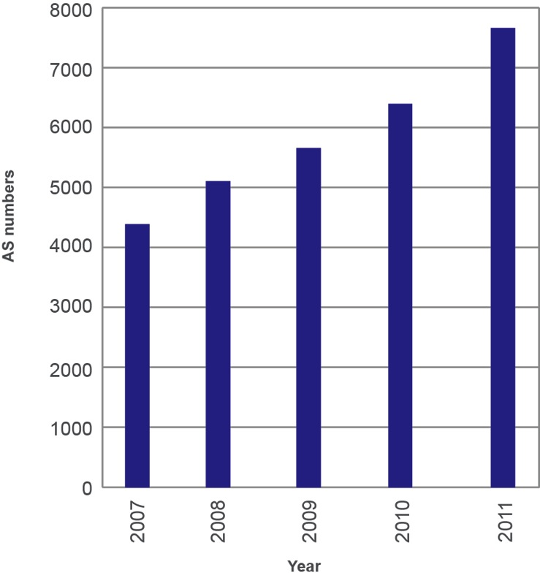
AS Number Delegations 2011
As of 31 December 2011
Notes:
* Steady growth of AS delegations (cum. ASN by year)

Slide 11
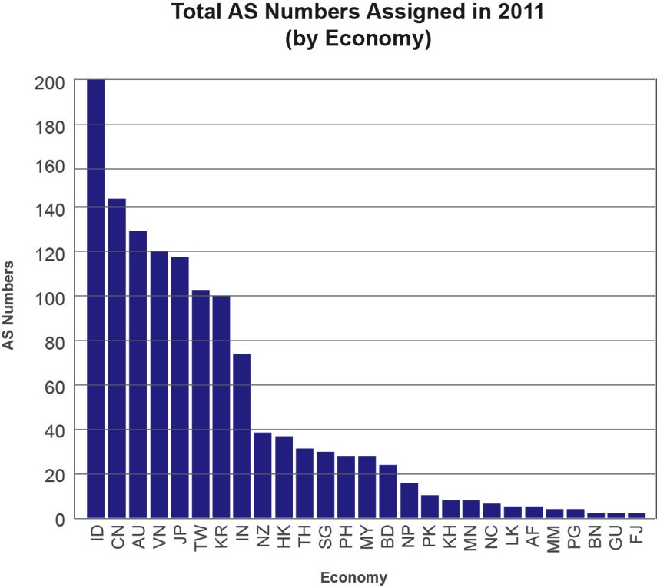
Total AS Number Distribution
As of 31 December 2011

Slide 12
Resource Quality Assurance
Whois cleanup project
  155,618 unreferenced objects removed
  49,542 errors updated
  Update your mnt-irt object attributes
Reachability testing 39/8, 106/8, and 103/8 (final /8)
BoF sessions at APNIC 31, 32, and 33
  http://meetings.apnic.net/33/program/bof
Outreach activities
  JANOG, LACNIC, and RIPE NCC

Slide 13
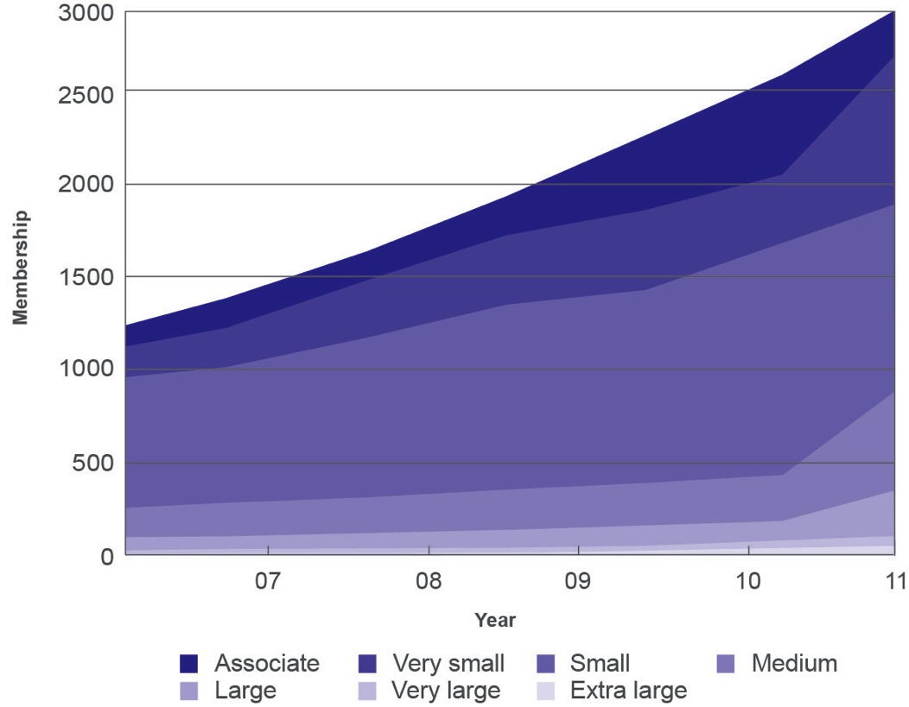
Membership Growth
As of 31 December 2011

Slide 14
Member Services
Registered MyAPNIC users - 4,698
Helpdesk stats:
  Chat requests: 1,770
  Tickets received: 12,625
  Administration tickets resolved: 3,302
  New Member accounts established: 524
  Growth 2010 – 2011: 4.29%

Slide 15
MyAPNIC Features in 2011
DNSSEC support
  Account holders can now sign their reverse DNS records through MyAPNIC
IRT object reminder
  Reminds Members if they have not registered an IRT object
Whois update improvements
  Bulk upload feature improvement
  All whois object types are now supported
IPv6 sparse assignment
  A tool to help Members calculate starting addresses of sparsely managed sub-delegations
IPv4 transfers facilitation
  Implementation of prop-050 and prop-096

Slide 16
Thank You

