Slide 1
Project CONNECT
Louise Flynn, Marketing and Public Relations Consultant
Services Area

Slide 2
Background to Project CONNECT

Slide 3


Slide 4
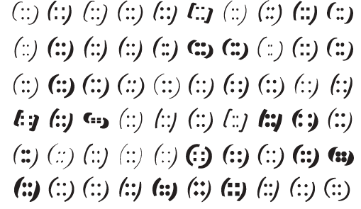
APNIC Community

Slide 5
APNIC Community
APNIC is a region with different cultures, languages and experiences
We have so much collective intelligence across our community
We as the Internet Community have a long history of sharing information

Slide 7


Slide 8
What is Project CONNECT?

Slide 9
What is Project CONNECT?
CONNECT streamlines the sharing of information
More information on APNIC Services and how to use them
More information on APNIC Research and statistics
More information about what your fellow APNIC community members are doing locally
More information on what is happening in global technical and governance forums meetings
More information from Technical publications
CONNECT gives you the opportunity to get the best from your APNIC membership

Slide 10
What is Project CONNECT?
Build to a single stream of information that members will be able to access and bring into a format that suits them
We will look to utilize familiar tools such as Facebook, Twitter and RSS.
Let Start Now
  ‘Follow’ us now on #APNIC #APNIC33 @apnic
  ‘Like’ our Facebook page
  Join our linked in Community

Slide 11
Getting Involved

Slide 12
Getting Involved
We are taking feedback from:
  Previous member and stakeholders surveys
  The website usability survey
  The upcoming Member survey
about how APNIC community want to receive information on what what they want to know about
But please feel free to approach myself or my fellow project members during APNIC 33

Slide 13
Thank You

