Slide 1
APNIC Website Usability Survey Analysis
Bhadrika Magan, Publications Manager

Slide 2
Background
21 Survey questions
Respondents rated the website according to a scale of very dissatisfied to very satisfied, with some questions providing for comments
418 respondents
223 account holders
195 non-account holders
Respondents generally reflect membership composition and are spread across Australia and New Zealand (24.6%), SE Asia (23.44%) and South Asia (22.97%)
Secondary data from Google Analytics indicates strong use by the Chinese-based community, but requires more research
Notes:
Secondary data from Google analytics indicates strong use by the Chinese-based community, but would require further research

Slide 3
Key Findings
Overall, high satisfaction
71.5% of respondents were “somewhat satisfied” or “very satisfied” (77% when considering neutral responses)
95.8% of respondents found what they were looking for
83.7% of respondents were familiar with Internet concepts
Majority of users visited the website from an APNIC communication
Notes:
Satisfaction:
77.8% when considering neutral responses
Users:
Indicative that the website is visited by predominantly technically-minded users

Slide 4
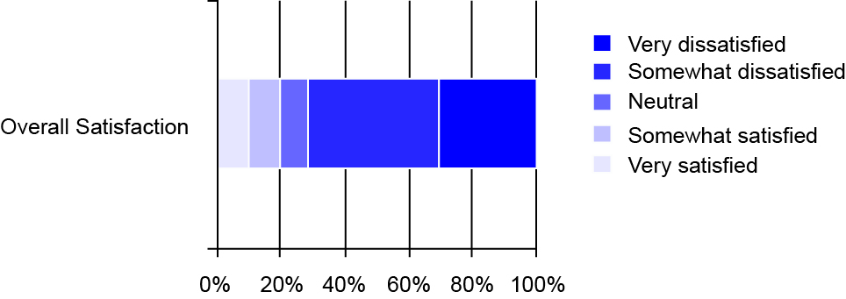
Satisfaction
71.2% were “somewhat satisfied” and “very satisfied”
Notes:
Overall satisfaction was 3.71% /5

Slide 5
Top 15
IP addressing
Learn about IPv6
IP address trends in the AP
Membership information
MyAPNIC
IPv4 exhaustion
Apply for resources
Current policies
9. Technical standards
10. Training and education
11. DNS research
12. About the Internet community
13. Membership fees
14. Address management objectives
15. Internet routing Registry
Notes:
These reveal expected results
But there were small trends noted in the comments indicating some dissatisfaction with getting IP addresses
First time users also indicated they access the website to find “General information about IP addressing”

Slide 6
Top 15

Slide 7
Bottom 15
Staff and human resources/Benefits of working at APNIC
Mailing lists
Resource Certification
Policy drafts
APNIC By-laws and Corporate documents
Press and Media resources
7. Contribute to APNIC news
8. APNIC in the press
9. Host or sponsor an event
10. ICONS
11. Participate in elections
12. NRO news
13. ISIF program
14. EcoAPNIC
15. Book a speaker
Notes:
These are consistent with the demands of the average user
Notable results with Res Cert, ICONS, and Mailing lists

Slide 8
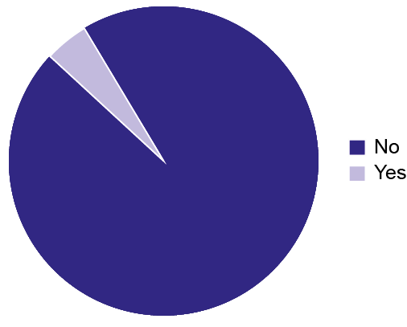
Navigation
94.8% found the menu options on the home page clear
90.9% found the left-hand menu and other navigation tools clear

Slide 9
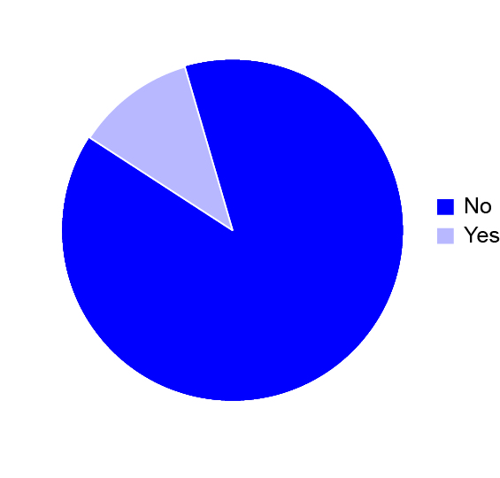
Navigation
80.3% did not have problems navigating the website. 19.7% did with 10 comments related to trouble accessing information and tools

Slide 10
Accessibility
95.8% of respondents found what they needed
89.2% did not have any problems accessing the website

Slide 11
Users
Majority users visited “Several times a month” (29.06%); “Several times a week” (17.9%) and “Once a month” (19.5%)
First visitors measured 13.56%
Three distinct categories emerged:
Frequent users (several times a month or week)
Regular users (once a month)
First time users

Slide 12
Usage

Slide 13
Getting Updates
269 respondents preferred email updates
Desired getting information in a preferred format rather than relying on visiting a web page

Slide 14
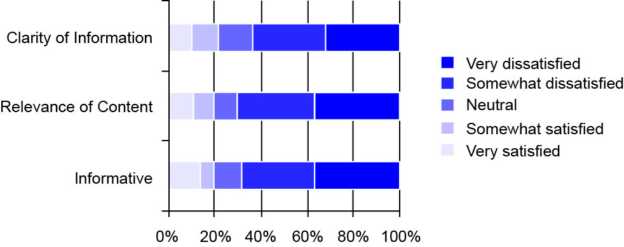
Functionality
Responses were “very satisfied” (VS) and “somewhat satisfied” (SS) for content that is:
Informative - 36.4% (VS); 31.9% (SS)
Relevant - 36.6% (VS); 33.8 (SS)
Clear - 31.8% (VS); 31.8% (SS)

Slide 15
Quality and Appearance
71.5% were “somewhat” and “very satisfied” overall
Speed of page load (3.58 /5)
Easy to navigate (3.65 /5)
Easy to understand (3.60 /5)
Visually pleasing (3.54 /5)
Little variance between satisfaction rates

Slide 16
Quality and Appearance

Slide 17
Recommendations
“General information about IP addressing” must be kept up-to-date as it was accessed the most by first time and regular users
Resource Certification content may need to be updated and awareness of Mailing lists will need to be improved
Navigation can be tweaked to address the 70 respondents who made comments

Slide 18
Navigation Update
Notes:
Something like this

Slide 19
Further Research
The Survey should be repeated annually to assess whether trends can be established:
Satisfaction
Geographic spread
Usage

