Slide 1
APNIC Member Services
George Kuo

Slide 2
MyAPNIC

Slide 3
What is MyAPNIC
A secure Member services website
Internet resources management, for example:
Whois updates (reverse DNS, IRT, DNSSEC)
IPv4 transfers and pre-approval
Resource Certification (RPKI)
Account and contact administration
Ongoing updates as a result of policy implementations
https://myapnic.net

Slide 4
Access to MyAPNIC
For all current APNIC accounts
Username and password registration
Instant access for all Corporate Contacts
Access approval required for non Corporate Contacts

Slide 5
IPv4 Transfers

Slide 6
IPv4 Transfer Policy
Prop-69 implemented Nov 2011
Recipients to demonstrate need
Initial implementation on Nov 2010 (prop-50) without demonstrating needs
Between APNIC account holders
Address pools managed by APNIC
www.apnic.net/transfer

Slide 7
MyAPNIC IPv4 Transfer Feature
Policy implementation support
Reduces overhead
Source account to initiate
Initiated transfer will expire in 30 days if no action is taken by the recipient
Recipient account to accept within 30 days
Recipient account can decline the transfer
All Corporate Contacts are informed of the transfer details
Successful transfers appear in the transfer statistics

Slide 8
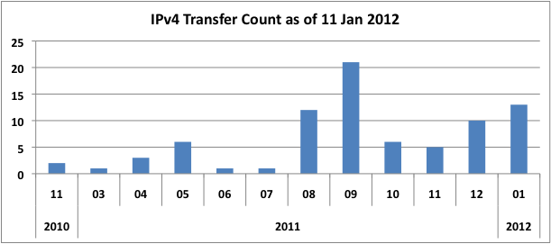
IPv4 Transfer Statistics
http://ftp.apnic.net/transfers/apnic/

Slide 9
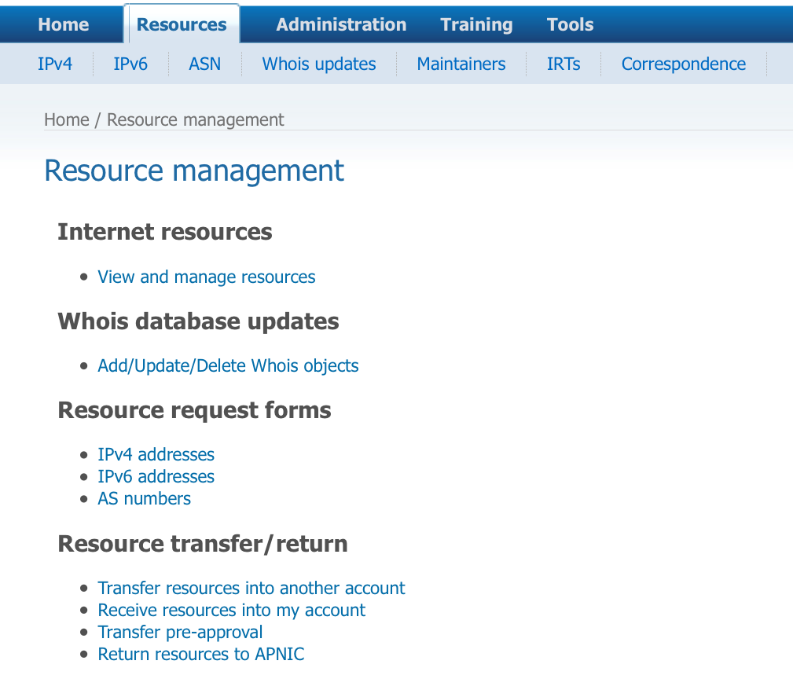
MyAPNIC IPv4 Transfer Feature

Slide 10
Transfer pre-approvals

Slide 11
IPv4 Transfers Pre-approval
APNIC to evaluate needs of the recipient account before the transfer source is located
Pre-approval expires in 12 months if no transfer source is available to initiate the transfer
A subsequent pre-approval will, if granted, replace the existing one
http://www.apnic.net/pre-approval

Slide 12
MyAPNIC Pre-approval Feature

Slide 13
Resource Certification

Slide 14
Resource Certification
Supports secure routing
Resource Public Key Infrastructure (RPKI)
Enables third party to verify the authenticity of information about Internet resources when data is digitally signed by the custodian of those resources
http://www.apnic.net/rescert
Notes:
Enables third parties to verify the authenticity of information about number resources when the data is digitally signed by custodian of the resources

Slide 15
MyAPNIC Resource Certification
Certification feature initially launched in August 2008
Creation of Route Origin Attestations (ROAs)
Statement of one or more prefixes advertised by an autonomous system (AS)
Allows entities to verify the permission given by an IP address holder to advertise routes to the AS
Download of certificates
For your resources sets

Slide 16
MyAPNIC Resource Certification
Secure access
Only to users accessing with APNIC digital certificates
Optional
Services activation required

Slide 17
MyAPNIC Resource Certification

Slide 18
MyAPNIC Resource Certification

Slide 19
MyAPNIC Resource Certification

Slide 20
DNSSEC

Slide 21
DNSSEC
Three-phase implementation complete
Hardware and software testing around late 2009
All APNIC managed zones signed throughout April 2010
Improved features in MyAPNIC in mid 2011
http://www.apnic.net/dnssec

Slide 22
DNSSEC in MyAPNIC
Members who implemented DNSSEC for their reverse zones to publish their signature information into the parent zone
"ds-rdata:” attribute for the domain object
Bulk update available
Zone file upload
Built-in validation tool

Slide 23
MyAPNIC DNSSEC

Slide 24
Thank You

