Slide 1
APIX update
APNIC Member Meeting, 2 Mar. 2012
Che-Hoo Cheng / Katsuyasu Toyama
interim co-chairs
APIX

Slide 2
What is APIX?
“Asia-Pacific Internet Exchange”
  An association of Internet Exchange Providers in Asia-Pacific region.
    just like Euro-IX in Europe
  Objectives:
  To share information about
  technical, operational, and business issues and solutions regarding Internet Exchange.
Notes:
APIX is Asia Pacific Internet Exchange, an association of Internet exchanges in Asia Pacific region.
This is just like Euro-IX forum, the association in European region, a closed group of internet exchange.
The main objectives are:

Slide 3
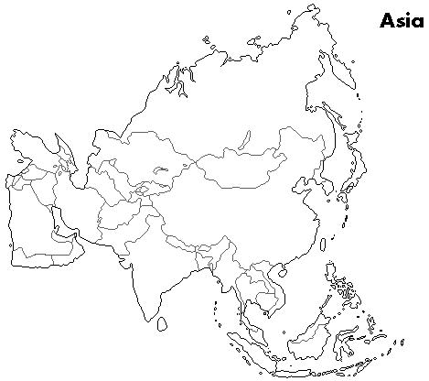











Participating IXPs
14 IXPs in AP region
  BD: BDIX(Dhaka)
  HK: HKIX(Hong Kong)
  JP: BBIX, Dix-ie, JPIX, JPNAP
  KR: KINX(Seoul)
  IN: NIXI (7 locations in India)
  MY: MyIX (KL)
  NP: NP-IX(Katmandu)
  SG: SGIX(Singapore),
  SOX(Singapore)
  VN: VNIX(Hanoi/HCMC)
  AP: Equinix (Hong Kong, Singapore, Tokyo, Sydney)
Dix-ie
VNIX
SOX
* MyIX is a newcomer.

Slide 4
Scope
Topics discussed in APIX meetings
Tools
Standardization
Peering issues
Education
Research and Development
Exchange point architecture
Technologies for internet exchanges
Operational issues
Requests to vendors
Traffic
  trend, analysis, projection, and so on

Slide 5
Organization and its operation
Current (Interim) Chair and Co-chairs
  Katsuyasu Toyama (JPNAP)
  Raphael Ho (Equinix)
  Che-Hoo Cheng (HKIX)
  Gaurab Raj Upadhaya (NP-IX)
  Akira Kato (Dix-ie)

Slide 6
Meeting history
# | Date | Place | Attendees | IXPs in AP
5th | 26 Feb. 2012 Sunday | New Delhi (India) | 27 people (22 from IXPs) | 11 IXPs in AP (2 remotely)
4th | 30 Aug. 2011 Tuesday | Busan (Korea) | 23 people (21 from IXPs) | 12 IXPs in AP
3rd | 20 Feb. 2011 Sunday | Hong Kong (Hong Kong) | 31 people (23 from IXPs) | 10 IXPs in AP
2nd | 23 Aug. 2010 Monday | Gold Coast (Australia) | 11 people (9 from IXPs) | 7 IXPs in AP
1st | 1 Mar. 2010 Monday | Kuala Lumpur (Malaysia) | 15 people (14 from IXPs) | 7 IXPs in AP
Preliminary | 25 Aug. 2009 Tuesday | Beijing (China) | 14 people (8 from IXPs)
Attendees are limited only to IXP people.
Supporters, who contribute to APIX activities, may be invited.

Slide 7
5th Meeting
Participated IXPs
Asia-Pacific
  BD: BDIX
  HK: HKIX
  JP: BBIX,JPIX,
  JPNAP, Dix-ie
  KR: KINX
  IN: NIXI
  MY: MyIX
  NP: NP-IX
  SG: SGIX, SOX
  VN: VNIX
  AP: Equinix
Other regions
Europe
  DE: DE-CIX
  NL: AMS-IX
  SE: Netnod
  UK: LONAP
Latin America
  BR: PTT Metro
IXP associations
  Euro-IX
  LAC-IX
Red names denote participated IXPs, remotely participated IXPs are denoted with underline

Slide 8
Summary of 5th meeting
Administrative session
  APIX bylaws are adopted.
    Organization architecture and membership are defined.
Technical session
  IXP update
  Invited talks
    Update about CISCO Route Server Development
      Rajesh Parikh @ CISCO
    ARP Hijacking Mitigation
      Henk Steenman @ AMS-IX
    Jumbo Frame Deployment at IXPs
      Martin J. Levy @ Hurricane Electric

Slide 9






Organization Architecture
Association (APIX)
“Patron”
Member
(IXP)
Member
(IXP)
Member
(IXP)
Member
(IXP)
representative
Selects committee members
Delegates some tasks
General Meeting
Chair
Secretary
Treasurer
Steering Committee

Slide 10
Outstanding Issues
Bylaws modification
Legal entity
Membership Fee
Collaboration with other IXP associations
  Euro-IX and LAC-IX

Slide 11
Thank you!
Contact:
  apix-admin (at) apix.asia

