Slide 1
Treasurers Report
APNIC 33

Slide 2
Financial Status 2011
Completed audit of annual accounts by Ernst & Young:
  Operating surplus of AUD 2,563,490
  Operating revenue
    AUD 15.4m (budget was AUD 14.4m)
      6.8% above budget
  Operating expenses
    AUD 12.9m (budget was AUD 14.2m)
      9.7% below budget

Slide 3
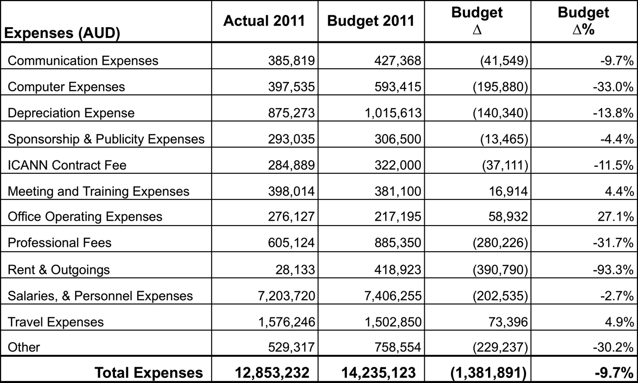
Income Statement - Expenses

Slide 4
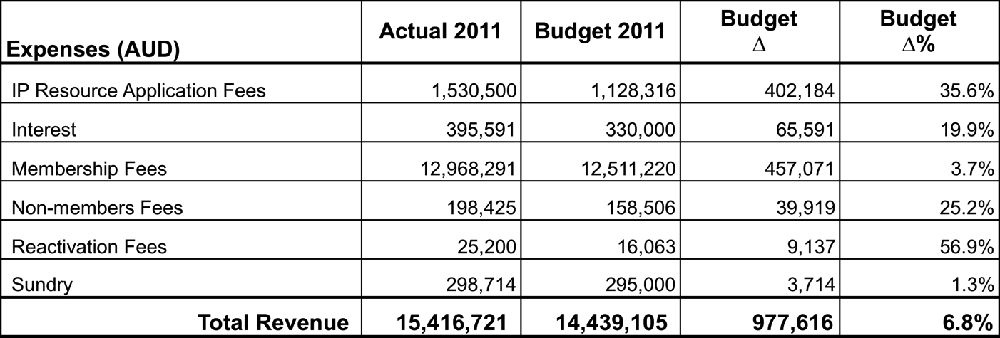
Income Statement - Revenues

Slide 5
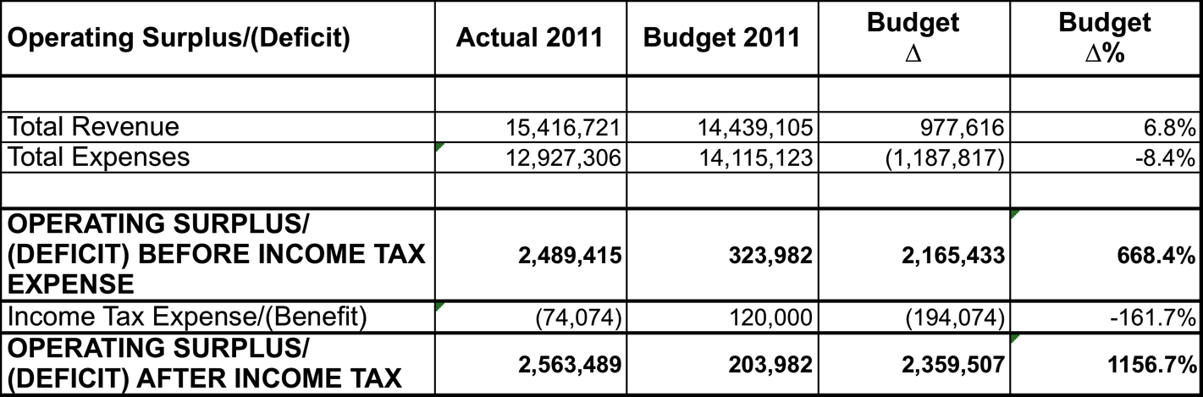
Operating Surplus/(Deficit)

Slide 6
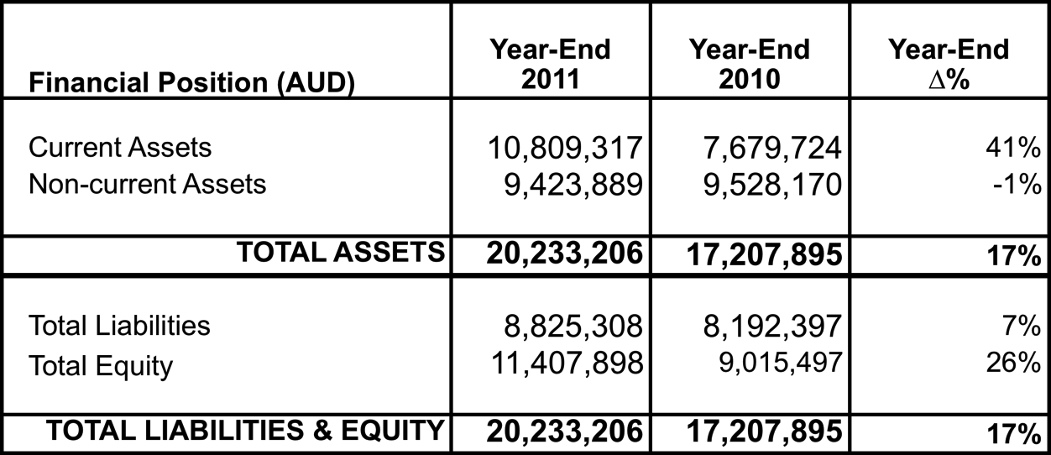
Financial Position as at 31 December 2011

Slide 7
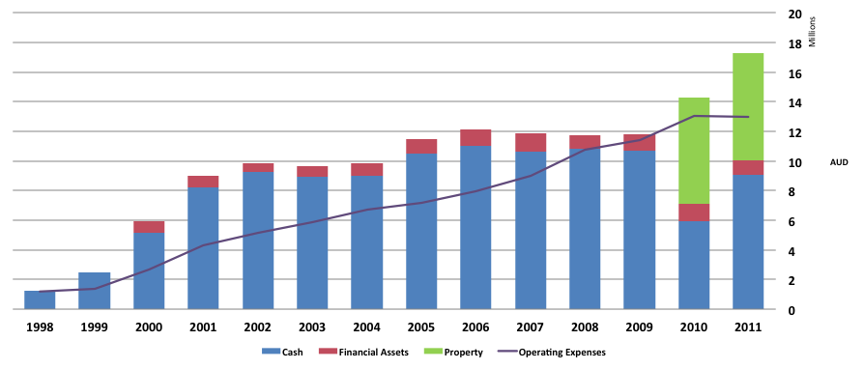
APNIC Reserve Analysis

Slide 8
Questions?

Slide 9
APNIC Budget 2012

Slide 10
Budget Objectives
The APNIC Member and Stakeholder survey was used as the basis to develop the activity and operational plans for the 2012 budget
Focus on financial stability
Ensure high level of financial governance and control in APNIC activities

Slide 11
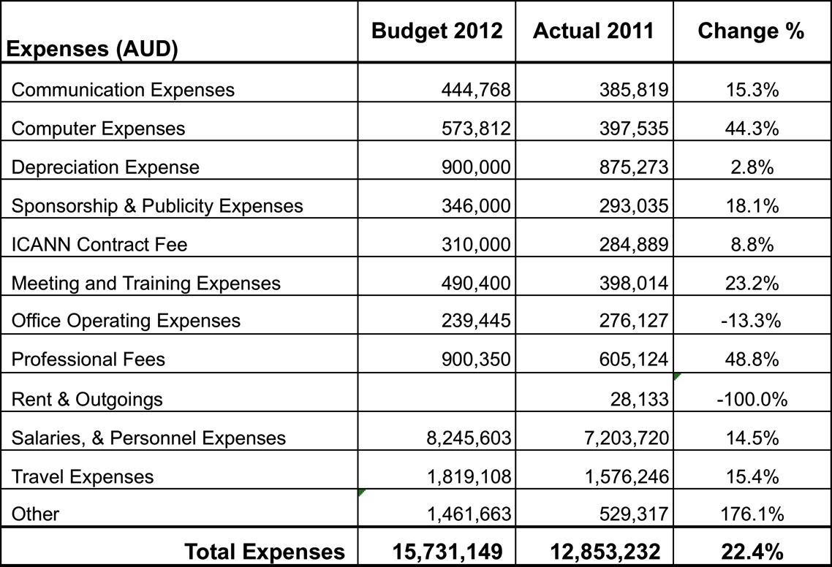
Projected Expenses 2012
Notes:
11

Slide 12
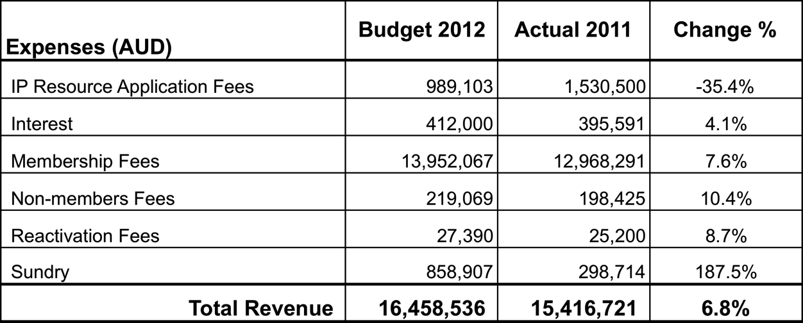
Projected Revenue 2012
Notes:
12

Slide 13
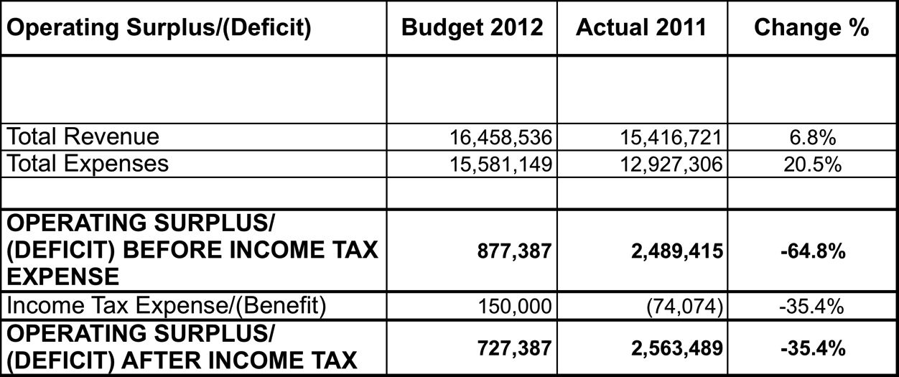
Projected Operating Surplus 2012
Notes:
13

Slide 14
Questions?

