Slide 1
APIPv6TF Gathering
29/02/2012 in conjunction with APRICOT2012/APNIC33 in New Delhi, Inida

Slide 2
Agenda
Greetings from the Chair (5min)
  Report on APStar participation
  Report on continuation of the Secretariat by APNIC and the Chair
Secretariat update (5min)
  Introduction of the new website
Efforts to increase IPv6 deployment (40min)
  How APIPv6TF can support IPv6 deployment in 2012? (20min)
Current APIPv6TF structure (15min)
Closing (5min)

Slide 3
Secretariat update
Website renewal
  Management of the domain name ap-ipv6tf.org was transferred from TWNIC to APNIC
  The site is hosted on a IPv4 and IPv6 dual stack server in the Secretariat
  Big thanks to TWNIC’s continuous support for managing the site for the last 9 years!
Resource to mange the site is limited
  Keep it simple but with useful and up to date information

Slide 4
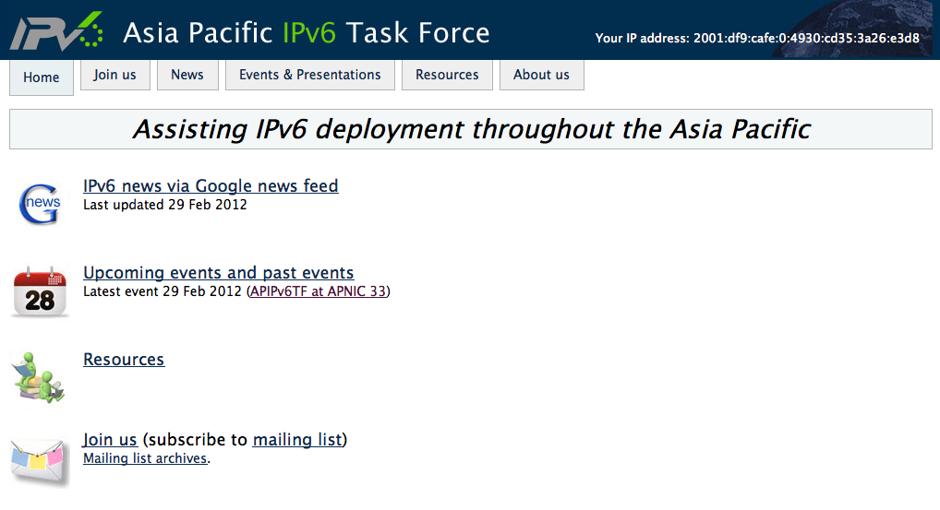

Website on a DS server

Slide 5
Economy update
5 min per presentation x 7 (35min)
Topics
  Current IPv6 deployment status
  IPv6 deployment roadmap and update
  Stance toward World IPv6 Launch in your economy
  Etc.
  How APIPv6TF can support IPv6 deployment in 2012? (25 min)

Slide 6
Current APIPv6TF structure
Definition of APIPv6TF Gathering/Meeting
  Face to face discussion forum
  Anyone can participate
Definition of Mailing List
  Virtual space for continuous discussion
Definition of Member Economies
  Need to define member economies
Defining Chair election process
  Need to define the process and procedures

Slide 7
Thank you!

