Slide 1
Corporate Support
Richard Brown, Business Director

Slide 2
Corporate Support
Infrastructure
Risk Management
Resource Management
Planning
Process Improvement
People and Culture
Notes:
Introduction to the key aspects of corporate support in 2011
Infrastructure – includes Physical Office , Technical Office Support
Risk Management includes – Insurance, Legal & BCP

Slide 3
Infrastructure
New office establishment
  Contract finalization
  Service and maintenance contracts in place
  Decommissioning old premises
Immediate benefits
  On time and within budget
  Secure facility
  Collaborative environment
  Adaptable to APNIC’s future requirements

Slide 4
Infrastructure
Technical Office Support
  Three-site redundancy provides resilience for key Secretariat services
  Improvement in monitoring of services
  Continued 24/7 support for Secretariat technical issues

Slide 5
Risk Management
Insurance
  Risk exposure workshops
  Risk register
  Insurance coverage and gap identification
  Legal
  Legal representation
  Focus on corporate governance
  Knowledge management for legal issues
  Contract management

Slide 6
Risk Management
Business Continuity Planning (BCP)
  Tested during flood crisis – Jan 2011
  Regular scenario testing
  BCP approach to all activities
  Planned collaboration with RIPE NCC

Slide 7
Resource Management
New ERM (Enterprise Resource Management) System
  Reduces complexity and automates manual processes
  Replaces a range of standalone applications
  Real-time, flexible reporting
  Custom workflows, approvals, and audit trails
  Single source of key organizational data

Slide 8
Resource Management
New ERM functionality:
  Financial and management accounting
  Procurement and asset management
  Role-based reporting and dashboards
  Activity/project costing
  Interface with APNIC’s internal systems
  More to come, including:
    Travel and expense management
    HR and Payroll
    CRM

Slide 9
Planning
Full operational planning process in 2011
  Survey report and EC strategic vision
  Internal organizational assessments
  Review of environment
  Analysis of strengths and weaknesses
  Budget constraints
Clear priorities for 2012
  Defined at all levels and incorporated into individual and team KPI’s
    Regular review at strategic ELT meetings

Slide 10
Process Improvement
Implemented best practice for:
  Software development methodologies
    Improved reporting capabilities, increased communication and information sharing
    Greater software quality through test-driven development
    Guided by continuous integration principles
    More frequent opportunities to make minor course adjustments during a project
  Business process modelling
    Modelling and documenting processes
    Identifying bottlenecks and opportunities for improved efficiency

Slide 11
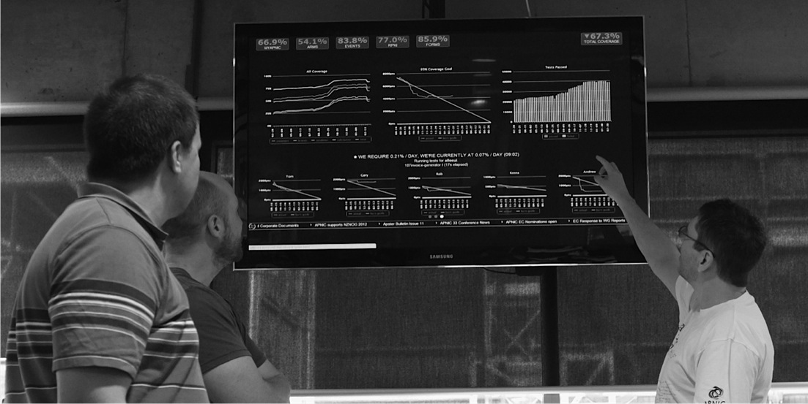
Process Improvement
Status Board
  Visibility of current work/priorities
  Maintaining focus on required outcomes

Slide 12
People and Culture
Diversity
  28 economies
  30 languages
Training and development
  English conversation group
  Lunch ‘n’ Learn program
  Job specific training for technical currency
  Self-education support

Slide 13
People and Culture
RIR staff exchange program
  APNIC publications team member hosted by the RIPE NCC
  APNIC hosted a RIPE NCC communications specialist

Slide 14
People and Culture – WH&S
Preparation for Work Health & Safety Act 2012
  Policy and procedure review
  Staff training and information sessions; online compliance register
Fire warden, CPR, and First aid training

Slide 15
People and Culture
Performance Management
  Change from anniversary-based to bi-annual performance reviews in 2011
  Six-monthly reviews in May/June
  Annual reviews in Nov/Dec
  Ensures moderation of results
  Certainty for budget planning
  Enables alignment of performance to operational planning priorities

Slide 16
Thank You

