Slide 1
LACNIC Update
Arturo L. Servin
LACNIC
1

Slide 2
Membership Update

Slide 3
Staff updates
No updates but we are hiring:
Customer Manager
External Relations Officer
E-mail to: rrhh@lacnic.net

Slide 4
Resources updates
New /8 IPv4
179/8 (update your filters please!!)
IPv4 Address Space (09/Feb/2011)
4.562683105 /8s
Exhaustion date: ~05/15/2014

Slide 5
Resources updates cont…
IPv4 vs IPv6 alloc/assig
IPv4 Addresses alloc/assig

Slide 6
ASNs

Slide 7
Participation in Public Forums
IGF - September, Vilnius, Lithuania.
NANOG 50 / ARIN XXVI – October, Atlanta, Georgia
ITU Plenipot PP-10 – October, Guadalajara, México
LACNOG 2010 – October, Sao Paolo, Brazil
RIPE 61 – November, Rome, Italy
XVII CCPI – CITEL – November, Salta, Argentina
ICANN - Cartagena de Indias, Colombia
NANOG 51 – Miami, Florida

Slide 8
Other important projects
AMPARO
To provide training and to promote the creation of Computer Security Incident Response Teams (CSIRTs)
FRIDA
Regional Fund for Digital Innovation in Latin America and the Caribbean
Raíces (Roots)
Target: To install anycast copies of root servers (DNS) in the region (ended this year)
Public Affairs
8

Slide 9
LACNIC XIV
Held in Sao Paolo, Brazil
Co-organized with LACNOG 2010 and 4th PTT Forum
Almost 300 participants
5 policies presented, 4 reached consensus.
LACNIC IPv4 reserves and IPv4 exhaustion model presented

Slide 10
Policies
LAC-2009-09 Modification: 2.3.3.3. Direct Allocations to Internet Service Providers
LAC-2010-05 Initial allocation and assignment of IPv4 addresses for ISPs
LAC-2010-06 Assignment to End Users with need of interconection
To update the “Multihoming” requirement with a more flexible one like “Interconnection Needs”.
Consensus reached

Slide 11
Policies (cont…)
LAC-2010-03 Inclusion of ASN in the whois when available
Inclusion of ASN of origin (provided that it is available) in the information of WHOIS of all the LACNIC’s received prefixes.
Consensus reached

Slide 12
Policies (cont …)
LAC-2010-04 Global Policy for IPv4 Allocation by the IANA post exhaustion
This is a proposal to create a policy allowing for the allocation of IPv4 address space after the depletion of the IANA IPv4 address pool.
Returned to discussion by Policy Forum chairs. Require more discussion

Slide 13
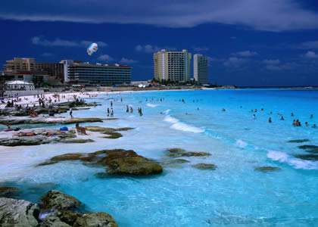
Next Meetings
LACNIC XV
General meeting, Policy Forum,
LACTLD and technical forums
(Security, IPv6, IXs).
Possibly LACNOG 2 as well
Cancun, Mexico. May 15 – 20, 2011.
LACNIC XVI
Policy Forum and co-organized with LACNOG 2 or 3
October 2011
Venue TBC

Slide 14
Thank you !
aservin@lacnic.net

