Slide 1
IANA Update
APNIC 31, Hong Kong
February 2011

Slide 2
Agenda
Addressing
DNSSEC
Root management
Continuity Exercise
Business Excellence

Slide 3
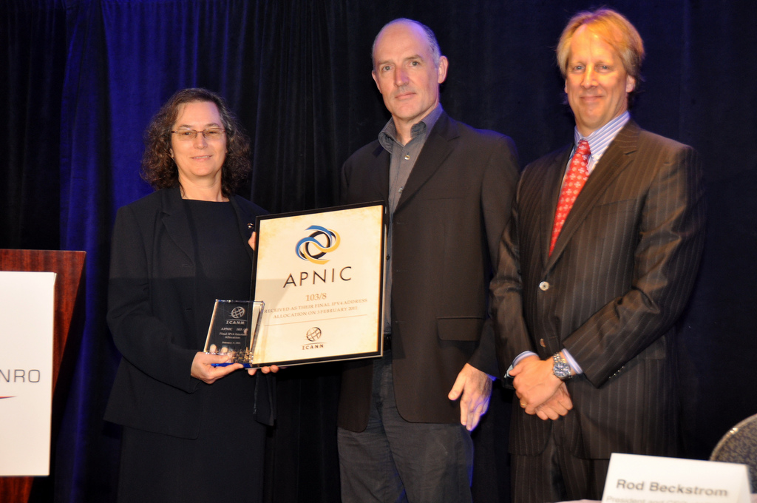
State of the IPv4 pool
The IPv4 pool is now fully allocated – at least at the top level
Photo by Silverstealth

Slide 4
But in IPv6…
We have barely started on the IPv6 address space yet
Source:
Guillaume Leclanche
v6stuff.leclanche.net

Slide 5
DNSSEC key signing ceremony
The 4th KSK ceremony was successfully performed in El Segundo, CA, USA on 7 February
The 5th ceremony is scheduled for May 2011, in Culpeper, VA, USA

Slide 6
Reverse zones & DNSSEC (1)
ICANN and the RIRs have worked together on a system to allow the RIRs to update DS RRSets in IP6.ARPA and IN-ADDR.ARPA
It is being implemented this month

Slide 7
Reverse zones & DNSSEC (2)
The RIRs and ICANN have deployed a new set of nameservers:
[A-F].IN-ADDR-SERVERS.ARPA
[A-F].IP6-SERVERS.ARPA

Slide 8
Reverse zones & DNSSEC (3)
IN-ADDR.ARPA zone edit function is moving from ARIN to ICANN
It is moving off the root DNS servers & will be signed
http://in-addr-transition.icann.org

Slide 9
Reverse zones & DNSSEC (4)
IP6.ARPA moved in December 2010 & has been signed since April 2010

Slide 10
Root Management
2010 saw an all time high for the number of root management requests completed
2010 also saw the first IDN ccTLD delegations and the signing of the DNS root
Both of these contributed to the number of requests

Slide 11
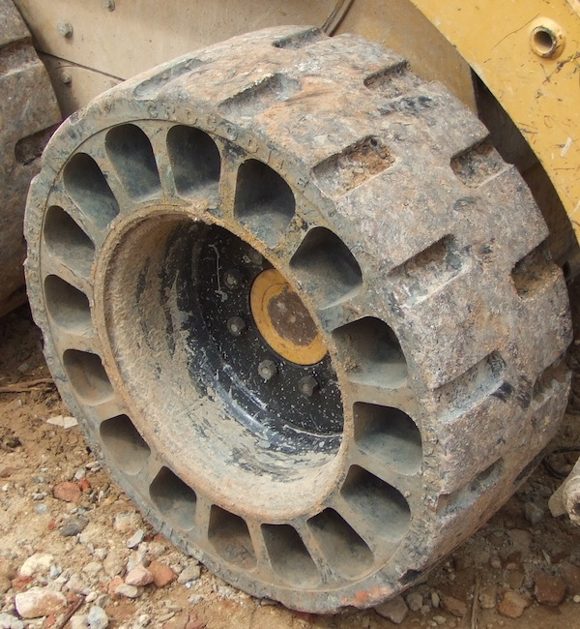
2011 continuity exercise
Ran a table top exercise for L-root single operations
The exercise demonstrated the DNS Ops group preparedness for local or global network issues
Well documented procedures; communication plans; communications; and a strong understanding of how to address anycast disruptions

Slide 12
2011 Business Excellence Self-assessment
The IANA Department began using the EFQM (European Foundation for Quality Management)methodology for continuous improvement in 2009
EFQM is similar to the Deming Prize and Baldrige Award methodologies
The first self-ssessment was carried out in January 2010
Second self-assessment performed in January
Strong progress seen in standardised process documentation
New goals includes better measurements for success

Slide 13
Thank you

