Slide 1
IP in Smart Object Networks
Jeff Apcar, Distinguished Services Engineer, Cisco Systems
With acknowledgement to JP Vasseur Cisco Distinguished Engineer, Co-Chair IETF Roll Working Group, TAB Chair IPSO Alliance
Notes:
1

Slide 2

Agenda
A world of sensors
Smart Objects
Low Power Lossy Networks (LLN)
802.15.4 Low Power PAN
Using IP for Smart Objects
6LoWPAN Working Group
Roll Working Group
Routing over Low Power Lossy Networks (RPL)
Conclusion
2

Slide 3

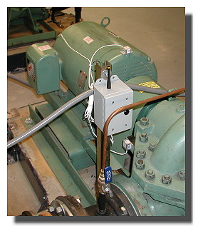
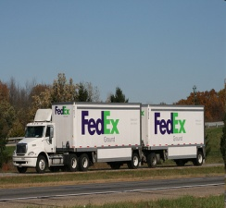


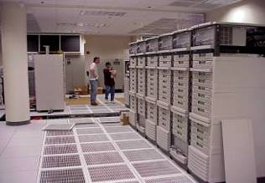

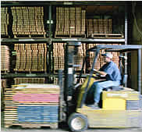


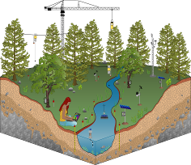
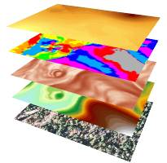


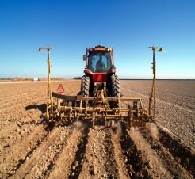


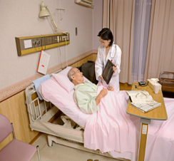
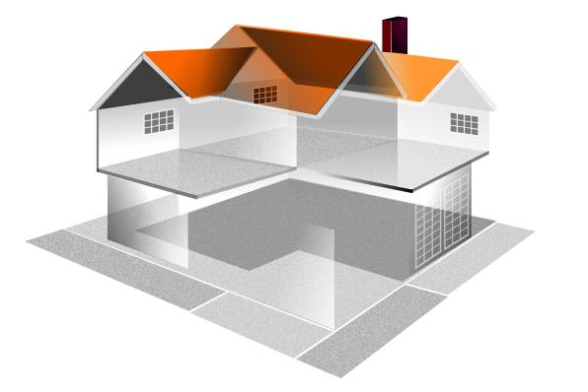




A World of Sensors
Mostly RS485 wired actuators/sensors
Generally proprietary architectures for specific applications
Predictive
Maintenance
High-Confidence
Transport and
Asset Tracking
Energy Saving
Smart Grid
Improve
Productivity
Intelligent
Buildings
Enable New
Knowledge
Enhanced Safety & Security
Improve Food
and H²O
Healthcare
Smart Home
S+CC
Notes:
Sensors are nothing new. They have been around for a long time in many applications. Mostly based on RS485 electrical interface. Upper layer protocols are not part of the RS485 definition.
EIA-485 only specifies electrical characteristics of the driver and the receiver. It does not specify or recommend any communications protocol. EIA-485 enables the configuration of inexpensive local networks and multidrop communications links. It offers high data transmission speeds (35 Mbit/s up to 10 m and 100 kbit/s at 1200 m). Since it uses a differential balanced line over twisted pair (like EIA-422), it can span relatively large distances (up to 4000 feet or just over 1200 meters).
In contrast to EIA-422, which has a single driver circuit which cannot be switched off, EIA-485 drivers need to be put in transmit mode explicitly by asserting a signal to the driver. This allows EIA-485 to implement linear topologies using only two wires. The equipment located along a set of EIA-485 wires are interchangeably called nodes, stations and devices.

Slide 4






A World of Proprietary Protocols
Many legacy networks use closed and proprietary protocols
  Each with different implementations at each layer (Physical, Link, Network)
  Many non-interoperable “solutions” addressing specific problems
  Resulting in different architectures and protocols
Interoperability partially addressed (poorly) by protocol gateways
  Inherently complex to design, deploy and manage
  Results in inefficient and fragmented networks, QOS, convergence
Similar situation to computer networks in the 1980s
  Islands of systems communicating using SNA, IPX, Appletalk, DECnet, VINES
  Interconnected using multiprotocol gateways
Notes:
Because the higher layer protocols were not standardised we have ended up with a myriad of proprietary protocols – all interoperable unless through a gateway.
We are in a situation similar to the multi-protocol routers of the 1980s

Slide 5

Standardise to Build The Internet of Things
Internet of Things
Next iteration of the Internet
  Standardise IP into sensors and other smart objects
  Any object or environmental condition can be monitored
  Expand the current Internet to virtually anything and everything
Internet of Things (IoT)
  Pervasive and ubiquitous network which enables monitoring and control of physical environment by collecting, processing, and analyzing the data generated by Smart-Objects
6loWPAN
Smart Object
Networks
Sensor Networks
Low Power &
Lossy Networks
Notes:
So why not standardise on a protocol that will allow sensors to inter operate
We can create the next iteration of the Internet. A place where anything and everything can communicate.
We call this the Internet of Things (apart form what we can do now with end hosts, phones etc)
This is a Pervasive and Ubiquitous world
Where we can control and monitor any physical attribute imaginable
Collect, process and Analyse data generated by Smart Objects

Slide 6

Smart Objects
Presentation_ID
© 2010 Cisco and/or its affiliates. All rights reserved.
Cisco Confidential
6
Notes:
6
So what is a Smart Object?

Slide 7
What is a Smart Object?
A tiny and low cost computer that may contain:
  A sensor that can measure physical data (e.g., temperature, vibration, pollution)
  An actuator capable of performing a task (e.g., change traffic lights, rotate a mirror)
  A communication device to receive instructions , send data or possibly route information
This device is embedded into objects (to make them smart ☺)
  For example, thermometers, car engines, light switches, gas meters
Smart Objects enable many sophisticated applications and solutions
  Smart+Connected Communities
  Smart Grid and Energy Management
  Home and Building Automation
  Connected Health
Smart Objects can be organised into networks
Notes:
Smart objects are small computers with a sensor or actuator and a
communication device, embedded in objects such as thermometers, car engines,
light switches, and industry machinery. Smart objects enable a wide range of
applications in areas such as home automation, building automation, factory
monitoring, smart cities, structural health management systems, smart grid and
energy management, and transportation. Until recently, smart objects were
realized with limited communication capabilities, such as RFID tags, but the new
generation of devices has bidirectional wireless communication and sensors that
provide real-time data such as temperature, pressure, vibrations, and energy
measurement. Smart objects can be battery-operated, but not always, and
typically have three components: a CPU (8-, 16- or 32-bit micro-controller),
memory (a few tens of kilobytes) and a low-power wireless communication
device (from a few kilobits/s to a few hundreds of kilobits/s). The size is small
and the price is low: a few square mm and few dollars

Slide 8
Characteristics of Smart Objects
These devices are highly constrained in terms of
  Physical size
  CPU power
  Memory (few tens of kilobytes)
  Bandwidth (Maximum of 250 KB/s, lower rates the norm)
Power consumption is critical
  If battery powered then energy efficiency is paramount
  Batteries might have to last for years
May operate in harsh environments
  Challenging physical environment (heat, dust, moisture, interference)
Wireless capabilities based on Low Power & Lossy Network (LLNs) technology
  Predominantly IEEE 802.15.4 (2.4 GHz and 900 MHz)
  Newer RF technologies IEEE 802.15.4g (Smart Utility Network PHY)
Notes:
Smart Objects don’t have much of anything to spare. Everything is resource is precious – they are constrained in size, CPU cycles, memory and wireless bandwidth
Ofcourse the most important aspect is power consumption – if they operate on batteries then you don’t want to be changing a battery every few months they have to last for a very long time.
The wireless technology they use are based on Low Power Losy Networks or LLNs – the most predominant technology in that area is 802.15.4 (from the same family as Bluetooth)
The role of IEEE 802.15 Smart Utility Networks (SUN) Task Group 4g is to create a PHY amendment to 802.15.4 to provide a global standard that facilitates very large scale process control applications such as the utility smart-grid network capable of supporting large, geographically diverse networks with minimal infrastructure, with potentially millions of fixed endpoints.

Slide 9
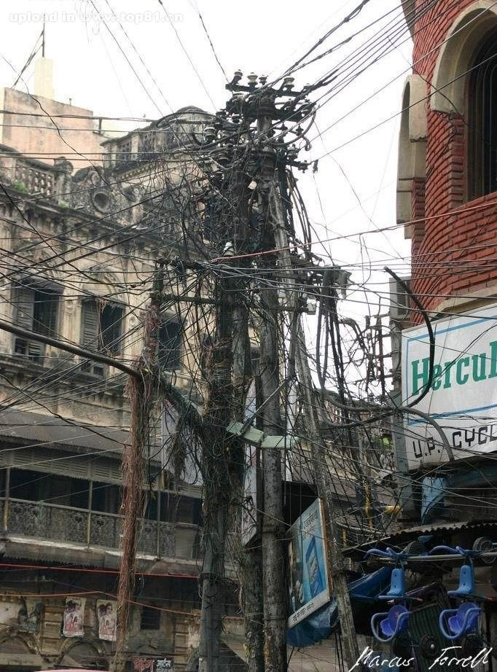
Low Power Lossy Networks
Presentation_ID
© 2010 Cisco and/or its affiliates. All rights reserved.
Cisco Confidential
9
Notes:
9
So let’s take a look at LLNs…

Slide 10
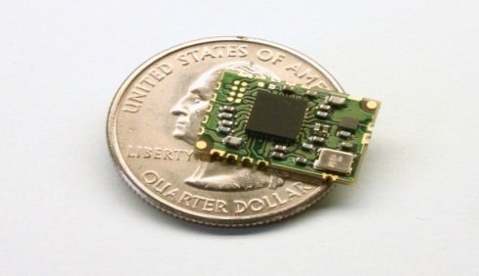
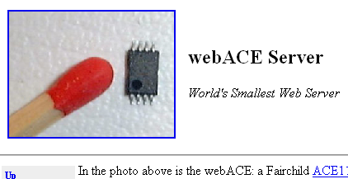
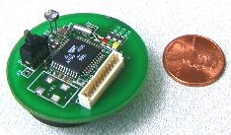
What is a Low Power Lossy Network (LLN)?
LLNs comprise a large number of highly constrained devices (smart objects) interconnected by predominantly wireless links of unpredictable quality
LLNs cover a wide scope of applications
  Industrial Monitoring, Building Automation, Connected Home, Healthcare, Environmental Monitoring, Urban Sensor Networks, Energy Management, Asset Tracking, Refrigeration
Several IETF working groups and Industry Alliance addressing LLNs
  IETF - CoRE, 6Lowpan, ROLL
  Alliances - IP for Smart Objects Alliance (IPSO)
World’s smallest web server
Notes:
The key to an LLNs lots of constrained devices connected by link for unpredictable quality.
There are a few groups in the IETF specifically working on LLNs…
Also we cannopt forget about the IPSO alliance that is driving interoperability

Slide 11
Characteristics of LLNs
LLNs operate with a hard, very small bound on state
In most cases LLNs optimised for saving energy
Traffic patterns can be MP2P, P2P and P2MP flows
Typically LLNs deployed over link layers with restricted frame-sizes
  Minimise the time a packet is in the air hence the small frame size
  The routing protocol for LLNs should be adapted for such links
LLN routing protocols must consider efficiency versus generality
  Many LLN nodes do not have resources to waste
Notes:
So let’s take a look at the characteristics on an LLN. What is it that makes an LLN
As mentioend before the devices are highly constrained, so we need to keep the state I neach device to a minimum – for example we would not want the entire Link State database in every Sensor
It is critical than an LLN uses the minimum amount of energy
There is a various array of traffic patterns - multipoint and point2point
Probably the most important thing to note is LLNs operate over networks with very restricted frame sizes
We can’t have giant packets running over poor quality links
The routing protocol has to be really efficient – we can have it catering for every event/situation possible.

Slide 12
IETF LLN Related Workgroups
Application
CoRE
Constrained Restful Environments
Charter to provide a framework for resource-oriented applications intended to run on constrained IP networks.
General
Internet
6LoWPAN
IPv6 over Low power WPAN
Charter is to develop protocols to support IPv6 running over IEEE 802.15.4 low-power radio networks.
IETF
Ops and Mgmt
Routing
ROLL
Routing over Low Power Lossy Networks
Charter focusses on routing issues for low power lossy networks.
Security
Reuse work done here where possible
Invent where needed
Transport
Notes:
So the IETF have several working groups worlking on the problem of LLNS
Core – these guys are working on a framework on how applications communicate with devices on constrained networks This includes applications to monitor simple
sensors (e.g. temperature sensors, light switches, and power meters), to control actuators (e.g. light switches, heating controllers, and door locks), and to manage devices.
The ones we are going to go into more detail are 6LowPan and ROLL.
I have not mentioned it previously but this world of LLNs will run on IPv6. More of that to come. 6LowPan are tasked with making IPv6 work over 802.15.4
ROLL is the main reason for this presentation – they have developed the RPL protocol that hopefull will be the standard for sensor networks

Slide 13

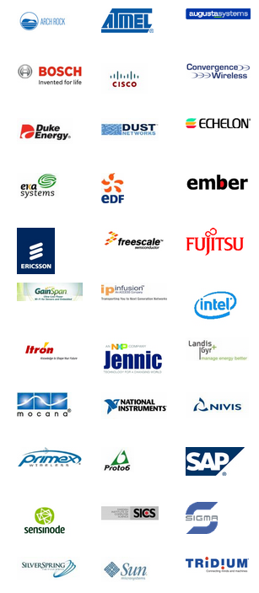
IP for Smart Objects (IPSO) Alliance
IPSO Alliance formed drive standardisation and inter-operability
  Create awareness of available and developing technology
As of 2010 More than 65 members in the alliance
Document use of new IP based smart object technologies
  Generate tutorials, webinars, white papers and highlight use cases
  Provide an information repository for interested parties
Coordinate and combine member marketing efforts
Support and organise interoperability events
  COMPLIANCE program (Based on IPv6 forum)
http://www.ipso-alliance.org
Notes:
The main object of IPSO is to drive awareness and interoperability of Smart Object Networks. They have quite a number of good Webinars on their website that I recommend you take a look at.
A lot more detail on the protocols etc that I am covering today.

Slide 14
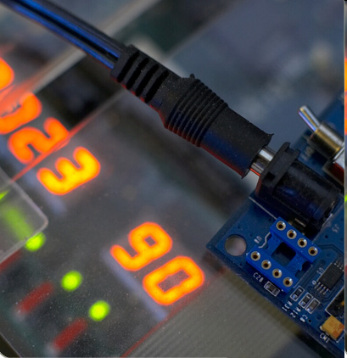
IEEE 802.15.4 PAN
Presentation_ID
© 2010 Cisco and/or its affiliates. All rights reserved.
Cisco Confidential
14
Notes:
14
So let’s take a quick look at 802.15.4 which is the predominant physical layer wireless standard for Smart Objects

Slide 15
IEEE Wireless Standards
802.11 – Wireless Local Area Networks (WiFi)
  802.11a, 802.11b, 80211g, 802.11n
802.15 – Wireless Personal Access Networks (WPAN)
  Task Group 1 – Bluetooth (802.15.1)
  Task Group 2 – Co-existence (802.15.2)
  Task Group 3 – High Rate WPAN (802.15.3)
  Task Group 4 – Low Rate WPAN (802.15.4 or 802.15 TG4)
  Task Group 5 – Mesh Networking (802.15.5)
802.16 – Wireless Metropolitan Area Networks (WiMax)
802.20 – Mobile Broadband Wireless Access (Mobile-Fi) - Defunct
802.22 – Wireless Regional Access Network (WRAN)
  Utilise free space in the allocated TV spectrum
Used in LLNs
Notes:
802.11 and 802.11x refers to a family of specifications developed by the IEEE for wireless LAN technology. 802.11 specifies an over-the-air interface between a wireless client and a base station or between two wireless clients. Although the terms 802.11 and Wi-Fi are often used interchangeably, the Wi-Fi Alliance uses the term "Wi-Fi" to define a slightly different set of overlapping standards. In some cases, market demand has led the Wi-Fi Alliance to begin certifying products before amendments to the 802.11 standard are complete
The 802.15 WPAN™ effort focuses on the development of consensus standards for Personal Area Networks or short distance wireless networks. These WPANs address wireless networking of portable and mobile computing devices such as PCs, Personal Digital Assistants (PDAs), peripherals, cell phones, pagers, and consumer electronics; allowing these devices to communicate and interoperate with one another. The goal is to publish standards, recommended practices, or guides that have broad market applicability and deal effectively with the issues of coexistence and interoperability with other wired and wireless networking solution
The IEEE 802.16 Working Group on Broadband Wireless Access Standards develops standards and recommended practices to support the development and deployment of broadband Wireless Metropolitan Area Networks.
IEEE 802.20 or Mobile Broadband Wireless Access (MBWA) Working Group, the establishment of which was approved by IEEE Standards Board on December 11, 2002, aims to prepare a formal specification for a packet-based air interface designed for IP-based services. It is hoped that such an interface will allow the creation of low-cost, always-on, and truly mobile broadband wireless networks, nicknamed as Mobile-Fi.
EEE 802.22 is a new working group of IEEE 802 LAN/MAN standards committee which aims at constructing Wireless Regional Area Network (WRAN) utilizing white spaces (channels that are not already used) in the allocated TV frequency spectrum. The use of the spectrum will be used in an opportunistic way in order not interfere with any TV channel that is transmitting.

Slide 16

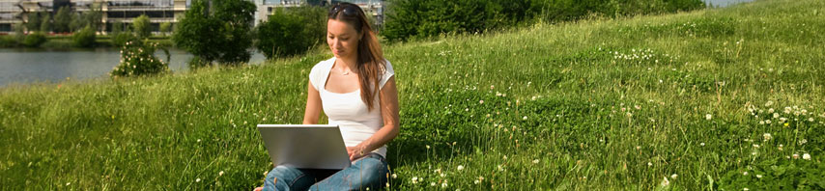
“The IEEE 802.15 TG4 was chartered to investigate a low data rate solution with multi-month to multi-year battery life and very low complexity. It is operating in an unlicensed, international frequency band. Potential applications are sensors, interactive toys, smart badges, remote controls, and home automation.”
http://www.ieee802.org/15/pub/TG4.html
IEEE 802.15 WPAN™ Task Group 4 (TG4) Charter
Notes:
16
16
16
The charter of 802.15.4 was to build a technology that was simple, would not suck up much power and was easily implemented in all manner of objects
802.15.4 is part of the 802.15 wireless personal-area network effort at the IEEE. It is a simple (128 byte) packet-based radio protocol aimed at very low-cost, battery-operated widgets and sensors (whose batteries last years, not hours) that can intercommunicate and send low-bandwidth data to a centralized device.

Slide 17
IEEE 802.15.4 Features
Designed for low bandwidth, low transmit power, small frame size
  More limited than other WPAN technologies such as Bluetooth
  Low bit rate and packet size to ensure reasonably low packet error rates
  Packet size (127 bytes) reflects minimal buffering capabilities in Smart Objects
  Low power allows batteries to last for years
Data rates of 250 kbps, 40 kbps, and 20 kbps
Two addressing modes; 16-bit short (local allocation) and 64-bit IEEE (global allocation)
Communicates over multiple hops
  Range is in tens of metres, reduces transmission power
3 possible unlicensed frequency bands
  (Europe 868-868.8 MHz – 3 chans , USA 902-928 MHz – 30 chans, World 2400-2483.5 MHz – 16 chans)
Notes:
Low bandwidth, low transmit power = small frame size = small buffering capabilities inside the smart objects
It does not have all the bells and whistles of its cousin bluetooth that can detect devices types headsets etc…

Slide 18
IEEE 802.15.4 Node Types
R
F
R
P
R
F
Full Function Device (FFD)
  Can operate as a PAN co-ordinator (allocates local addresses, gateway to other PANs)
  Can communicate with any other device (FFD or RFD)
  Ability to relay messages (PAN co-ordinator)
Reduced Function Device (RFD)
  Very simple device, modest resource requirements
  Can only communicate with FFD
  Intended for extremely simple applications
Notes:
There are two types of devices in an 802.15.4 network
The first one is the full-function device (FFD). It can serve as the coordinator of a personal area network just as it may function as a common node. It implements a general model of communication which allows it to talk to any other device: it may also relay messages, in which case it is dubbed a coordinator (PAN coordinator when it is in charge of the whole network).
Reduced-function devices (RFD) are meant to be extremely simple devices with very modest resource and communication requirements; due to this, they can only communicate with FFD's and can never act as coordinators.
Networks can be built as either point-to-point or star networks. However, every network needs at least an FFD to work as the coordinator of the network. Networks are thus formed by groups of devices separated by suitable distances. Each device has a unique 64-bit identifier, and if some conditions are met short 16-bit identifiers can be used within a restricted environment. Namely, within each PAN domain, communications will probably use short identifiers.

Slide 19
IEEE 802.15.4 Topologies
Operates at Layer 2
Star Topology
Mesh Topology
Cluster Tree
R
F
R
R
R
F
R
F
P
R
F
F
P
F
R
P
R
F
F
F
F
F
All devices communicate to PAN co-ordinator which uses mains power
Other devices can be battery/scavenger
R
R
R
R
Devices can communicate directly if within range
Higher layer protocols like RPL may create their own topology that donot follow 802.15.4 topologies
Single PAN co-ordinator exists for all topologies
Notes:
In the star topology, the communication is established between devices and a single central controller, called the PAN coordinator. The PAN coordinator may be mains powered while the devices will most likely be battery powered. Applications that benefit from this topology include home automation, personal computer (PC) peripherals, toys and games. After an FFD is activated for the first time, it may establish its own network and become the PAN coordinator. Each start network chooses a PAN identifier, which is not currently used by any other network within the radio sphere of influence. This allows each star network to operate independently.
In peer-to-peer topology, there is also one PAN coordinator. In contrast to star topology, any device can communicate with any other device as long as they are in range of one another. A peer-to-peer network can be ad hoc, self-organizing and self-healing. Applications such as industrial control and monitoring, wireless sensor networks, asset and inventory tracking would benefit from such a topology. It also allows multiple hops to route messages from any device to any other device in the network. It can provide reliability by multipath routing.
Cluster-tree network is a special case of a peer-to-peer network in which most devices are FFDs and an RFD may connect to a cluster-tree network as a leave node at the end of a branch. Any of the FFD can act as a coordinator and provide synchronization services to other devices and coordinators. Only one of these coordinators however is the PAN coordinator. The PAN coordinator forms the first cluster by establishing itself as the cluster head (CLH) with a cluster identifier (CID) of zero, choosing an unused PAN identifier, and broadcasting beacon frames to neighboring devices. A candidate device receiving a beacon frame may request to join the network at the CLH. If the PAN coordinator permits the device to join, it will add this new device as a child device in its neighbor list. The newly joined device will add the CLH as its parent in its neighbor list and begin transmitting periodic beacons such that other candidate devices may then join the network at that device. Once application or network requirements are met, the PAN coordinator may instruct a device to become the CLH of a new cluster adjacent to the first one. The advantage of this clustered structure is the increased coverage area at the cost of increased message latency.

Slide 20
802.15.4 uses CSMA-CA
Carrier Sense Multiple Access with Collision Avoidance
Wireless networks cannot detect collisions
  Fundamental difference from wired networks
Wired – CSMA/CD – Collision Detection
Wireless – CSMA/CA – Collision Avoidance
  RX/TX antennas immediately next to each other
  Hence RX can only see its own TX when transmitting
Notes:
The most important differences between the wireless LAN and the MAC protocol of most wired networking applications is the impossibility to detect collisions. With the receiving and sending antennas immediately next to each other, a station is unable to see any signal but its own. As a result, the complete packet will be sent before the incorrect checksum reveals that a collision has happened. It is therefore of utmost importance that the number of collisions be limited to the absolute minimum.

Slide 21

Using IP for Smart Objects
Presentation_ID
© 2010 Cisco and/or its affiliates. All rights reserved.
Cisco Confidential
21
Notes:
21
This section is probably a little defunct. Originally when the idea of having a common standard was proposed there was a lot of push back. Particularly from those with proprietary protocols. It took a bit of convincing that IP should be standardised upon for sensor/smart objects.

Slide 22
IP in Smart Object Networks
Today’s computer networks are almost exclusively IP based
  Provides end-to-end reliable connectivity
  Brings scalability, flexibility and reliability
  Supports wide a range of devices, transports and applications
    Email, WWW, VOIP, Video, Collaboration
Smart Object Networks standardising on IP
  General consensus is that IP based Smart Objects networks are the future
  Move away from proprietary and closed protocols
  Solid standardisation base allows future innovation
  Allows quick adoption of emerging applictions
  Allows the creation of the “Internet of Things”
Notes:
The bottom line is 99% of every network device uses IP
It is the end-to–end protocol
Therefore it would make sense if the Smart Object networks of the future are also based on IP to provide a true end to end view of things

Slide 23
IP is both an Architecture & Protocol
It can meet all the requirements to support a Smart Object Network
Based on open standards
  IETF RFCs
Flexibility in many dimensions
  Support a wide range of media - Serial, SDH, Ethernet, DWDM, FR, ATM
  Support a wide range of devices - From phones to routers
Always favor global than local optimum
  IP is capable of supporting many different applications; voice, video, data, mobile
Secure
Plug & Play
Scalable
  The Internet comprises billions of connected devices
Notes:
23
23

Slide 24
IPv4 or IPv6
Smart Object Internet
TENS of Billions
Mobile Internet
The current Internet comprises several billion devices
  Add to this growing 3G, 4G mobile devices
  There is no scope for IPv4 to support Smart Object Networks
Smart Objects will add tens of billions of additional devices
IPv6 is the only viable way forward
  Solution to address exhaustion
  Stateless Auto-configuration thanks to Neighbour Discovery Protocol
Some issues with IPv6 address size
  Smart Object Networks use low power wireless with small frame size
  Solution to use stateless and stateful header compression (6LoWPAN)
Fixed
Internet
Billions/Billions
Notes:
So if you are going to use IP for Smart Object networks the next obvious question is should it be IPv4 or IPv6.
It is somewhat of a no brainer to choose IPv6 as we are going to have billions of smart objects compared to where we are today
However we do have some issue with using IPv6 headers over 802.15.4 which we will discuss later

Slide 25
Conservative Connected Devices Projection
Based on what we
know is true today
(Conservative)
World Population
6.3 Billion
6.8 Billion
7.2 Billion
7.6 Billion
Connected Devices
500 Million
12.5 Billion
25 Billion
50 Billion
Connected Devices Per Person
More connected
devices than people
0.08
1.84
3.47
6.58
2003
2008
2010
2015
2020
Source: Cisco IBSG, 2010
Notes:
In 2003, there were approximately 6.3 billion people living on the planet and 500 million devices connected to the Internet. (Sources: U.S. Census Bureau, 2010; Forrester Research, 2003). By dividing the number of connected devices by the world population, we find that there was less than one (0.08) devices for every person.
At this time, the Internet of Things (the point when more things are connected to the Internet than people) didn’t yet exist because the number of connected “things” was relatively small given that ubiquitous devices such as smartphones including the Apple iPhone were just being introduced. Steve Jobs, Apple’s CEO, in fact, unveiled the iPhone to the public on January 9, 2007 at Macworld 2007. (Source: Wikipedia, 2010).
Between 2007 and today, the number of connected devices ballooned due to advances in smartphones, tablet PCs, and so on.
This explosive growth brought the number of devices connected to the Internet to 12.5 billion in 2010, while the number of people living on earth increased to 6.8 billion. (Sources: Cisco IBSG, 2010; U.S. Census Bureau, 2010).
Cisco IBSG believes the Internet of Things was born between 2008 and 2009.
Today, the Internet of Things is well underway, as initiatives such as planetary skin, the smart grid, tablet PCs, and intelligent vehicles take hold and flourish.
Looking to the future, Cisco IBSG predicts there will be 25 billion devices connected to the Internet by 2015 and 50 billion by 2020. This growth will come largely from future initiatives such as sensor networks and connected buildings.
It is important to understand that Cisco IBSG’s estimates for connected devices do not take into account any unforeseen advances or innovations in Internet or device technology. The numbers presented here are based solely on applying what we know to be true today.
In addition, the number of connected devices per person may seem low. This is because we are basing our calculation on the entire world population, many of whom are not connected to the Internet yet. By reducing the population sample to the number of people actually connected to the Internet, the number of connected devices per person goes up dramatically. For example, we know that approximately 2 billion people use the Internet today. (Source: World Internet Stats, June 30, 2010). Using this figure, the number of connected devices per person is 6.25 in 2010 instead of 1.84.
Note
Calculations are based on number of connected IP devices.
Source Detail
Forrester Research
(From Inforworld story dated March 10, 2003, titled, “Forrester CEO: Web services next IT storm”)
http://www.infoworld.com/t/platforms/forrester-ceo-web-services-next-it-storm-873
Today about 500 million devices are connected, by the end of the decade there will be billions of connected devices, including cars, phones and many other electronic devices. –George Colony, Forrester Research founder and chief executive officer
Internet World Stats
Internet Usage Statistics, The Internet Big Picture, World Internet Users and Population Stats, June 30, 2010
http://www.internetworldstats.com/stats.htm
U.S. Census Bureau
U.S. Census Bureau, 2010, “Total Midyear Population for the World: 1950-2050,”
(Data updated 6-28-2010)
http://www.census.gov/ipc/www/idb/worldpop.php
Wikipedia
http://en.wikipedia.org/wiki/IPhone
Jobs unveiled the iPhone to the public on January 9, 2007 at Macworld 2007. Apple was required to file for operating permits with the FCC, but since such filings are made available to the public, the announcement came months before the iPhone had received approval. The iPhone went on sale in the United States on June 29, 2007, at 6:00 pm local time, while hundreds of customers lined up outside the stores nationwide. The original iPhone was made available in the UK, France, and Germany in November 2007, and Ireland and Austria in the spring of 2008.
Methodology
Cisco IBSG determined the number of connected devices per year by applying the theory of Moore’s Law (or the doubling of processing power every 5.32 years) to the estimated number of connected devices in 2003 according to Forrester Research. The number of connected devices was then divided by the world population as determined by the U.S. Census Bureau to come up with the number of connected devices per person.
###

Slide 26

Contiki + uIPv6 Code for Smart Objects
Contiki is a memory efficient O/S for smart objects
  Open source operating system for the Internet of Things
uIPv6 is world’s small certified stack for objects such as actuators and sensors
  uIPv6 does not require an O/S (such as Contiki)
  Able to run over any link layer (for example, 802.15.4)
All IPv6 features (except MLD) are implemented from RFC4294
Obtained IPv6 ready phase 1 logo
Open source release http://www.sics.se/contiki
Memory requirements for IPv6/6LoWPAN/802.15.4
  35K ROM 3K RAM (minimal O/Sfeatures)
  40KB ROM 10KB RAM (full O/S features)
Minimal
Memory Requirements
ROM 11KB
uIPv6
RAM 1.8KB
ROM 24KB
Contiki OS
RAM 1.2KB

Slide 27

6LoWPAN Working Group
Presentation_ID
© 2010 Cisco and/or its affiliates. All rights reserved.
Cisco Confidential
27
Notes:
27
so now we have IPv6 protocol and we have the 802.15.4 physical layer. How do we bring them together – that’s where the 6LoWPAN Working Group comes in

Slide 28
What is 6LoWPAN ?
IPv6
and
Upper Layers
6LowPAN
IPv6 over Low power Wireless Personal Area Networks
  An adaptation layer for IPv6 over IEEE 802.15.4 links
Why do we need an adaption layer?
  IEEE 802.15.4 MTU is only 127 bytes, IPv6 minimum MTU is 1280 bytes
  IPv6 does not do fragmentation, left to end nodes or lower layers
Performs 3 functions each with its own 6LoWPAN header
  IPv6 Header compression
  IPv6 packet fragmentation and re-assembly
  Layer 2 forwarding (also referred to as mesh under)
RFC4919 defines the Problem Statement
RFC4944 defines Transmission of IPv6 Packets over IEEE 802.15.4
  Improved header compression being worked on may deprecate RFC4944
802.15.4 MAC
802.15.4 Physical
go
smart object networks
go
smart object networks
better
better
with
with
IPv6 & IEEE 802.15.4
Notes:
28
So why do we need 6LowPAN
Simple, because IPv6 minimum MTU size is 1280 bytes
802.15.4 can only carry 127 bytes
And… IPv6 expects fragmentation to be done by the end nodes
So the 6LowPAN adaption layer does this fragmentation if necessary and also compresses the IPv6 headers into something more manageable
It can also provide layer 2 forwarding but this reserved for future use

Slide 29
Basic IPv6 Header
1 Nibble
1 Byte
5 Bytes
4 Bytes
2 Bytes
2 Bytes
Version
Traffic Class
Flow Label
Payload Length
Next Header
Hop Limit
Source Address
16 Bytes
40
Bytes
Destination Address
16 Bytes
Minimum size is 40 bytes (double that of IPv4)
Can be extended by additional headers
Fragmentation must be performed by end nodes
Notes:
Ipv6 header is much simpler
Ipv6 base header is fixed 40bytes Ipv4 may vary based on Ip options
Streamlined
Fragmentation fields moved out of base header
IP options moved out of base header
Header Checksum eliminated
Header Length field eliminated
Length field excludes IPv6 header
Alignment changed from 32 to 64 bits
Revised
Time to Live → Hop Limit
Protocol → Next Header
Precedence and TOS → Traffic Class
Addresses increased 32 bits → 128 bits
Extended
Flow Label field added

Slide 30
Typical 6LoWPAN Header Stacks
6LoWPAN headers included only when needed
  IPv6 compression header
  Fragmentation header (eliminated if single datagram can fit entire IPv6 payload)
  Mesh or Layer 2 forwarding header (currently not used/implemented)
127 bytes
Max MTU for 802.15.4
102 bytes
Less max 25 bytes for frame overhead
Worst case leaves only 81 bytes
for headers and payload
81 bytes
Less max 21 bytes link layer security
IPv6 Fragmentation | Multiple L2 Hops
No | No
Yes | No
Yes | Yes (Future)
No | Yes (Future)
802.15.4 Header
IPv6 Header
Compression
IPv6 Payload
802.15.4 Header
Fragment Header
IPv6 Header
Compression
IPv6 Payload
802.15.4 Header
Mesh Header
Fragment Header
IPv6 Header
Compression
IPv6 Payload
802.15.4 Header
Mesh Header
IPv6 Header
Compression
IPv6 Payload
Notes:
So once you start loading up the 802.15.4 frame with its 25 byte header and most like the 21 byte security link layer (you really want to keep things private between sensors)
You end up with 81 bytes of usable payload that you need to cram the IPv6 packet into
So the 802.15.4 packet can comprise different headers depending on whether you need to compress the header (always), fragment the packet (sometimes) or forward it using later 2 (never at this point)
The IPv6 header can be compressed down to 2 bytes minimum as much of the information can be derived from the Layer 2 header

Slide 31

ROLL Working Group
Presentation_ID
© 2010 Cisco and/or its affiliates. All rights reserved.
Cisco Confidential
31
Notes:
31

Slide 32
What is ROLL?
Routing Over Low power and Lossy networks (2008)
  http://www.ietf.org/html.charters/roll-charter.html
  Co-chairs: JP Vasseur (Cisco), David Culler (Arch Rock)
Mission: To define routing solutions for LLNs
Application specific LLN routing requirements developed
  Industrial (RFC5673)
  Urban (RFC5548),
  Home Automation (RFC5826)
  Building Automation (RFC5867)
Specifying the routing protocol for smart object networks
  Routing Protocol for LLNs (RPL) adopted as WG document
Notes:
32
The original intent of the working group was not to produce a brand new routing protocol but to look at routing requirements for LLNs
Over the past 20 years or so plenty or protocols have been developed so the task was to see if we could fit the usual routing protocols around LLN requirements
For about a year after ROLL was started they produced four requirements RFCs for various LLN environments – Industrial, Urban, Connected Homes, Buildings
Then they looked at existing protocols to see if they could meet these various requirements
It became obvious that existing protocols could not meet the requirements so ROLL was rechartered to come up with a protocol that would meet the various LLN requirements
ROLL itself was made up of many participants a few who had done little work with IETF in the past.

Slide 33
Where Should Routing Take Place ?
Historically, a number of interesting research initiatives on WSN
  Work on Wireless Sensors Network focussed on algorithms … not architecture
Most work assumed the use of MAC addresses
  Layer 2 “routing” (mesh-under)
Support of multiple PHY/MAC is a MUST
  IEEE 802.15.4, Low Power Wifi, Power Line Communications (PLC)
Use IP to route
  Supports multiple PHY/MAC
  Moves from mesh-under (L2) to router-over(L3)
Notes:
So ROLL as tasked with look at routing – shold we have mesh under (later 2) or route-over (layer 3)
A lot of the work that had been carried out before relied heavily on the use of MAC addressing as part of the protocol
This poses problems in that the protocol then becomes intrinsically linked with the underlying physical layer
To support multiple physical transports we need to follow the IP model that runs over any physical media.

Slide 34
Characteristics for Smart Object Routing
Current Internet | Smart Object Networks
Nodes are routers | Nodes are sensor/actuators and routers
IGP with typically few hundreds of 100 nodes | An order of magnitude larger in nodes
Links and Nodes are stable | Links are highly unstable Nodes fail more frequently
Node and link bandwidth constraints are generally non-issues | Nodes & links are high constrained
Routing is not application aware | Application-aware routing, in-Band processing is a MUST
Notes:
So let us compare the Internet as we know with a Smart Object Internet or Internet of Things

Slide 35
Technical Challenges
Energy consumption is a major issue (battery powered sensors/actuators)
Limited processing power
Very dynamic topologies
  Link failure (LP RF)
  Node failures (triggered or non triggered)
  Node mobility (in some environments),
Data processing usually required on the node itself
Sometimes deployed in harsh environments (e.g. Industrial)
Potentially deployed at very large scale
Must be self-managed (auto-discovery, self-organizing networks)
Notes:
Looking at these challenges you need to have a fairly sophisticated protocol to deal with so many constraints and caveats.
The bottom line is you need to quickly find the shortest path in a network that could comprise 100,000s or even millions of nodes.

Slide 36
Current Routing Protocols
The current IGPs (OSPF, ISIS) rely upon static link metrics
  Used to create best/shortest path to destination
  No account taken of node/router status (high CPU, hardware failures)
Not suitable for the dynamic nature of an LLN with many variables
  Wireless Signal Strength and Quality
  Node resources such as residual energy
  Link throughput and reliability
IGP needs the ability to consider different metric/constraint categories
  Node vs Links
  Qualitative vs Quantitative
  Dynamic vs Static
Notes:
Put simply the current routing protocols cannot meet the requirements
This is because they rely on static link metrics to compute the shortest path
An LLN protocol needs to take into account link and node metrics, including things like the health of the node how busy it is, how much energy it has left, the reliability of a particular link
Quantitative – How much battery is left, what is the load on this link?

Slide 37



Routing over low Power Lossy networks (RPL)
Presentation_ID
© 2010 Cisco and/or its affiliates. All rights reserved.
Cisco Confidential
37
Notes:
37
Which brings us to the birth of a new routing protocol! RPL pronounced “Ripple”

Slide 38

RPL - Routing Protocol for LLNs
RPL is pronounced
“Ripple”
RPL is an extensible proactive IPv6 distance vector protocol
  Builds a Destination Oriented Directed Acyclic Graph (DODAG)
  RPL supports shortest-path constraint based routing applied to both links and nodes
  Supports MP2P, P2MP and P2P between devices (leaves) and a root (border router)
RPL specifically designed for “Lossy” networks
  Should not be categorised as a WSN routing protocol
  Agnostic to underlying link layer technologies (802.15.4, PLC, Low Power Wireless)
RPL supports different LLN application requirements
  RFC 5548 (Urban) RFC 5673 (Industrial) RFC 5826 (Home) RFC 5867 (Building)
http://datatracker.ietf.org/doc/draft-ietf-roll-rpl/
  Currently on last call implementation 18 (Feb 2011)
Notes:
RPL builds a routing topology in the form of a DAG – a Directed Acyclic Graph (tree vs DAGs)
It is a distance vector protocol that is proactive – it can build alternate paths during topology setup – rather than reactive where we rely on control plane messages after the failure to figure out the alternate path
DV was chosen because the size of a link state DB would be way too large
Historically, a number of interesting research initiatives on routing in WSN,
Main focus on algorithms … a bit less on architecture
Most work assuming the use of MAC addresses – L2 “routing” (mesh-under)
Support of multiple PHY/MAC is a MUST: IEEE 802.15.4, LP Wifi, PLC (number of flavors), …
Now … if what you want is a layered architecture supporting multiple PHY/MAC, there aren’t that many options …
IP !
RPL has been designed for lossy links including PLC such as P1901.2, which are of the utmost important for example for AMI in Europe. Since
these links do exhibit similar properties in terms of instability, BER, ... RPL is well suited for these networks too. I had to fight a bit when we first determine
ROLL's charter to make sure that non RF links such as PLC were part of the charter (strictly speaking we are independent of the L3 of course but this was to insist on
that decoupling and point out that RPL was a routing protocol for LLN).

Slide 39
What is a Directed Acyclic Graph?
In the context of routing, a DAG is formed by a collection of vertices (nodes) and edges (links), each edge connecting one node to another (directed) in such a way that it is not possible to start at Node X and follow a directed path that cycles back to Node X (acyclic).
A Destination Oriented DAG is a DAG that comprises a single root node.
Notes:
39
39
39
Now DODAGs form the routing topology in RPL.
The difference between a tree and a DODAG is you can choose more parents on the path to the root

Slide 40
RPL Terminology
RPL Instance
Consists of one or more DODAGs sharing SAME service type (Objective Function)
Identified by RPL INSTANCE ID
Direction Oriented DAG (DODAG)
Comprises DAG with a single root
Node
(OF configured)
DODAG
Rank = n
DODAG
Rank > n
UP (DAO Messages)
DOWN (DIO Messages)
4
4
Siblings
Rank
Sub-DODAG
Towards DODAG Root
3
3
4
3
3
Towards DODAG leafs
Rank decreases
Rank increases
DODAG parent
to adjacent “4”s
2
2
2
1
1
1
1
Rank < n
Rank = n
0
Non-LLN Network
(IPv6 Backbone)
0
DODAG Root
(Typically an LBR - LLN Border Router)
DODAG Root
Identified by DODAG ID

Slide 41
RPL Instances
RPL can form multiple instances
  Each instance honours a particular routing objective/constraint
  Instance consists one or more DODAGs derived from the same objective function
  Nodes select a parent (towards root) based on metric, OF and loop avoidance
Allows upwards and downwards routing (from DODAG root)
Trickle timers used to suppress redundant messages
  Saves on energy and bandwidth (Like OSPF exponential backoff)
Under-react is the rule
  Local repair preferred versus global repair to cope with transient failures
Notes:
Under react is the rule. This is contrary to most protocols that want to react very quickly and try and find an alternate path very quickly
In contrast with other protocols – really want to react with failure of a node IP-FRR, MPLS-TE
RPL needs to cope with transient failure – from the perspective only do something of you really need to…
For example, what is the point of repairing the DAG is there is not data to send?
We use trick timers to control the amount of chatter or control information that is really necessary. We only send packets when necessary and stop sending them when the DAG is stable. Other nodes also see those control packets so if it matches what they were going to send they keep quiet
You want to try and do a local repair of the DAG is possible within the node. A global repair would require a rebuilding of the entire DAG including a new root

Slide 42
RPL DODAGs
RPL enables nodes to discover each other and form DODAGs
  Uses special ICMPv6 control messages
Each root uses a unique {DODAG ID} to identify itself within an RPL Instance
Routing performed over the DODAG using distance vector techniques
Every hop to the root MUST have an alternate path
  (Quite possible with Wireless/Radio Networks)
A DODAG will ensure nodes always have a path up towards the root
A DODAG is identified by {RPL Instance ID, DODAG ID}

Slide 43
Objective Function (OF)
An OF defines how nodes select paths towards DODAG root
  Dictates rules on how nodes satisfy a optimisation objective (e.g., minimise latency)
  Actual routing metrics and constraints carried ICMPv6 control messages
A rank in the DODAG reflects its distance from the root
There is a single Objective Function per RPL Instance
  An instance can comprise one or more DODAGs (share same OF)
http://datatracker.ietf.org/doc/draft-ietf-roll-of0/ (Basic OF specification)
Objective Function
Optimization Objective
Routing Metrics
Rank =
Rank is higher as distance increases from DODAG root
Energy Minimisation
Latency
Other Constraints
Link Metrics
Node Metrics
Notes:
Metric and constraints decoupled from Objective function

Slide 44
ICMPv6 RPL Control Messages
4
4
3
3
4
ACK
DAO
DIS
DIO - DODAG Information Object
  Used for DODAG discovery, formation and maintenance
DIS - DODAG Information Solicitation Message
  Used to probe for DIO messages from RPL nodes
DAO - DODAG Destination Advertisement Object
  Propagates prefix availability from leaves up the DODAG
  Supports P2MP and P2P traffic
DAO-ACK - DODAG Destination Advertisement Object
  Unicasted by a DAO recipient in response to a unicast DAO message
2
2
1
1
UP
DIO
DIS
DOWN
0
Root
Link-local
Destination
Link-local
Source
RPL Control Payload
Most RPL control messages
have scope of a link
All-RPL-Nodes
FF02::1A
Link-local
Source
RPL Control Payload
Global or
Unique-Local
Global or
Unique-Local
RPL Control Payload
DAO/DAO-ACK in non-storing mode
passes over multiple hops
Notes:
DIO
Sent by nodes to advertise information about the DODAG (OF, node rank)
Route to DODAG root is usually the default route
DIS
A Node may use a DIS to probe the neighbourhood for DODAGs
DAO
Unicast message to either selected parents or direct to DODAG root

Slide 45
RPL Identifiers
Four values used to identify and maintain DODAG topology
  Nodes in a particular topology will belong to the same DODAG version
  Rank within {RPL Instance ID, DODAG ID, DODAG Version} scope
RPL Instance ID
DODAG Identifier
RPL Instance 16
5
5
DODAG Version
4
4
4
Rank
3
3
4
3
3
2
2
2
2
1
1
1
1
DODAG ID 25
DODAG ID 25
0
0
Identifies unique DODAG topology within RPL Instance
Topology Event
{16, 25, Version)
{16, 25, Version+1)
Notes:
To ensure all nodes keep within the same DODAG there are four values we need to be aware of that keep track of the topology.
You could consider them like rings on an onion.
The Node is identifies its place in the DAG by a rank – the rank is dependant upon the OF
When the OF is first advertised using a DIO message, the root will also send out the version of the DAG, plus it’s identifier. The OF is uniquely identified by the RPL Instance ID
If there is a change in topology then the DODAG version will change so nodes need to recalculate their rank

Slide 46
RPL Supported Traffic Flows
Multipoint to Point
  DIO messages
Point to Multipoint
  DAO messages
Point to Point
  Storing Mode, DAO
  Fully Stateful
Point to Point
  Non-Storing Mode, DAO
  Source routed to root
Subset of devices
4
4
4
4
4
4
4
4
3
3
4
3
3
4
3
3
4
3
3
4
2
2
2
2
2
2
2
2
UPwards routes
DOWNwards routes
1
1
1
1
1
1
1
1
DODAG Root
0
DODAG Root
0
DODAG Root
0
DODAG Root
0
IPv6
IPv6
IPv6
IPv6
Notes:
Traffic Flows Supported by RPL
RPL supports three basic traffic flows: Multipoint-to-Point (MP2P),
Point-to-Multipoint (P2MP), and Point-to-Point (P2P).
4.1. Multipoint-to-Point Traffic
Multipoint-to-Point (MP2P) is a dominant traffic flow in many LLN
applications ([RFC5867], [RFC5826], [RFC5673], [RFC5548]). The
destinations of MP2P flows are designated nodes that have some
application significance, such as providing connectivity to the
larger Internet or core private IP network. RPL supports MP2P
traffic by allowing MP2P destinations to be reached via DODAG roots.
4.2. Point-to-Multipoint Traffic
Point-to-multipoint (P2MP) is a traffic pattern required by several
LLN applications ([RFC5867], [RFC5826], [RFC5673], [RFC5548]). RPL
supports P2MP traffic by using a destination advertisement mechanism
that provisions Down routes toward destinations (prefixes, addresses,
or multicast groups), and away from roots. Destination
advertisements can update routing tables as the underlying DODAG
topology changes.
4.3. Point-to-Point Traffic
RPL DODAGs provide a basic structure for point-to-point (P2P)
traffic. For a RPL network to support P2P traffic, a root must be
able to route packets to a destination. Nodes within the network may
also have routing tables to destinations. A packet flows towards a
root until it reaches an ancestor that has a known route to the
destination. As pointed out later in this document, in the most
constrained case (when nodes cannot store routes), that common
ancestor may be the DODAG root. In other cases it may be a node
closer to both the source and destination.
RPL also supports the case where a P2P destination is a ’one-hop’
neighbor.
RPL neither specifies nor precludes additional mechanisms for
computing and installing potentially more optimal routes to support
arbitrary P2P traffic.

Slide 47
DODAG Neighbours and Parent Selection (Upward Routes)
Set of
Candidate Neighbours
Set of
Parents
Geographic Layout
Preferred Parent
IPv6 Core
IPv6 Core
IPv6 Core
IPv6 Core
Logical sets of link-local nodes
Upward route discovery
  Comprises three logical sets of link-local nodes
  Neighbours are learnt from DIO advertisements
Candidate Neighbour Set
  Subset of nodes reachable via link-local multicast
  Elements in the set may belong to different DODAG versions
Parent Set
  Consists of nodes with a higher rank (lower #)
  Elements in the set must belong to SAME DODAG version
Preferred Parent
  Preferred next-hop to the DODAG Root
  Multiple preferred parents possible if ranks are equal
Notes:
Upward Routes
This section describes how RPL discovers and maintains upward routes.
It describes the use of DODAG Information Objects (DIOs), the
messages used to discover and maintain these routes. It specifies
how RPL generates and responds to DIOs. It also describes DODAG
Information Solicitation (DIS) messages, which are used to trigger
DIO transmissions.
8.1. DIO Base Rules
1. For the following DIO Base fields, a node that is not a DODAG
root MUST advertise the same values as its preferred DODAG parent
(defined in Section 8.2.1). In this way these values will
propagate Down the DODAG unchanged and advertised by every node
that has a route to that DODAG root. These fields are:
1. Grounded (G)
2. Mode of Operation (MOP)
3. DAGPreference (Prf)
4. Version
5. RPLInstanceID
6. DODAGID
2. A node MAY update the following fields at each hop:
1. Rank
2. DTSN
3. The DODAGID field each root sets MUST be unique within the RPL
Instance and MUST be a routable IPv6 address belonging to the
root.
8.2. Upward Route Discovery and Maintenance
Upward route discovery allows a node to join a DODAG by discovering
neighbors that are members of the DODAG of interest and identifying a
set of parents. The exact policies for selecting neighbors and
parents is implementation-dependent and driven by the OF. This
section specifies the set of rules those policies must follow for
interoperability.
8.2.1. Neighbors and Parents within a DODAG Version
RPL’s upward route discovery algorithms and processing are in terms
of three logical sets of link-local nodes. First, the candidate
neighbor set is a subset of the nodes that can be reached via linklocal
multicast. The selection of this set is implementationdependent
and OF-dependent. Second, the parent set is a restricted
subset of the candidate neighbor set. Finally, the preferred parent
Winter, et al. Expires April 4, 2011 [Page 63]
Internet-Draft draft-ietf-roll-rpl-12 October 2010
is a member of the parent set that is the preferred next hop in
upward routes. The preferred parent is conceptually a single parent
although it may be a set of multiple parents if those parents are
equally preferred and have identical rank.
More precisely:
1. The DODAG parent set MUST be a subset of the candidate neighbor
set.
2. A DODAG root MUST have a DODAG parent set of size zero.
3. A node that is not a DODAG root MAY maintain a DODAG parent set
of size greater than or equal to one.
4. A node’s preferred DODAG parent MUST be a member of its DODAG
parent set.
5. A node’s rank MUST be greater than all elements of its DODAG
parent set.
6. When Neighbor Unreachability Detection (NUD) [RFC4861], or an
equivalent mechanism, determines that a neighbor is no longer
reachable, a RPL node MUST NOT consider this node in the
candidate neighbor set when calculating and advertising routes
until it determines that it is again reachable. Routes through
an unreachable neighbor MUST be removed from the routing table.
These rules ensure that there is a consistent partial order on nodes
within the DODAG. As long as node ranks do not change, following the
above rules ensures that every node’s route to a DODAG root is loopfree,
as rank decreases on each hop to the root.
The OF can guide candidate neighbor set and parent set selection, as
discussed in [I-D.ietf-roll-of0].
47

Slide 48
RPL Security
RPL has three basic security modes
Unsecured Mode
  Relies on underlying link layer security mechanisms
Pre-Installed Mode
  RPL nodes use same pre-shared/installed key to generate secure messages
Authenticated mode
  Uses pre-installed key to allow RPL node to join as a leaf only
  To function as a router requires obtaining a key from authentication authority

Slide 49
Routing Metrics and Constraints in LLNs
http://datatracker.ietf.org/doc/draft-ietf-roll-routing-metrics/
  Specifies a set of link and node LLN routing metrics and constraints
Constraints provide a path “filter” for more suitable nodes and links
Metrics are the quantitative value used to evaluate the path cost
Concept of routing objects that can be treated as a metric or a constraint
  Low pass thresholds used to avoid unnecessarily recomputing DAG
Computing dynamic metrics takes up power and can change rapidly
  Solved by abstracting number of discrete values to a metric
Link Quality Metric
Value
Meaning
  Tradeoff
  Reduced accuracy vs overhead and processing efficiency
0
1
2
3
Unknown
High
Medium
Low
Notes:
It is fairly common for LLNs to be made of nodes with heterogeneous attributes and capabilities (e.g. nodes being battery operated or
not, amount of memory, etc). More capable and stable nodes may assist the most constrained ones for routing packets, which results
in extension of network lifetime and efficient network operations. This is a typical use of constraint-based routing where the computed
path may not be the shortest path according to some specified metrics. In some cases the path that exhausts the battery of a node on
the bed table in a month may be preferable to a route that reduces the lifetime of a node in the wall to a decade.
We have requirement for Link and node metrics as well as constraints
We define the concept of routing objects that can treated as a metric or a constraint. For example, a hop count object we colud say we want to choose a path
that never exceeds more than 10 hops – this would be a constraint or you can just use the hop count as a metric
Low pass thresholds also used. When you see a change in a metric you do not necessarily want to recompute the DAG – the change needs to be big enough

Slide 50
Routing Metrics in LLNs
Node Metrics | Link Metrics
Node State and Attributes Object Purpose is to reflects node workload (CPU, Memory…) “O” flag signals overload of resource “A” flag signal node can act as traffic aggregator | Throughput Object Currently available throughput (Bytes per second) Throughput range supported
Node Energy Object “T” flag: Node type: 0 = Mains, 1 = Battery, 2 = Scavenger “I” bit: Use node type as a constraint (include/exclude) “E” flag: Estimated energy remaining | Latency Can be used as a metric or constraint Constraint - max latency allowable on path Metric - additive metric updated along path
Hop Count Object Can be used as a metric or constraint Constraint - max number of hops that can be traversed Metric - total number of hops traversed | Link Reliability Link Quality Level Reliability (LQL) 0=Unknown, 1=High, 2=Medium, 3=Low Expected Transmission Count (ETX) (Average number of TX to deliver a packet)
 | Link Colour Metric or constraint, arbitrary admin value
Notes:
It is fairly common for LLNs to be made of nodes with heterogeneous
attributes and capabilities (e.g. nodes being battery operated or
not, amount of memory, etc). More capable and stable nodes may
assist the most constrained ones for routing packets, which results
in extension of network lifetime and efficient network operations.
This is a typical use of constraint-based routing where the computed
path may not be the shortest path according to some specified
metrics.
In some cases the path that exhausts the battery of a node on the bed table in a month may be preferable to a route that reduces the lifetime of a node in the wall to a decade.

Slide 51
DODAG Example
Geographic Layout
DIO
DODAG Topology
DIO
DIO
DIO
20
10
10
DIO
DIO
20
DIO
DIO
10
10
10
10
5
B
B
10
10
DIO
DIO
DIO
20
5
50
10
DIO
DIO
DIO
IPv6 Core
10
10
5
LQL=3 (Poor)
IPv6 Core
LQL=2 (Fair)
LQL=1 (Good)
Battery powered
B
DIO messages are propagated from the DODAG root
Notes:
51

Slide 52
OF: Use High Quality Links, Avoid battery powered nodes
DODAG Topology
LQL=3 (Poor)
LQL=2 (Fair)
LQL=1 (Good)
Battery Powered
B
B
IPv6 Core
Notes:
52

Slide 53
OF: Low Latency Paths only
DODAG Topology
LQL=3 (Poor)
20
10
10
LQL=2 (Fair)
20
10
10
10
10
5
LQL=1 (Good)
10
10
Battery Powered
B
20
5
50
10
10
B
10
10
5
IPv6 Core
Notes:
53

Slide 54
RPL Loop Detection
DODAG
3
3=3
3
2<3
2
1
1
0
Data path validation used to check for loops (Simple mechanism)
  IPv6 options header carries rank of transmitter
If node receives packet with rank <= to its own, drop packet
  Detection happens when link is actually used.

Slide 55
RPL Summary
RPL is a foundation of the Internet of Things
  Open standard to meeting challenging requirements
Promising technology to enable IP on many billions of smart objects
Very compact code
  Supports wide range of media and devices
Cisco Implementation
  Passed execute commit, planned for IOS 15.2PI16
  In roadmap for SGBU nextgen routers
Standardisation Status (Dec 2010)
  Passed WG and IETF last call
  Adopted by several alliances: Zigbee/IP, Wavenis, IEEE P1901.2 (Power line comms)

Slide 56
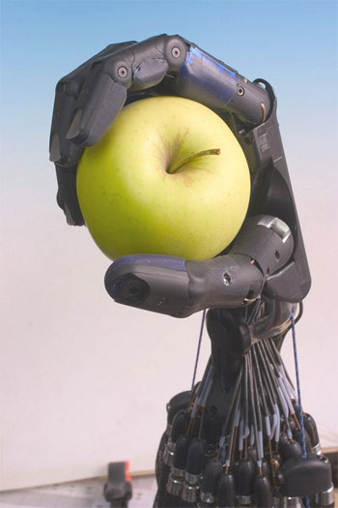
Conclusion
Presentation_ID
© 2010 Cisco and/or its affiliates. All rights reserved.
Cisco Confidential
56
Notes:
56

Slide 57
Conclusion
Smart Objects have several major applications
  Smart Grid, Green, Industrial, Connected building/homes, Smart Cities
  There is a lot of momentum around using IP
Major progress in several key areas
  IP-based technologies: 6Lowpan, RPL and now CoRE
  IPSO alliance
  Adoption of IP by several other SDOs/alliance: Zigbee/IP for SE2.0, Bacnet, ….
Internet of Things is coming
  Current Internet = Some things (computers and hosts)
  Next Internet = Everything!
Notes:
57

Slide 58
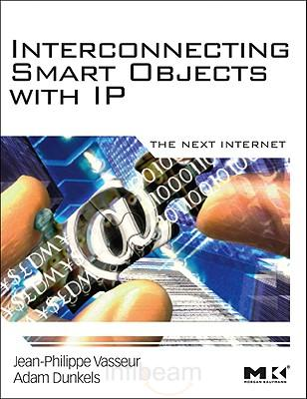
Recommended reading
Covers the trends in Smart Objects
RPL protocol
Detailed application scenarios
Written by
  JP Vasseur (Cisco DE)
  Adam Dunkels (Inventor of Contiki O/S, uIPv6)

Slide 59



