Slide 1


IP Addressing Research
2011.2.21

Slide 2

Outline
Overview
IP addressing research activities at CNNIC
Future Work

Slide 3

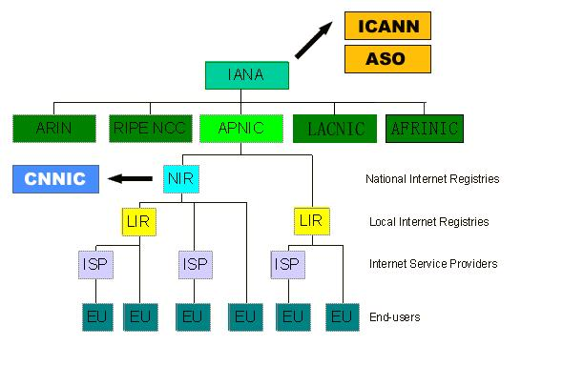

Overview
Internet
Research
CNNIC LABs
IP addressing Research

Slide 4
IP Addressing Research Work
IP application
IP address allocation
IP address query
IP related protocol
Automatic security parameter configuration
IP address itself
New IPv6 address format
Related framework design

Slide 5
Outline
Overview
IP addressing research activities at CNNIC
Future Work

Slide 6
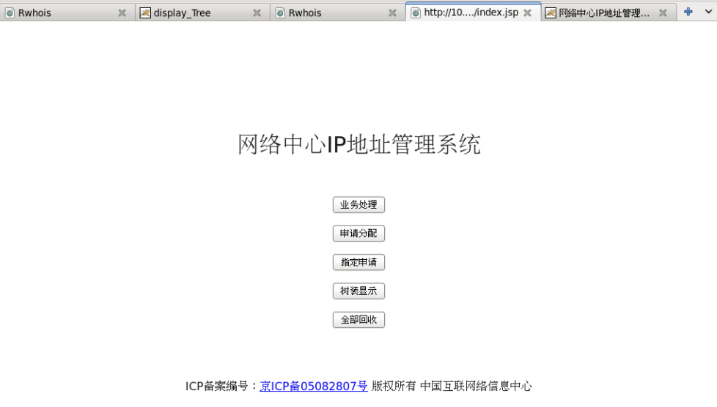
IP Allocation and Query
Root
1.Automatic IP address Allocation
2. Recursive IP address information query
3. IP address renumbering
A
B
C
A1
A2
B1
B2
Accessing Networks
PC
PC
Terminals

Slide 7
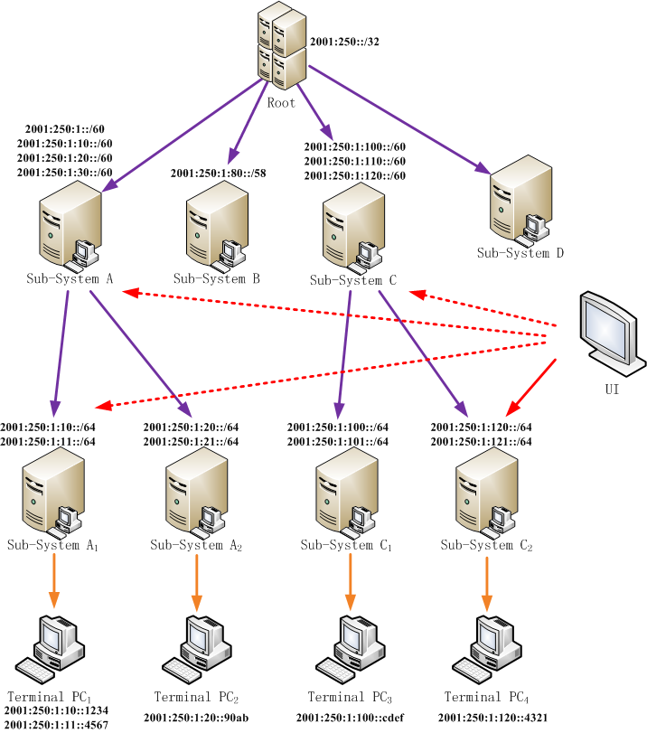
IP Address Information Query
1
Allocation history query
2
IP using history query using specific time

Slide 8
IPSec Security Association Configuration
IPSec is widely used to build secure channels
SA parameters need to be configured
DNS recursive name server
Separated from IP address configuration process
SIP server
DHCPv6 is to piggyback the parameters needed for IPSec

Slide 9
Operation Process
DHCP Client
Service Server
Notes:
target server
A local server of the access network, which is to be configured the security association with a specific host, by DHCP. The target server works as a DHCP client listening for DHCP messages on UDP port 546
requestor
A host that wants to establish security association with a specific local server. The requestor works as a DHCP client requesting the configuration parameters for security association.

Slide 10
Source IP Address Accountability
Motivations
Our work
IP address abusive activities is severe(spam, IP spoofing)
propose an accountable type of IPv6 address
IPv6 is a big challenge for the IP management work
Wide variety of things will be connected to the internet at the age of internet of things
Easy for roaming devices to access network managed by different ISPs
Supporting different security demands for different services
Notes:
We note that one of main reasons why IPv6 is desired is that IPv6 comes with a huge IP address space which could
meet the need from the enormous number of terminals. we propose a new type of IPv6 address—HIA (standing for Host-Identifier- Embedded IPv6 Address) for the Internet accountability in the similar fashion with the method GSE and ILNP employ to achieve the so-called separation in IPv6 address, while
retaining the IP addressing structure. With HIA as basis, we present an out-of-band assignment approach for part of IPv6
address called host identifier (HI), independent of the host’s access location.

Slide 11
  Proposed IPv6 Address Format
IPv6 Address Format(NP+EI)
EI Attributes
  Unique
  Position independent
Indicator
  0xFFFE(compatible with IEEE-EUI-64)
  Host
  Things
  Other
64 | 24 | 16 | 24
Prefix |  | Indicator

Slide 12
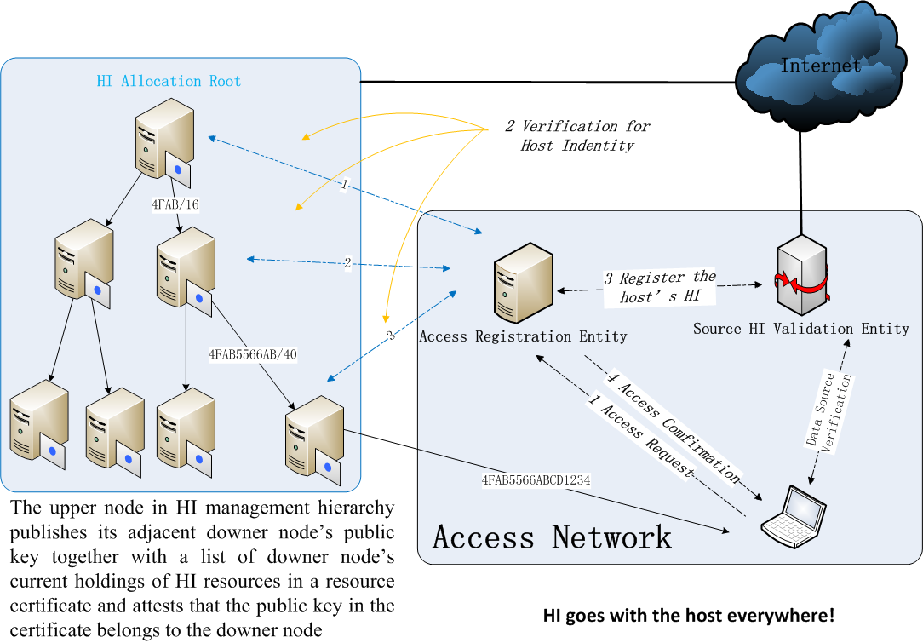
Source IP Address Accountability

Slide 13
Outline
Overview
IP addressing research activities at CNNIC
Future Work

Slide 14
Future Work
Future improve our work
Expand Cooperation
ISPs
Academic institutions
Device providers
Detailed protocol and framework design
Put our research results into practice
Build IPv6 tested for Internet of things
Promote our research results among IP alliance members

Slide 15
Thank you!
北京市海淀区中关村南四街四号中科院软件园 邮编: 100190
www.cnnic.cn

