Slide 1
APNIC Executive Council (EC) Election

Slide 2
Overview
About 2011 EC Election
Voting entitlement
Online voting
On-site voting
Proxy appointment
Counting procedure
Declaration of result
Dispute resolution
Candidate speeches

Slide 3
General Principles
The EC election is a formal election under the APNIC By-laws
Voting ballots are secret
The APNIC EC has adopted recommendations made by the 2010 Election Review Panel (ERP)

Slide 4
ERP Recommendations
The appointment of an Election Chair
The use of Secretariat staff to serve as Election Officers to manage the elections process and Election Tellers to count the ballots
The appointment of independent Scrutineers to observe the vote counting
The documentation of the EC Election procedure

Slide 5
2011 APNIC EC Election
Four vacant seats on the APNIC EC
Two-year term starting from 25 February 2011
Call for nominations ended 9 February 2011
http://www.apnic.net/publications/news/2011/ec-noms-open
Online and on-site voting available to APNIC Members only
http://www.apnic.net/elections

Slide 6
Election Chair
Election Chair
Appointed by the APNIC EC
Responsibilities:
Oversee the election process
Appoint the Election Scrutineers
Declare the election results
Resolve disputes

Slide 7
Election Officers
Election Officers
Appointed by the Director General
Selected from APNIC Secretariat staff
Responsibilities:
Administer the call for nominations
Manage the online and on-site voting processes
Supervise the ballot paper collection
Perform the vote counting with the Election Tellers
Retrieve the online voting reports

Slide 8
Election Tellers
Election Tellers
Appointed by the Director General
Selected from APNIC Secretariat staff
Responsibilities:
Supervise the ballot box
Validate and count the votes
Report the results to the Election Chair

Slide 9
Election Scrutineers
Election Scrutineers
Appointed by the Election Chair
Selected from staff of other RIRs, ICANN, and ISOC who are on site
Do not vote and must be independent from any APNIC Member, or candidate
Responsibilities:
Observe the Election Tellers in counting the votes
Not handle or touch the ballot papers
Notify the Election Chair in case any anomaly or issue is identified

Slide 10
Voting Entitlement

Slide 11
Voting Entitlement
Only current Member’s Corporate Contacts, and authorized contacts with voting rights can vote
The number of votes are determined by the Membership tiers
Membership Tier | Votes
Associate | 1 vote
Very Small | 2 votes
Small | 4 votes
Medium | 8 votes
Large | 16 votes
Very Large | 32 votes
Extra Large | 64 votes

Slide 12
Online Voting

Slide 13
Online Voting
Voting period
Started: 11 February 2011
Ended: 09:00 (UTC+8) Wednesday, 23 February 2011
Online voting is accessible via MyAPNIC
The system preserves anonymity, storing a record of who has voted, and a separate record of votes cast

Slide 14
On-site Voting

Slide 15
On-site Voting
Voting period
Starts: As announced by the Election Chair
Ends: 14:00 (UTC+8) Friday, 25 February 2011
Corporate Contacts, contacts with voting rights, or appointed proxies can collect ballot papers from the Voting desk until 14:00 (UTC+8) Friday, 25 February 2011

Slide 16
On-site Voting Logistics
The Voting desk is set up outside the APNIC Member Meeting (AMM) room
The ballot box is placed at the Voting desk after the opening of on-site voting is announced
The ballot box is supervised by the Election Tellers at all times
Enquiries should be directed to the Election Officers at the Voting desk

Slide 17
Voting Ballot Paper
Voting ballot papers provide clear voting instructions and are marked with a unique stamp
A ballot paper is invalid if:
No boxes are marked
More than four boxes are marked
It has ambiguous marking
It does not bear a validation stamp

Slide 18
Voting Ballot Paper
Ballot papers with 1, 2, 4, 8, and 16 votes are used
Members who wish to split their vote may exchange their ballot paper at the Voting desk for a set of single-vote papers equal to the Member's total voting entitlement

Slide 19
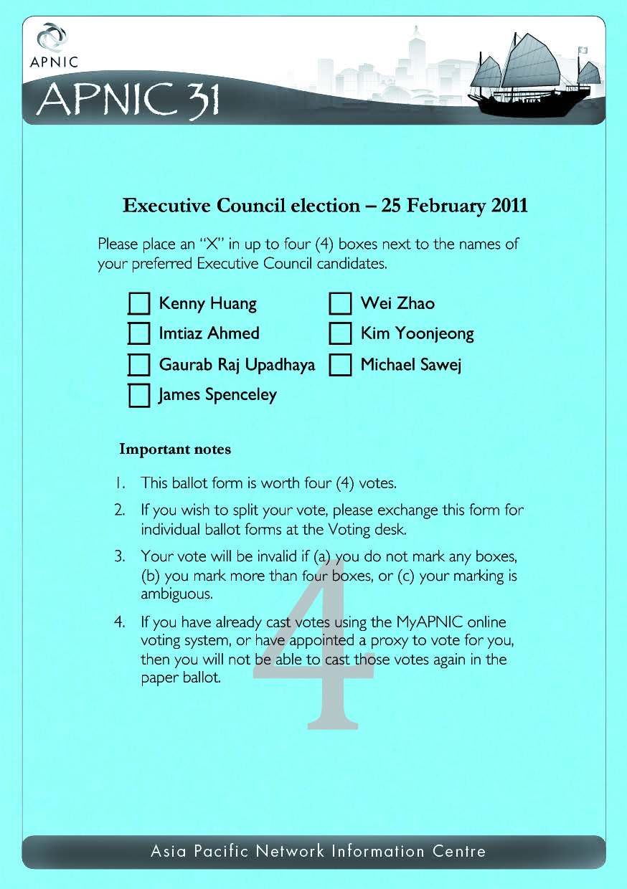
Voting Ballot Paper

Slide 20
Proxy Appointment

Slide 21
Proxy Appointment
Proxy appointment period
Started: 11 February 2011
Ended: 09:00 (UTC+8) Wednesday, 23 February 2011
Proxy holders are appointed by Corporate Contacts to vote on the Member’s behalf
Proxy holders need not be from the Member organization but must be registered for the AMM

Slide 22
Counting Procedure

Slide 23
Counting Procedure
Votes are counted in the presence of the Election Scrutineers
All ballot papers are checked
Tally forms are used to count, record, and verify the total number of check marks for each candidate
They are validated and checked by multiple Tellers
Online voting reports are printed during the vote count
The total votes for each candidate are calculated by combining the total votes from online and on-site votes

Slide 24
Declaration of Result

Slide 25
Declaration of Result
The result of the election will be announced by the Election Chair
This declaration will include:
The name and total vote count received by each candidate in the election
The total number of valid and invalid ballots
Notice of any disputes and resolutions
Disclosure of any communication from the Election Scrutineers regarding any anomaly or issue

Slide 26
Dispute Resolution

Slide 27
Notice of Dispute
Any complaint regarding the conduct of the election must be lodged in writing with the Election Chair at the Meeting
Such notices must be lodged no later than one hour before the scheduled Declaration of the Election
Notices may only be lodged by Members through their authorized voting representatives

Slide 28
Resolving Disputes
The Election Chair shall resolve the dispute at his or her discretion
The Election Chair shall provide notice of all lodged disputes and the Chair’s decision at the Declaration of the Election

Slide 29
Questions?

