Slide 1
IPv6: The Current Scenario in Pakistan
By
Aftab A. Siddiqui
Cyber Internet Services (Pvt.) Ltd
IPv6 Task Force Pakistan

Slide 2
Agenda
Introduction
IPv6 delegation in Pakistan
Pakistan’s IPv6 prefixes visibility
IPv6 Task Force Introduction
Pakistan v6Core architecture
v6Core Road Map
IPv4 to IPv6 Transition

Slide 3
Introduction
IPv6 is the new version of the Internet Layer Protocol (IP) in the TCP/IP suite.
BUT, its not new….
RFC 2460 (IPv6) was released in December 1998.
It has been more than a decade now.
So, NO MORE EXCUSES…..

Slide 4
IPv6 delegations in Pakistan
As of 1st February 2011, there are 57 APNIC members in Pakistan.
Every member is entitled to get an IPv6 allocation of /32 (and /48 in some cases).
BUT Unfortunately…..
According to APNIC routing database out of 57 only 19 Members have got their IPv6 address space. i.e. ~33%

Slide 5
IPv6 delegations in Pakistan
Member Name | Category | IPv6 Address Space
AMZ Technologies (Private) Limited | SMALL | 2401:a200::/32
Connect Communication | MEDIUM | 2401:ea00::/32
Cyber Internet Services Pakistan | MEDIUM | 2001:4538::/32
Delta Networks | SMALL | 2402:7c00::/32
Gerrys Information Technology (PVT) Ltd | MEDIUM | 2406:ac00::/32
HEC | SMALL | 2400:fc00::/32
IMZAK UK Limited | SMALL | 2401:9e00::/32
Linkdotnet Telecom Limited | LARGE | 2401::/32, 2404:148::/32
Micronet Broadband (Pvt) Ltd. | MEDIUM | 2407:d000::/32
Multinet Broadband | MEDIUM | 2401:8e00::/32
National Institutional Facilitation Technologies. | VERY SMALL | 2001:df0:84::/48
Pakistan Software Export Board | SMALL | 2405:c00::/32
Pakistan Telecom company limited | VERY LARGE | 2404:7000::/32
Supernet, PDS Limited | MEDIUM | 2001:fe8::/32
Telenor Pakistan (Pvt) Ltd | SMALL | 2402:e000::/32
TRANSWORLD ASSOCIATES (PVT) LIMITED | MEDIUM | 2404:d400::/32
WARID TELECOM | SMALL | 2407:9c00::/32
Wi-Tribe Pakistan Limited | LARGE | 2404:f400::/32
Worldcall Multimedia Limited (WML) | LARGE | 2406:7000::/32

Slide 6
IPv6 Prefixes Visibility
Out of 19 members having IPv6 address space only 6 are advertising their prefixes on the Internet. i.e. ~31%
Member Name | Category | IPv6 Address Space | v6 Route
Cyber Internet Services Pakistan | MEDIUM | 2001:4538::/32 | Advertised
Delta Networks | SMALL | 2402:7c00::/32 | Advertised
Linkdotnet Telecom Limited | LARGE | 2401::/32, 2404:148::/32 | Advertised
Pakistan Telecom PTCL | VERY LARGE | 2404:7000::/32 | Advertised
Supernet, PDS Limited | MEDIUM | 2001:fe8::/32 | Advertised
Worldcall Multimedia Limited | LARGE | 2406:7000::/32 | Advertised

Slide 7
IPv6 Task Force Pakistan
IPv6 Task Force was created by few technology enthusiast from Cybernet, Supernet and Dancom.
It is accredited by IPv6 Forum, APNIC, SANOG and PTA.
The main idea was to start working towards IPv6 deployment as early as possible.
A working charter was established with consensus among the stake holders.

Slide 8
IPv6 Task Force Pakistan
Task Force was formed with the following objectives:
Identify key application/product vendors and ISPs to promote IPv6 in Pakistan.
Propose, discuss, implement and share regional and local IPv6 strategies
Facilitate the means to promote IPv6 and its related technology through TF managed events and webportal.
Work with academia to promote addition of IPv6 in their curriculum.
Develop General Deployment and Transition Guidelines
Investigate and publicize IPv6 deployment status;
Establish and maintain Project 6Core (National IPv6 Core of Pakistan).

Slide 9
IPv6 Task Force Pakistan
Membership:
Membership is open to any organization willing to contribute to IPv6 promotion and deployment in Pakistan.
No membership fees.
There shall be no limit as to the number of Members of the Task Force.
All Members shall be entitled to participate in Task Force discussions.

Slide 10
v6 Core Project
6Core stands for "IPv6 National Core.” which is the First IPv6 based project initiated by ISPs of Pakistan under the common platform of Pakistan IPv6 Task Force. The 6Core is a test-bed network that was started by CYBERNET, SUPERNET, DANCOM towards transition from IPv4 to IPv6.
The 6Core project was started to enable various IPv6 testing as well as to assist in the transitioning of Pakistan ISP/NSP and other Enterprises’ IPv4 networks into IPv6 Internet.
It is managed on a collaborative, best-effort basis by its Nationwide ISP/NSPs, Educational institutes etc.

Slide 11
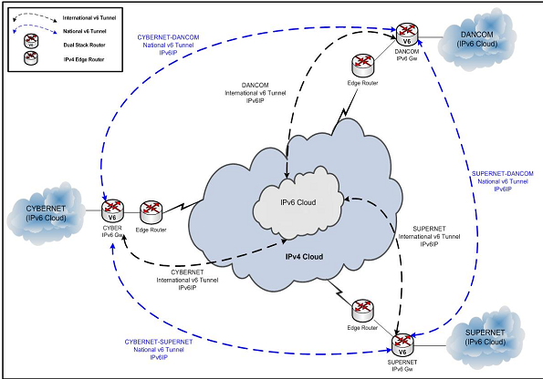
V6 Core Architecture

Slide 12
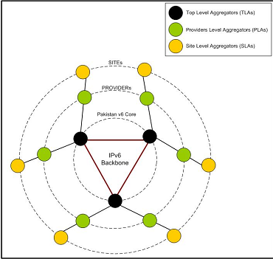

Slide 13
V6 Core Road Map
The proposed road map is in 5 phases initially.
Phase I:
Every ISP will initiate single IPv6 Tunnel with all other ISPs in Pakistan to establish IPv6 tunnel ring.
Every ISP will advertise its /32 CIDR only (No v6 Transit services will be offered).
IPv6 Tunnel will be used only for IPv6 traffic (unicast/multicast) only.
BGP neighborship will be created over National IPv6 tunnels.
For international IPv6 traffic every ISP will forward it to their International IPv6 Tunnel provider.

Slide 14
V6 Core Road Map
Phase II:
Every ISP will launch www6, DNS and FTP services over IPv6 in their Testbeds.
Services like TFTP, Telnet and SSH, and DHCPv6 will be tested.
ICMPv6 functions verification i.e. ICMPv6 Echo Request, Reply and Redirect, ICMP "hop limit exceeded," Neighbor Unreachability Detection, Path MTU Detection and Fragmentation/Reassembly, etc..

Slide 15
V6 Core Road Map
Phase III:
Multiple v6 Tunnel between the ISP (base on major regions KHI/LHR/ISB only).
Every ISP will relax the prefix filter policy to /32 upto /48 to implement Multi-homed Traffic Engineering.
Routing Protocol performance “OSPFv3, ISIS and BGP4+” will be tested.
Different Tunnel scenarios i.e. static tunnels, 6to4, ISATAP, Teredo and Tunnel Broker will be tested.

Slide 16
V6 Core Road Map
There were many phases in the road map but somehow we never went ahead of Phase II and Phase III.
So, what went wrong?
Gap in understanding between front line engineers and decision makers.
Lack of support/interest from Govt. functions and regulators.
Lack of support/interest from academia specially HEC-PERN
Failure to create a business case. No user is asking for IPv6.

Slide 17
V6 Core Road Map
Crunch line to move forward:
IPv6 is the only technology available to serve the long term solution for Internet.
It is not perfect, its not backward compatible and it DOES NOT work with IPv4.
BUT, it does work ALONGSIDE IPv4 through co-existence and transition.

Slide 18
IPv4 to IPv6 Transition
Since the IPv6 only networks are rare and working in isolation. Therefore, to reach IPv6 Internet from IPv6 host there should be certain transition methods
Transition approaches:
IPv6 only i.e. Native v6 in Parallel
Dual Stack
Tunneling
Translation

Slide 19
We are already late!
A planned rollout in an average moderate network environment could take 2 years.
If you are still looking for a business case than imagine Internet with NAT only.
The sooner you start, the more time you have to test the network.
Start conserving your IPv4 addresses for rainy days.

Slide 20
Starting Point

Slide 21
Academia Partnership

Slide 22
How we are helping?
IPv6 Task Force is doing IPv6 awareness seminars and lectures in universities.
IPv6 Task Force is helping enterprises and academia to setup networks and labs.
IPv6 Task Force provides IPv6 prefixes assigned by Cybernet.
We are working on a complete IPv6 task force portal with all the desired resources
Operational experience with transitional technologies is minimal. There are more questions than answers. We know few answers……

Slide 23
We Need Your Support!

Slide 24
Any Questions…..

Slide 25
Thank you..
Related Links
IPv6 Task Force Pakistan www.ipv6tf.org.pk
Tunnel Broker www.he.net
APNIC IPv6 Program www.apnic.net/community/ipv6-program
IPv6 Forum www.ipv6forum.org
Contact:
aftabs@cyber.net.pk

