Slide 1
Networking Solutions for A Server Virtualization Environment
APRICOT 2011
Russell Cooper
russ@juniper.net
Notes:
This presentation will discuss some current and emerging networking solutions for server virtualization environments, such as data centers where customers have deployed a lot of VMware or similar technologies to facilitate server virtualization. Today we’ll look at all the different aspects involved, including switching, security and data center orchestration.

Slide 2
What you will get from this session
1. Talk: about challenges Server Virtualization technologies brings for the data center networks.
2. Demonstrate: standards based approach, where available, to improve the experience and economics in a virtualized environment.
Notes:
This session will prepare you to talk about the challenges that server virtualization technologies pose for the data center. From small data centers to the biggest cloud deployments, there are specific challenges that server virtualization as a technology brings to the network, and we'll look at those in a lot more detail.
We're going to look at where server virtualization is, how it's growing, what kinds of challenges it brings to networks, and why we need to move on and consider alternatives to legacy network designs.

Slide 3
Agenda
Market Drivers
Limitations of legacy network
Solutions
Simplification
Infrastructure
Enhanced services
Summary
Notes:
This may be a slightly more technical conversation than required for some of these topics, but it's important to understand the landscape.

Slide 4
The evolution of Server Virtualization
PHASE 1 PAST
PHASE 2 FUTURE
Server Consolidation
Business Agility
Guiding Principle: Improve utilization of physical resources
Guiding Principle: : Improve utilization of a pool of resources
Driver:
Power and space
Improvements in server utilization
Savings
Driver:
Adapt quickly to new demands
Heightened compliance & security
Better disaster management
Cloud Based Computing Models
Network had no role
Network has a huge role
Notes:
Let's look at how this technology has evolved. This is important. In the last four or five years, VMware and server virtualization technologies have grown rapidly, for the simple reason that server virtualization improves the utilization of a given physical resource. Rather than having five servers all running at 5% utilization, server virtualization lets you consolidate those workloads on a single physical server running at 30%, 40% or 50% utilization, maximizing the resource. The network plays no role in this situation because no traffic is traveling over the network; it’s all getting optimized inside the server. This was the first phase, driven by server consolidation.
This trend started to change last year. Customers now are looking at server virtualization not just to improve the efficiency of a given resource, but to maximize utilization of a pool of resources or group of servers. This is due to the fact that these virtual machines or workloads can be moved from one physical server to another. In the VMware world, this technology is called vMotion. Different vendors have different names; IBM calls it Live Server Migration.
Why is this gaining momentum? Because this is the value proposition of cloud computing, which maximizes the benefits of a pool of resources working together.
Server virtualization is a fundamental building block of any cloud compute environment. How do you maximize utilization of a pooled group of resources? In today’s world, and for the next three to five years, the network will play a huge role because it’s what connects these sets of resources.
Everything else in the data center has changed. Servers have evolved with technologies like server virtualization. Similar efforts have taken place in the storage world where storage was virtualized. Applications have evolved, going from a mainframe‑based design to a client server‑based design to, now, more of services‑oriented architecture.
The only thing that has not changed and is actually a bottleneck to delivering the true value of server virtualization is the network itself. The data center network is still the same three‑ or four‑tiered, tree‑shaped architecture it’s always been.
Now it’s time to look at the network—it’s a bottleneck.

Slide 5
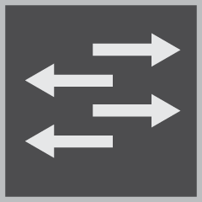
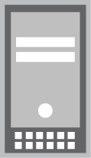
Legacy networks restrict agility
COMPLEX:
Too Many Devices to Manage
Additional virtual switches
INFRASTRUCTURE:
LACK OF ADDITIONAL SERVICES:
POOR PERFORMANCE
Multiple layers
Across North-South path
MOBILITY:
North-south path
Scale & scope of L2 adjacencies
Across sites
PROPRIETARY:
Pre-standard protocols
SECURITY: Silo’ed , unavailable across domains Intra-VM traffic
NIC
NIC
MANAGEABILITY: Orchestration between the physical and virtual network
VM1
VM2
VM3
VM1
VM2
VM3
SERVER 1
SERVER 2
Notes:
5
5
Let's look at some of the problems with the legacy design. This slide organizes them into three broad categories. First is “complexity.” Look at the picture in the middle; this is what 90 to 95% of data centers look like today. They’ve got servers; access switches extending to an aggregation layer; firewalls and other kinds of service appliances, which could be embedded or hanging off at the aggregation layer. Then there is a core tier of switches leading to the WAN or edge router, which is the data center entry and exit point.
Beneath this diagram are two call-outs, which you'll see a few times in this presentation, that show what is happening inside the physical server. You’ll notice this consists of multiple VMs, or virtual machines, labeled VM1, VM2 and VM3.
The server also includes an internal “virtual switch,” or vSwitch, depending on the vendor's nomenclature. This is essentially a software-based switch to which all the VMs are connected, allowing the VMs to talk to each other. On the top of all that is a network interface card, or NIC, which is part of the server and connects to the network.
This architecture includes the three fundamental problems defined by the basic categories. First, it's complex; there are already too many physical devices to manage, and now we’ve added the virtual switches that are built-in to the servers as part of VMware's hypervisor software. So now you've got additional devices to manage.
The next category, “infrastructure,” includes two big challenges. First, the network in the middle of the slide is not designed for high performance; it forces traffic that wants to go east-west to first go north‑south. In other words, traffic that wants to go directly between servers first has to follow a north‑south path, which affects performance in a big way.
The second infrastructure challenge is the use of proprietary standards — protocols that have evolved over time.
The third problem category is “lack of additional services.” As you’ll recall, the second phase of server virtualization is built around the fact that workloads move around in the data center. Virtual machines move from one server to another, perhaps vacant, server in the same or even a different data center. That happens a lot when customers want to back up all their information from one data center to another.
Since these data centers (virtual machines?) move around—they're very dynamic and can move in milliseconds—it creates mobility challenges for the network. Also, how do you secure these servers, these workloads and this traffic flying around the data center? Not just the traffic trying to move from one part of the data center to another, but the traffic moving between VMs as well. The network has no visibility into traffic flowing inside the server, so how do we secure the intra‑VM traffic?
Manageability, or orchestration, is also a huge challenge, because now we have both a physical network and a virtual network, consisting of software-based switches inside the servers. How do you manage all this and keep it all synchronized?
These problems raise several questions: How do we simplify the network? How do we improve performance? How do we make the network more open and standards based?
In terms of these additional services, we're going to look at what sort of mobility services, security services and manageability services are needed to maintain and manage a data center network that deploys server virtualization.
That is our problem statement. Let’s use this as a framework for the rest of the discussion, exploring each topic one by one.

Slide 6
Network Simplification for supporting Server Virtualization
COMPLEX:
Too Many Devices to Manage
Additional virtual switches
SIMPLIFICATION
LACK OF ADDITIONAL SERVICES:
INFRASTRUCTURE THAT IS:
ENHANCED SERVICES NEEDED
INFRASTRUCTURE:
POOR PERFORMANCE
Multiple layers
Across North-South path
MOBILITY:
North-south path
Scale & scope of L2 adjacencies
Across sites
HIGH PERFORMANCE
MOBILITY
PROPRIETARY:
Pre-standard protocols
Interoperability
Lock-in
SECURITY: Silo’ed , unavailable across domains Intra-VM traffic
OPEN, STANDARDS BASED
SECURITY
NIC
NIC
MANAGEABILITY: Orchestration between the physical and virtual network
MANAGEABILITY
VM1
VM2
VM3
VM1
VM2
VM3
SERVER 1
SERVER 2
Notes:
6
6
Let’s start with simplification. There is a lot of material available—collateral, presentations, etc.—that show how we fundamentally simplify the data center network, with or without server virtualization.
This is mainly about infrastructure.

Slide 7
Network Device Clustering
SIMPLIFICATION
Fewer devices to manage: 44 -> 4
BEFORE
AFTER
Notes:
Compare these pictures. The picture on the left is what 90 to 95% of data centers look like today. The picture on the right is an alternate network architecture. The main difference is that architecture on the right requires far fewer devices to achieve the same capabilities, performance and features as the one on the left.
The network on the left includes 44 independent devices, each of which could be running different operating systems and require different management applications. It's a nightmare. Contrast this with the network on the right. Using device clustering technologies to do the same thing with almost an order of magnitude fewer devices to manage.
Note the consolidated network services devices. In the past each individual network service was typically deployed as a separate appliance type device (SSL offload, SLB, FW, IDP etc). Now, with high performance devices capable of line rate throughput, smart software, huge arp/route table capability services can be consolidated on the one platform.
This is the starting point for how we fundamentally simplify data center network architectures and manageability. Important to remember we are not talking about switch ‘stacks’.

Slide 8
Technology approaches
Control Plane Unification
L2 Table Synch
Facts
Simplify operations
Behaves as a single node both at L2 & L3 layers so it inherits all benefits found in L2 Table Synch approach
Facts
Distributed link aggregation (LAG) plus some L2/L3 protocols enhancements to minimize interchassis link load
Multiple Devices – Enhanced Protocols
Multiple Devices – One Control Plane
Notes:
Various vendor specific solutions available today – pre-standards requires innovation and field deployments to set a direction.
Layer 2 Table Synchronization Examples – Cisco Virtual Port Channel, Avaya Nortel SMLT (Split Multi-link Trunking - IEEE 802.3ad static mode)
Control Plane Unification Examples – Cisco Virtual Switching System (VSS), Juniper Virtual Chassis

Slide 9
Open standards based
SIMPLIFICATION
INFRASTRUCTURE THAT IS:
ENHANCED SERVICES NEEDED
HIGH PERFORMANCE
MOBILITY
OPEN, STANDARDS BASED
SECURITY
MANAGEABILITY
Notes:
9
9
Let’s look at standards. As mentioned earlier, there are a lot of proprietary standards and protocols that other vendors have thrown out on the market. How do we change that picture and standardize our data center builds? It doesn’t matter what make of server it is, or what hypervisor vendor is being used—whether it is VMware or Microsoft or Citrix.

Slide 10
Communication between the Virtual machines
NIC
NIC
NIC
VM1
VM2
VM3
VM1
VM2
VM3
VM1
VM2
VM3
In the hypervisor vendor’s switch(e.g. VM Ware vSwitch)
2. In the NIC
3. In the existing external physical switch (VEPA)
Notes:
This slide shows communication between VMs inside the server. This communication can take three forms; the first picture shows the default vSwitch or software switch provided by the hypervisor being used. Traffic does not leave the server; it uses the software switch to communicate between virtual machines.
The picture in the middle shows a slightly different model where the traffic actually comes out of the server but the switching service is provided by the NIC. There are vendors doing that today. It's a very small market, but it's expected to grow in the near future.
The third picture shows what the networking industry propose, and that is something called VEPA. In this approach, in order for two virtual machines inside a physical server to communicate, they need to come all the way out of the server to the first-hop access-tier physical to facilitate the communication.
This approach challenges some assumptions about networks, which is that in a switch, traffic comes in on one port and goes out a different port. As this example shows, it's one physical port—the packet comes in and goes out the same interface on the switch.
The reason the whole industry is behind this model is because this is a physical switch. There is nearly two decades worth of R&D invested in switching technologies by companies like Juniper, Cisco, Brocade and others, and those physical switches have all the necessary features and performance capabilities. Rather than use the software- based switch that comes with the hypervisor, these vendors say that switching should be done where it belongs: on the physical switches connected to the servers.
There is an alternative to VEPA. In the simplest terms, VEPA is a simple software upgrade. This software is being written now; nobody has it yet because it is an emerging standard. With such a simple software upgrade, customers can keep their existing physical switches and implement the VEPA code or software. Alternatively, proprietary new switching technology called VNTag requires replacing the current installed base of physical switches.

Slide 11
Comparing VEPA AND VEB
Network services
in hardware
Physical switch
NIC
NIC
Hypervisor/software
switch
Network services
in software
VM1
VM2
VM3
VM1
VM2
VM3
Virtual Ethernet Port Aggregator (VEPA)
North – South optimized
Full functioned hardware switch
Virtual Ethernet Bridge (VEB)
East – West optimized
Limited function software switch
Notes:
VEPA
No trunk port to hypervisor hair-pinning
Each VM-to-VM flow requires 2 traversals of connection to adjacent switch.
Network services – CoS, firewall, access control, etc – performed in hardware
VEB
No trunk port to hypervisor hair-pinning.
Fast VM to VM if no network services. Latency introduced if network services are deployed in hypervisor.
Additional CPU cycles for network services. Network functions implemented in software.
Network Services can include:
Firewall (stateless or stateful)
IDP/IPS
Quality of Service marking/enforcement
Reference: ‘A Case for VEPA: Virtual Ethernet Port Aggregator’, Congdon, Fischer, Mohapatra

Slide 12
Comparison of options
1
2
3
vSwitch
NIC
VEPA
Switching done in
Software
Hardware
Hardware
Feature Richness
Very Low
Low
High
Customer’s Time to adopt solution
Low – comes in- built with hypervisor
Low - simple software upgrade
Unknown
Customers’ Cost to adopt
Low – comes with hypervisor
Unknown
Free - software upgrade
Compatibility with any existing network
Yes
Unknown
Yes
Latency for switching
Very Low
Very Low
Low
Industry support (standards based)
NA
Unknown
Yes
Virtual switching managed by
Network Admin
Server admin
Unknown
Notes:
Here is a quick reference slide comparing all the three different approaches spoken about to intra‑VM communication. Some of the disadvantages of the other solutions are highlighted.
Again, the preferred solution is VEPA. It is the least disruptive way for a customer to adopt intra‑VM communications.
VEPA – IEEE 802.1Qbg (Edge Virtual Switching)
- IEEE 802.1Qbh (Bridge Port Extension)

Slide 13
VEPA
Virtual Ethernet Port Aggregator
Uses external physical network for intra-server VM to VM communication
It’s an evolving open standard IEEE 802.1Qbg / 802.1Qbh
Supported by almost all the major IT vendors
For more information http://www.ieee802.org/1/files/public/docs2009/new-bg-thaler-par-1109.pdf http://www.ieee802.org/1/pages/802.1bg.html
NIC
VM1
VM2
VM3
VEPA brings the evolved Ethernet functionality to virtual networking
Notes:
Here are some more details about VEPA, which stands for Virtual Ethernet Port Aggregator. The links lead to more information about what VEPA is and where it’s going.

Slide 14
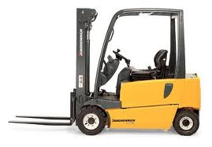
Top 3 benefits of VEPA
Elegant
Features & Scale
Open
VEPA is a non-disruptive and cost-effective
Switching where it belongs – on the switches
Server and hypervisor agnostic, maximum flexibility.
Notes:
In as nutshell, there are three basic advantages to VEPA.
First, it's the most elegant solution. It's not a rip‑and‑replace; it’s a simple software upgrade that is non disruptive and cost effective.
Next, in terms of features and scalability, VEPA contends that switching should happen where it belongs: on the physical hardware. This is by far the best solution.
Finally, VEPA is not specific to a certain hypervisor vendor or a certain server; it is completely open and built on open standards.
I like to think of it as making VMs look and act like physical servers within the data center network.

Slide 15
High performance
SIMPLIFICATION
INFRASTRUCTURE THAT IS:
ENHANCED SERVICES NEEDED
HIGH PERFORMANCE
MOBILITY
OPEN, STANDARDS BASED
SECURITY
MANAGEABILITY
Notes:
15
15
Now let’s look at high performance.

Slide 16
Latency with legacy network
Every hop adds additional latency Increases load on uplinks Requires VLANs to span multiple access switches to support VM migration
A
B
Notes:
You may have seen this picture before, which shows the problem with legacy networks. In most data center or cloud deployments today, about 75‑80% of all traffic is east-west, server‑to‑server.
In this diagram, Server A is trying to talk to Server B at the other end of the data center. The path the network provides today requires packets to go north and south before going east and west. It's like taking the elevator up to the 20th floor and back down again to visit the office next door.
It’s easy to see why traditional network designs provide such poor performance. Every step, marked by clocks here, add latency to the process.
The logical solution is to flatten the network to minimize the number latency inducing hops.

Slide 17
Virtualization with Chassis Clustering
10x latency improvement by eliminating trip to upper layers Single-point lookup model Works with any Hypervisor
Clustered Access Switches
A
B
Notes:
Chassis clustering allows several switches to be interconnected and behave like a single, logical switch. That's a big manageability advantage.
In this configuration, that 75‑80% of traffic that wants to travel east-west from one end of the data center to the other does just that—it flows flat, over the high‑speed link, instead of first travelling north and then south again.

Slide 18
mobility
SIMPLIFICATION
INFRASTRUCTURE THAT IS:
ENHANCED SERVICES NEEDED
HIGH PERFORMANCE
MOBILITY
OPEN, STANDARDS BASED
SECURITY
MANAGEABILITY
Notes:
18
18
Now let's look at some of the enhanced services needed to facilitate vMotion, or live server migration, required for server virtualization technologies.
This is to enable true data center network flexibility!

Slide 19
NETWORK Requirements for VM mobility
IP network with 622 Mbps is required.
The maximum latency between the two servers < 5 milliseconds (ms).
Access to the IP subnet & data storage location
Access from vCenter Server and vSphere Client.
Same IP subnet & broadcast domain
Layer 2 adjacency
VLAN stretch
Notes:
This list, taken directly from the VMware data sheet, explains what is required from the network for a virtual machine to move from one server in the data center to another in a Vmotion environment.
Focus on the two highlighted bullets in red. Put simply, the larger the playing field, the better for server virtualization. If you can provide multiple destinations for a virtual machine to move, that is what VMware expects.
Today that playing field—places where a server can actually move—is very limited. It's just 64 physical hosts from VMware. VMware is increasing this number to around 250 or 300 servers, which represents the pool of resources where workloads can be moved. For that to happen, the source and destination for the virtual machine must both in the same Layer 2 domain. This is called Layer 2 adjacency.
One other thing: VLANs must also stretch across a large domain and essentially provide the virtual machines with the large playing field that allows them to move around. That's the requirement for the network.

Slide 20
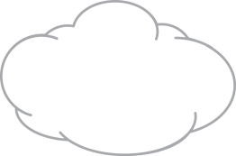
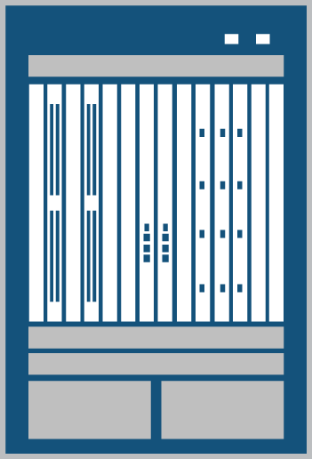
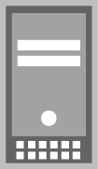
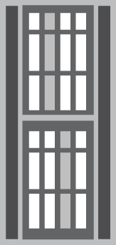
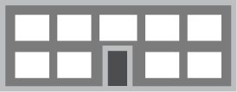
VM Migration Scenarios
Scenario #1
Scenario #2
Scenario #3
Within Same Data Center
Data Centers in the same
City - two different locations
Data Centers in different Cities
VPLS
Clustered Access Switches
Clustered Access Switches
Clustered Access Switches
Data Center
Data Center
Data Center
Data Center
Remember the vMotion Requirements!
Bandwidth/Latency/IP Subnet/VLAN
Rack A
Rack A
Layer 2 domain across racks
Layer 2 domain across fiber connected data centers
Layer 2 domain across virtual private LAN
Notes:
Here are three different scenarios.
Scenario 1 shows a virtual machine moving across racks within the same data center.
Scenario 2 shows two data centers located several kilometers apart, but still part of the same clustered access switch configuration. The example here is the Juniper Virtual Chassis technology. Virtual Chassis technology can extend across great distances using regular 10‑gigabit Ethernet links.
Scenario 3 shows communication between two data centers between two clouds, or between your customer's private data center where they're offloading some applications to a public cloud. How do you enable this communication between locations that could be hundreds of miles apart? This could be a combination of chassis clustering technology and technologies like VPLS.
20

Slide 21
RACK to RACK
RACK 1
RACK 2
Top-of-Rack / End-of-Row Clustered Switches
NIC
NIC
Managed as a single device
Automatic VLAN update propagation.
Sub 10us latency
VM1
VM2
VM3
VM4
VM5
Notes:
Let's look at these scenarios in more detail. The first one, as mentioned, is a simple access switch top-of-rack clustered configuration across a single data center. The virtual machine can move across the high‑speed link to wherever it wants to go within the data center.

Slide 22
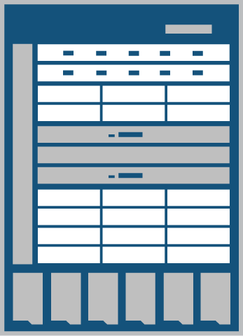
POD to POD
Core Clustered Chassis
Extends L2 domain across multiple Rows/Pods in a DC
Extends L2 adjacency to over 10,000 1GbE servers
Eliminates STP
Core managed as a single device
NIC
NIC
Clustered Access Switches
NIC
NIC
NIC
NIC
VM1
VM2
VM3
VM4
VM5
VM1
VM1
VM2
VM2
VM3
VM3
VM4
VM4
VM5
VM5
POD 1
POD N
Notes:
This example is slightly more complicated, where virtual machines are trying to move over larger distances—say between two data centers a few miles apart. With a combination of core clustered switches and access clustered switches, the virtual machine can move from one to the other.

Slide 23
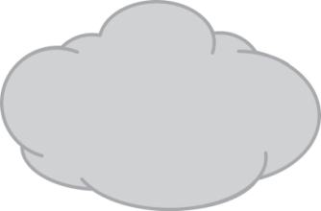
Across DC/Clouds
Routers
With VPLS
VPLS Over MPLS Cloud
Routers with VPLS
Core Switches
Core
Switches
Extends L2 domain across DC /clouds
Allows VM Motion across locations.
VPLS can be provisioned or orchestrated using vendor tools and scripts
VLAN to VPLS mapping
DB/Storage mirroring
NIC
NIC
NIC
NIC
NIC
Access Switches
NIC
NIC
Access Switches
NIC
NIC
NIC
NIC
NIC
VM1
VM2
VM3
VM4
VM5
VM1
VM2
VM3
VM4
VM5
VM1
VM1
VM2
VM2
VM3
VM3
VM4
VM4
VM5
VM5
VM6
VM1
VM1
VM2
VM2
VM3
VM3
VM4
VM4
VM5
VM5
Notes:
This scenario shows a virtual machine moving from one part of the world to another, tens of hundreds of kilometers away. This communication is enabled through a combination of clustered switch platforms within the data center, all the way across the cloud to another data center in another part of the world using VPLS technologies running on top of MPLS.
In terms of mobility, it doesn't matter if servers are adjacent or if they’re hundreds of kilometers apart. Remember the vMotion requirements!

Slide 24
MANAGEABILITY
SIMPLIFICATION
INFRASTRUCTURE THAT IS:
ENHANCED SERVICES NEEDED
HIGH PERFORMANCE
MOBILITY
OPEN, STANDARDS BASED
SECURITY
MANAGEABILITY
Notes:
24
24
Let's look at manageability.

Slide 25
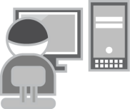
DC manageability challenges with Server Virtualization
Physical n/w
B
Blurred roles between the server and network admin.
No automation/ orchestration to sync-up the 2 networks.
VM Migration can fail.
Proprietary products & protocols
Network Admin
A
A
Virtual n/w
P
P
VM1
VM2
VM3
VM1
VM2
Server Admin
Notes:
The big challenge with manageability is the notion that there is now a physical network and a virtual network. The physical network is the network we can see, consisting of switches, routers, etc. The virtual network is new; it just got created with the soft switches that the hypervisor vendor provides.
This creates a management problem since the virtual network falls under the domain of the server administrator, who has no idea how to manage a network. The network administrator is only looking at the physical network, and the network admin and server admin don't talk to each other much. This means the physical network and the virtual network can quickly get out of sync, with the potential that vMotion can fail.
We have actually talked to VMware, and they tell us that this is the reason for most vMotion failures. Today, if VMware tries to move a virtual machine from one part of the data center to another, it does not talk to the network; therefore, the network has no idea that a virtual machine is moving from point A to point B.

Slide 26
One Step Orchestration
A
Network Admin
Physical n/w
A
A
Orchestration Tools
Clear roles and responsibilities
Automated orchestration between physical and virtual networks
Scalable solution – allows VMs to move freely
Open Architecture
A
A
A
Virtual n/w
P
P
VM1
VM2
VM3
VM1
VM2
Server Admin
Notes:
Solutions now available that act as a single point of management. Think of it as a control tower in an airport where the network administrator, who previously only had access to the physical network, sits. From this location, integrated orchestration tools act as a central point of control and management for both the physical and virtual networks.
As the diagram shows, the orchestration tool talks to both the physical and virtual network, enabling this automated orchestration. If a virtual machine tries to move, the orchestration tool will detect it and provision the physical network to facilitate this vMotion migration.
Several vendors have solutions that integrate with VMware. Solutions such as these should be non‑intrusive and 100% integrated with VMware, but based on a very open architecture. Work being done with Microsoft and Citrix to provide the exact same solution for environments using their hypervisors.

Slide 27
security
SIMPLIFICATION
INFRASTRUCTURE THAT IS:
ENHANCED SERVICES NEEDED
HIGH PERFORMANCE
MOBILITY
OPEN, STANDARDS BASED
SECURITY
MANAGEABILITY
Notes:
27
27
Now let's look at security.

Slide 28
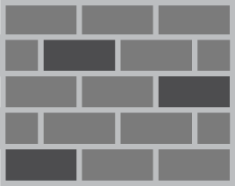
Security Implications of Virtual servers
PHYSICAL NETWORK
VIRTUAL NETWORK
VM1
VM2
VM3
ESX Host
HYPERVISOR
Firewall/IPS Inspects All Traffic Between Servers
Physical Security is “Blind” to Traffic Between Virtual Machines
Notes:
Security is a big challenge in the server virtualization world. The picture on the left is the physical network; a firewall sits somewhere in the network to inspect and enable security between servers.
The picture on the right shows how the world has changed, where virtual machines can be inside a physical server. If you've got a firewall sitting on the network, it is completely unaware of what’s happening between these virtual machines. That's a big problem.

Slide 29
Approaches To Securing Virtual servers: Three Methods
1. VLAN Segmentation
2. Agent-based
3. Kernel-based Firewall
Each VM in separate VLAN
Inter-VM communications must route through the firewall
Drawback: Possibly complex VLAN networking
Each VM has a software firewall
Drawback: Significant performance implications; Huge management overhead of maintaining software and signature on 1000s of VMs
VMs can securely share VLANs
Inter-VM traffic always protected
High-performance from implementing firewall in the kernel
Micro-segmenting capabilities
VM1
VM2
VM3
VM1
VM2
VM3
VM1
VM2
VM3
ESX Host
ESX Host
ESX Host
FW as Kernel Module
HYPERVISOR
HYPERVISOR
HYPERVISOR
FW Agents
Notes:
There are three ways to solve this problem—three possible options for securing intra‑VM traffic. We're not going to cover 1 or 2; their drawbacks and disadvantages are listed. Our preferred option Number 3, where the firewall is a virtual firewall sitting inside the server. The virtual firewall works with VMware to secure traffic between servers.

Slide 30
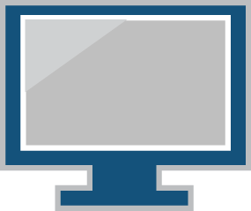
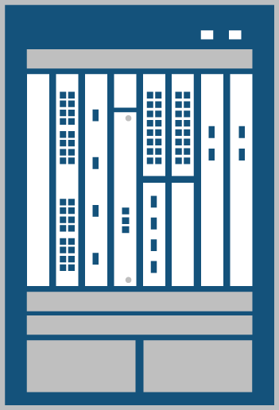
Introducing The Idea of a Stateful Kernel Firewall
Hypervisor Kernel Stateful Firewall
Purpose-built virtual firewall
Secure Live-Migration (VMotion)
Security for each VM by VM ID
Fully stateful firewall
Tight Integration with Virtual Platform Management, e.g. VMware vCenter
Fault-Tolerant Architecture
VM1
VM2
VM3
ESX Host
KERNEL VF
Security Policy
Management
Network
Security Information
And Event Management
Access Switch
Data Center
Firewall
Notes:
This slide shows the integration of a kernel based virtual firewall, shown in green, talking to an access switch, which in turn talks to a data center firewall.
The data center firewall becomes the center point of security for both traffic exiting out onto the physical network, as well as traffic flowing between virtual machines inside the physical server.
This is then linked to our network management applications, like an SIEM platform or an network management platform for policy management.

Slide 31
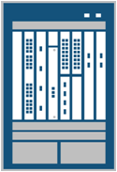
Follow-me policies
When a VM migrates, the network policies of the VM are migrated to the new server port.
Traffic between VMs still gets re-directed to the same appliance in the Services cluster
No migration of services state is required
VM1
VM2
VM3
VM2
VM3
ESX Host
ESX Host
KERNEL VF
Policy
Policy
KERNEL VF
Access Switch
Data Centre Firewall
Access Switch
Notes:
Let's take a look at a real‑world example. Say you’ve established a policy to secure traffic from VM1 to VM2. Now assume this virtual machine moves from one physical server to another. With the this solution, all that needs to happen is for the data center firewall to identify the move—to map the VM to the other server that the firewall already knows about. It should be completely non‑disruptive.
The data center firewall should have visibility into everything that's happening, and it's tied in with this virtual firewall. This is all done from a centralized location.

Slide 32
Summary of solutions for server virtualization
SIMPLIFCATION:
Few Devices
Fewer Devices to Manage
INFRASTRUCTURE:
Routers
ADDITIONAL SERVICES
HIGH PERFORMANCE
Few layers
Clustered Switches
MOBILITY:
VPLS
Clustered Switch domains
Core Switch Clusters
Data Center Firewalls
OPEN:
VEPA
Standards Based
SECURITY: Kernel Stateful Firewalls
Integration with DC FWs for follow me policies
Access Switch Clusters
NIC
NIC
MANAGEABILITY: VEPA
Orchestration Tools
VM1
VM2
VM3
VM1
VM2
VM3
SERVER 1
SERVER 2
Notes:
32
32
We’ve already gone through these three buckets: simplification; infrastructure changes; how to make it high performance yet open and standards-based; and how to provide solutions for vMotion, where these virtual machines are moving around in a matter of milliseconds; the enhanced services that are needed, in terms of mobility, and how to secure this mobile traffic; how to manage this entire picture—that’s a complete story. The total package.

Slide 33
Notes:
33
End of presentation.

