Slide 1
Technical Area Report
Siamak Hadinia, Infrastructure Service Manager

Slide 2
Key Deliverables
Delivering Value
  APNIC Meeting support
  Quality Assurance
  Redundancy improvements on all IPv4 and IPv6 services
  DNSSEC deployment
  IN-ADDR.ARPA transition

Slide 3
Key Deliverables
Corporate Support
  Office relocation
  Agile methodology
  Co-location triangle architecture
  Support for project work

Slide 4
Delivering value
Full production standard for IPv6 across all services
Redundancy improvements on all IPv4 and IPv6 services
Resource Certification
    NRO Global RPKI milestone reached 01/01/11

Slide 5
Delivering Value
DNSSEC deployment
  Signing APNIC’s zones
  Increase in load matched predictions
  IANA signed IN-ADDR.ARPA in February

Slide 6
Delivering Value
Serving IN-ADDR.ARPA ; one of six labels serving this zone
  e.in-addr-servers.arpa
  Collaboration with RIRs and IANA

Slide 7
Delivering Value
APNIC Meeting support
  New web-cast setup
    Supporting more streaming formats (Quicktime, Flash, and Mobile)
  Meeting improvement plan
    Streamlined setup and system complexity
    Improving quality of presentation output

Slide 8
Collaborating and Communicating
NRO collaboration
  Supporting DNSSEC in the ERX blocks with the other RIRs
  Supporting AfriNIC’s RPKI development with software and expertise
  Staff Exchange with RIPE NCC and AfriNIC

Slide 9
Collaborating and Communicating
Traffic measurements of RQA
  Ongoing R&D collaboration with Merit, NTT Communications (Yoshida), and AARNet
DNS-OARC measurement activities
  DNSSEC deployment
  IN-ADDR.ARPA transition
DNSSEC stale key threat identified

Slide 10
Corporate Support
Office relocation
  Implementation of:
    Network
    Phone service
    Internet connections
    Security systems
Agile methodology
  Comprehensive training
  Daily stand-up meetings

Slide 11
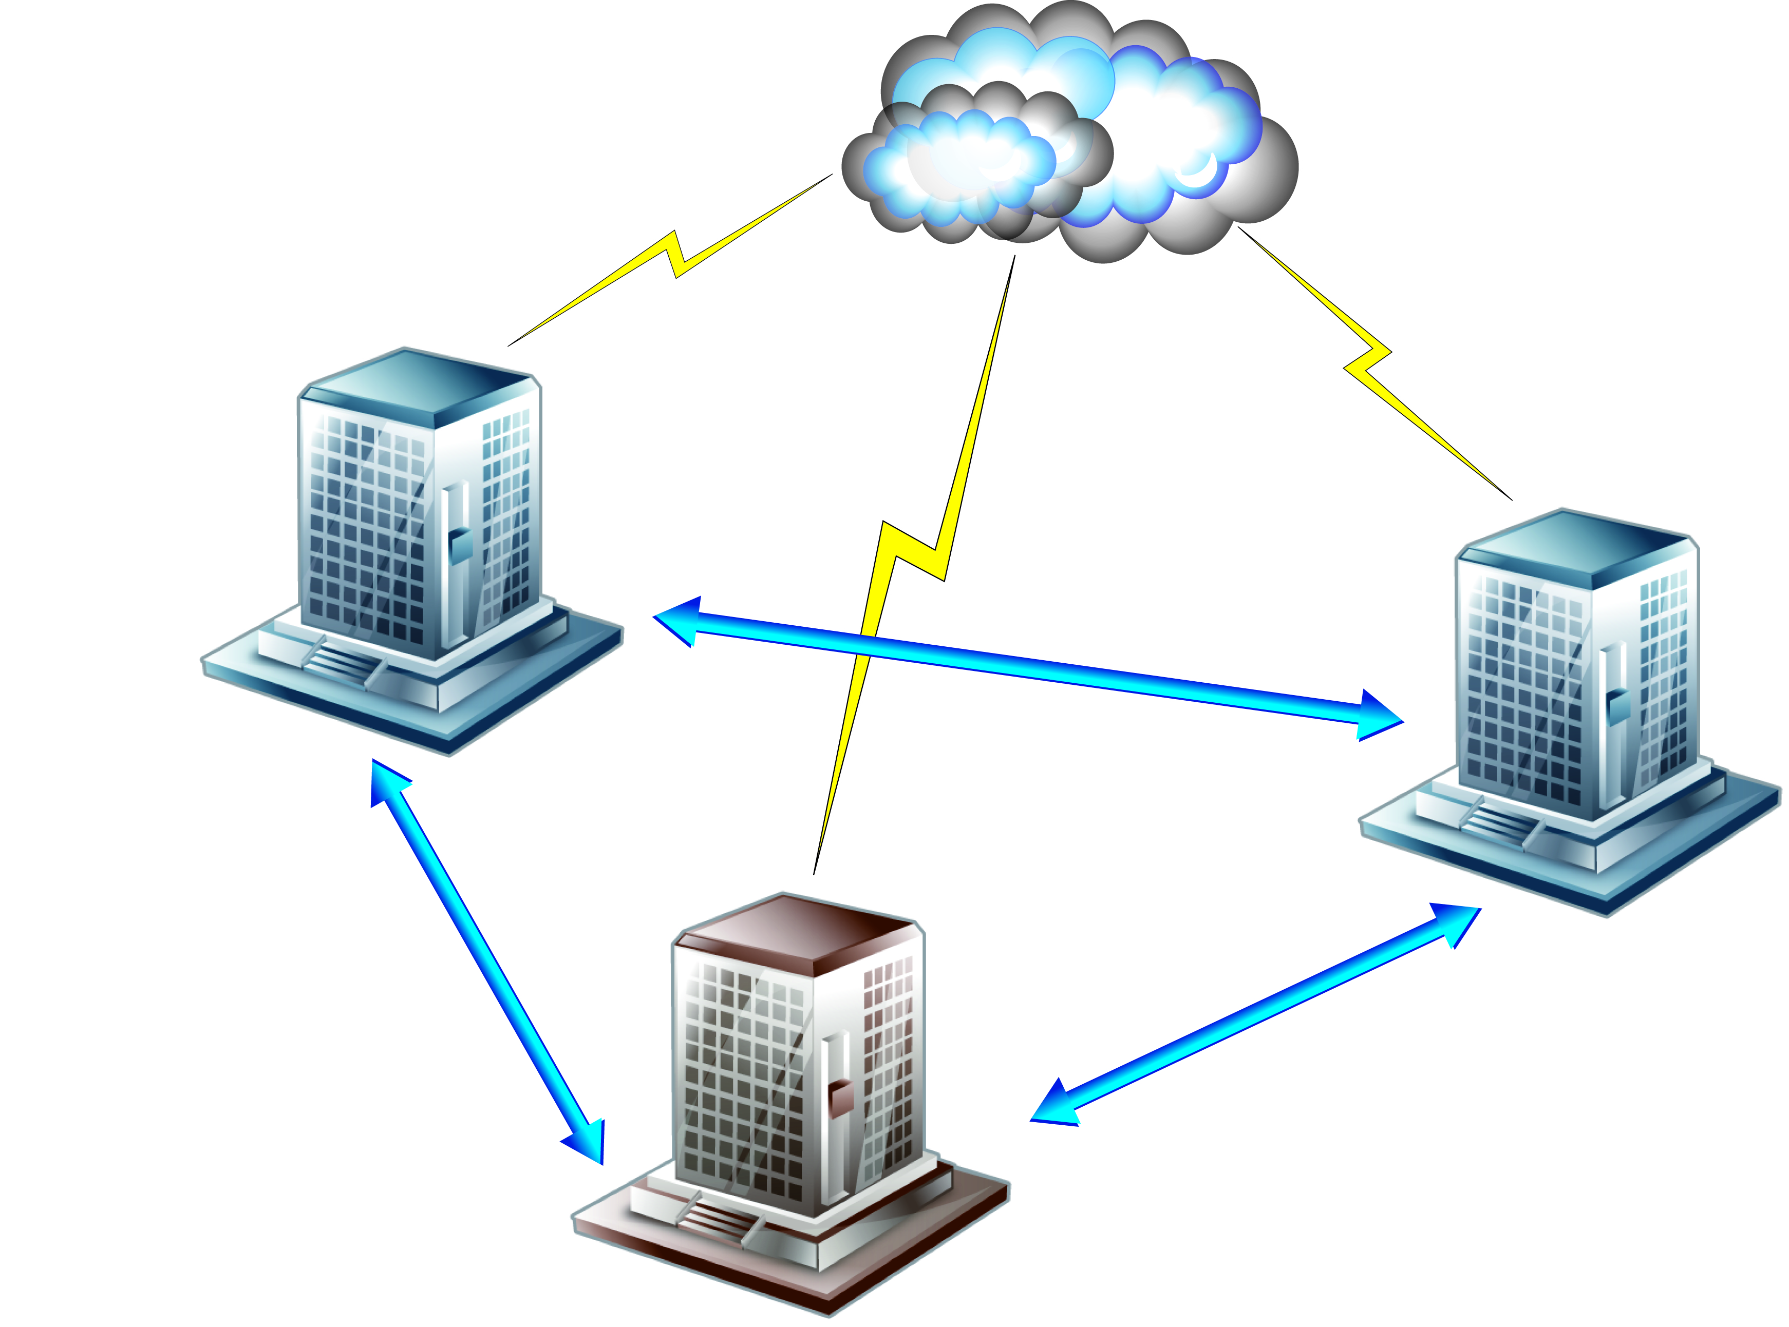
Corporate Support
New co-location facility
  “Triangle” architecture for redundancy
  Connected to existing co-lo and to office
  Used for office relocation in 2010

Slide 12
Corporate Support
Software and system support for project work, including:
  MyAPNIC improvements
  ARMS staff portal improvements
  Events registration and support systems
  IPv6 Kickstart program

Slide 13
Thank You!

