Slide 1
Services Area Report
Sanjaya
Services Area Director

Slide 2
Key Deliverables
Delivering Value
  Resource Quality Assurance
  MyAPNIC enhancements
  IPv6 growth
  2011 Member and Stakeholder Survey
Supporting Internet Development
  IPv4 Exhaustion Management
Service Delivery Indicator
  Helpdesk statistics
  Resource distribution

Slide 3

Delivering Value - RQA
Resource Quality Assurance
  Minimizing blocked traffic through:
    Reachability testing and experimentation
    Promotion of responsible filtering – Keeping ACLs and filters updated

Slide 4
Delivering Value - MyAPNIC
Abuse contact information implemented 8 November 2010
  Mandatory Incident Response Team (IRT) references in all IP address and AS number records in whois
  Streamlined process – enabling single IRT object to be linked to multiple objects
  1,300 IRT objects, linked from 57,800+ whois objects

Slide 5
Delivering Value - MyAPNIC
Whois management enhancements
  All object types now supported
  Bulk update form
DNSSEC support
  Users can easily update their Reverse DNS with their DS record (June 2011)
  Pending IANA to sign in-addr.arpa root zone

Slide 6
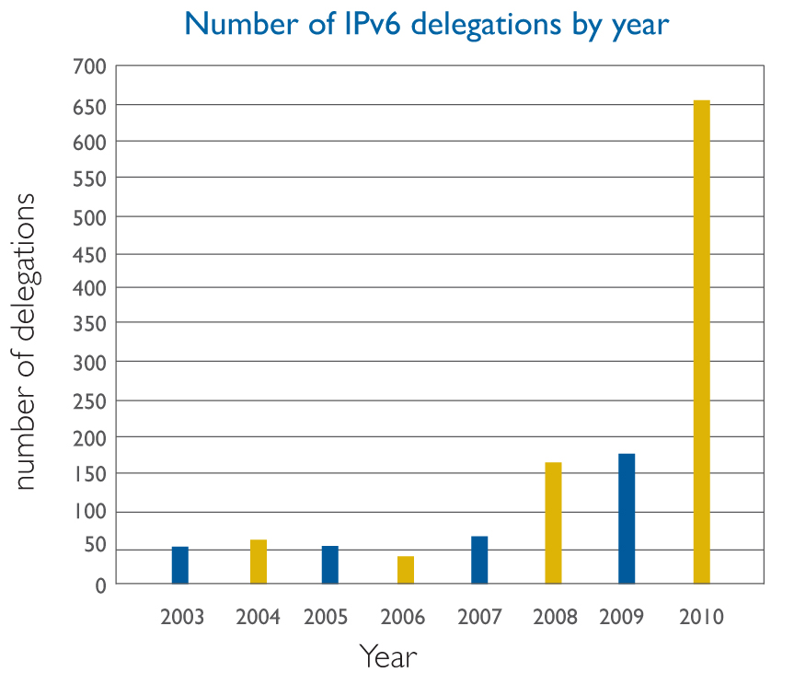
Delivering Value – IPv6
2010 IPv6 delegations more than tripled

Slide 7
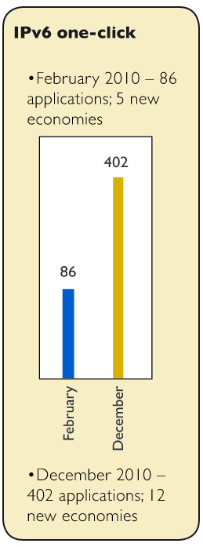
Delivering Value – IPv6
Fuelled by strong response to “Kickstart IPv6” – over 402 applications including 12 new economies

Slide 8

Delivering Value - Survey
2011 Member and Stakeholder Survey
  Conducted on behalf of EC by independent consultant, Prof. Ang Peng Hwa of Singapore Internet Research Center.
  Ran from 2 to 21 November 2010

Slide 9
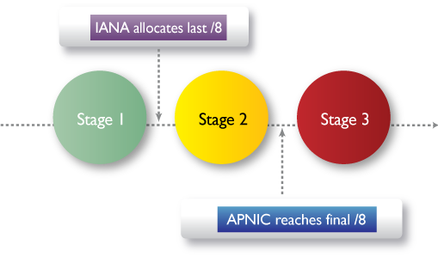
Supporting Internet Development
IPv4 exhaustion management
  http://www.apnic.net/ipv4-exhaustion
  3 stages – currently in stage 2

Slide 10
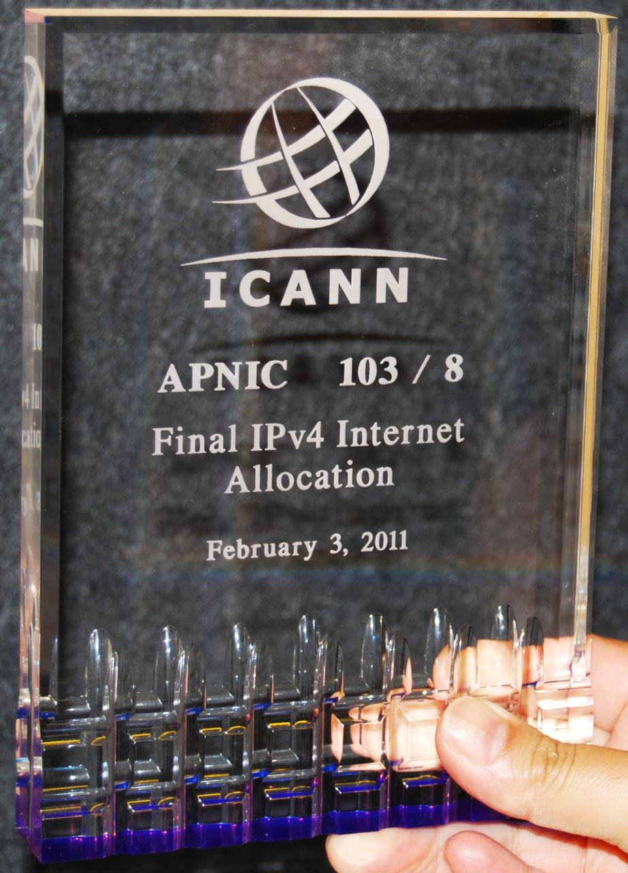
Supporting Internet Development
IPv4 Exhaustion Status
  APNIC received 2 /8s end January 2011
  Triggers allocation of last 5 /8 blocks to the RIRs in accordance with global policy
  Formal ceremony handing out last /8s on Wednesday, 3 February 2010 in Miami, USA
  APNIC’s Stage 2 operational mechanisms now implemented

Slide 11
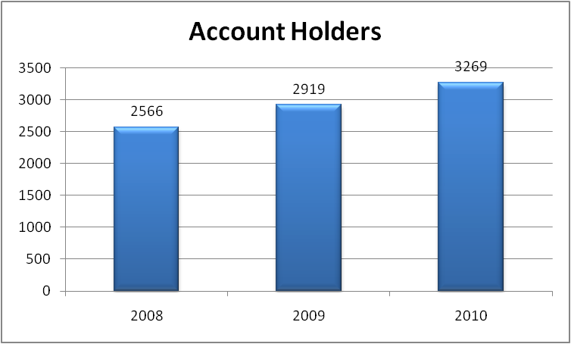
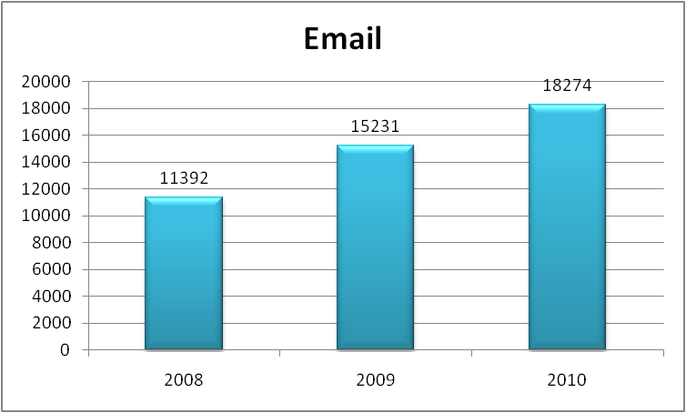
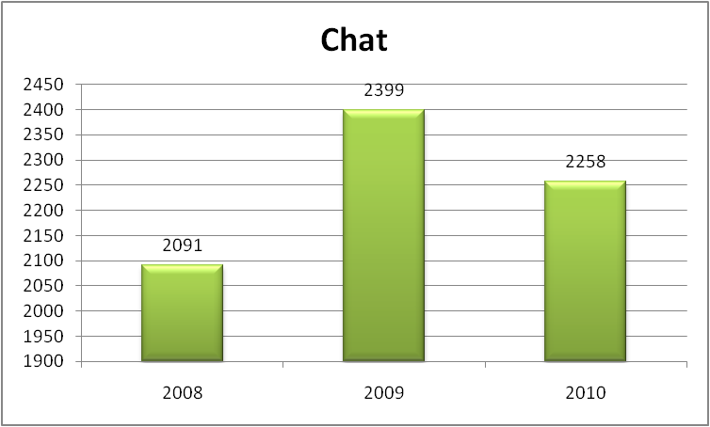
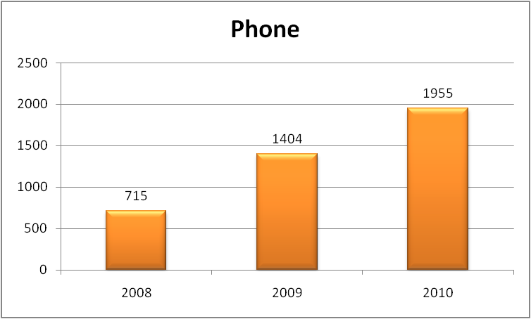
Member Services Statistics

Slide 12
Resource Delegation
2008 - 2010

Slide 13
IP Address Delegation
2008 - 2010

Slide 14
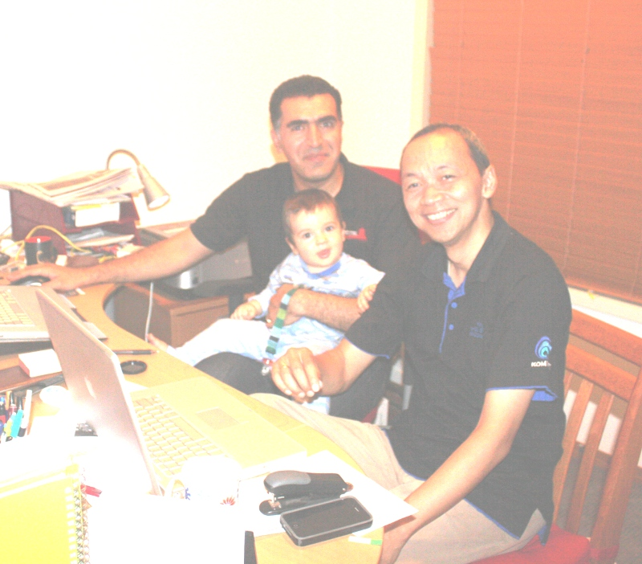
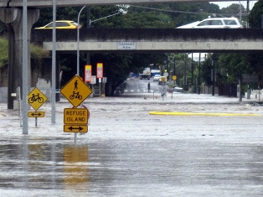
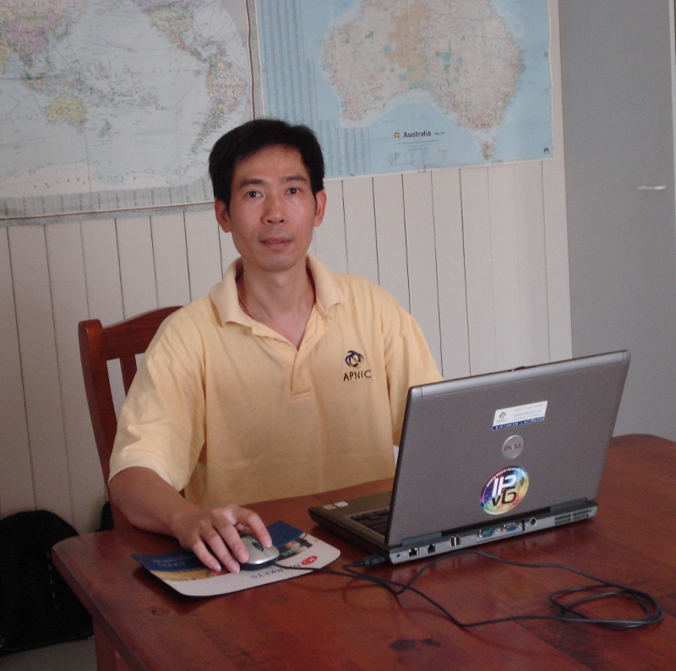
Thank You!
Brisbane flood didn’t stop us from serving you ...

