Slide 1
Business Area Report
Richard Brown
Business Area Director

Slide 2
Key Deliverables
Delivering Value
  Member Fee Schedule
  Non-Member Fee Schedule
  Taxation Status
Corporate Support
  Business Continuity Planning
  New home for APNIC
  Operational Plan and Budget
ISIF update

Slide 3
Delivering Value
Member Fee Schedule
  Implemented Jan 2010
New Non-Member Fee Schedule
  Effective Jan 2011
Taxation Status
  APNIC objection to ATO ruling upheld
  “Mutuality status” confirmed

Slide 4
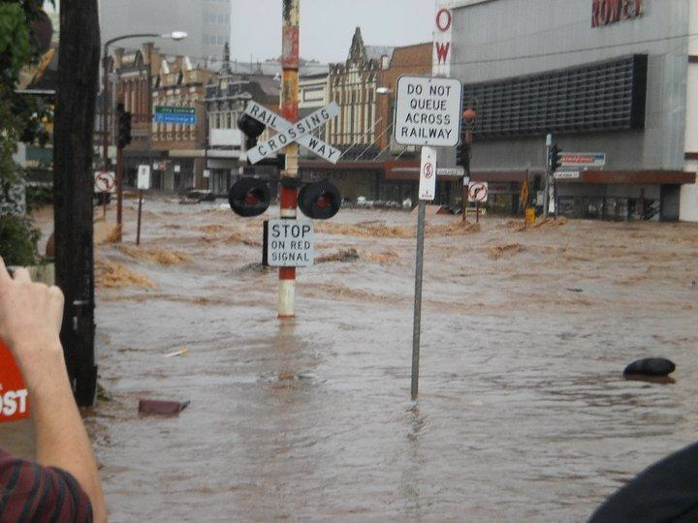
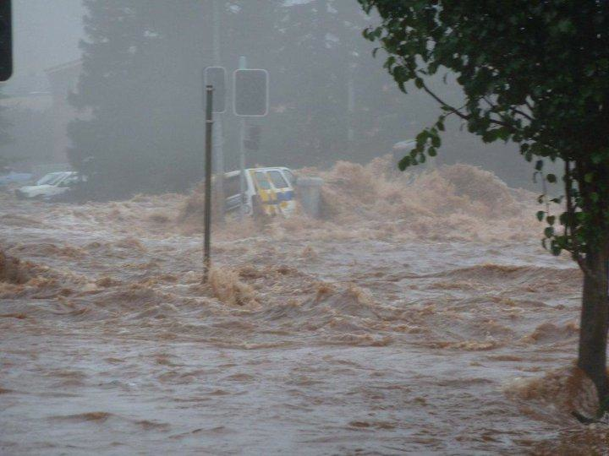
Corporate Support
Business Continuity Planning

Slide 5
Corporate Support - BCP
BCP Incident:
  Monday Jan 10
    Continued heavy rain in dam and river catchments, flash flooding reported
    Large-scale flooding event unfolds across Qld
    APNIC still relocating services from Park Rd premises
    Authorities begin warnings of potential for flooding in Brisbane

Slide 6
Corporate Support - BCP
APNIC response 11 January 2011:
  Engage BCP team
  Enact rehearsed BCP procedures
  Priority list:
    Ensure Staff safety
    Monitoring of Infrastructure and facilities
    Maintenance of services
    Communication to Members and Stakeholders

Slide 7
Corporate Support - BCP
BCP Status 11-12 January 2011:
  In BCP “Monitoring mode”
  All staff accounted for
  Staff working remotely
  Facilities secure and unaffected by flood
  Power supply biggest risk
  Co-locations unaffected
  Services to community largely unaffected
  Team prepared for potential disaster situation

Slide 8
Corporate Support - BCP
BCP Status 13-14 January 2011:
  Office and co-location facilities monitored for loss of power supply
    Power and PSTN services lost for < 24 hours
  New office and co-locations unaffected
  Widespread flooding in Brisbane and surrounds
  Significant damage to public/private infrastructure
  Staff route to physical office affected

Slide 9
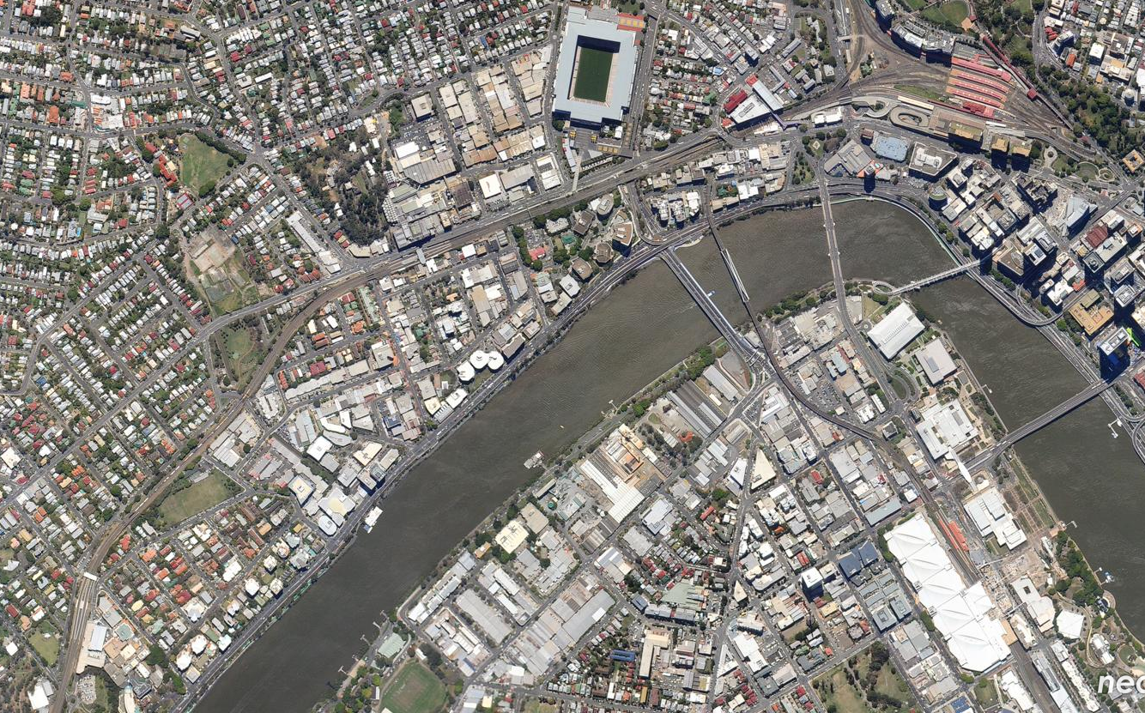
APNIC moves…
12 Jan 2010

Slide 10
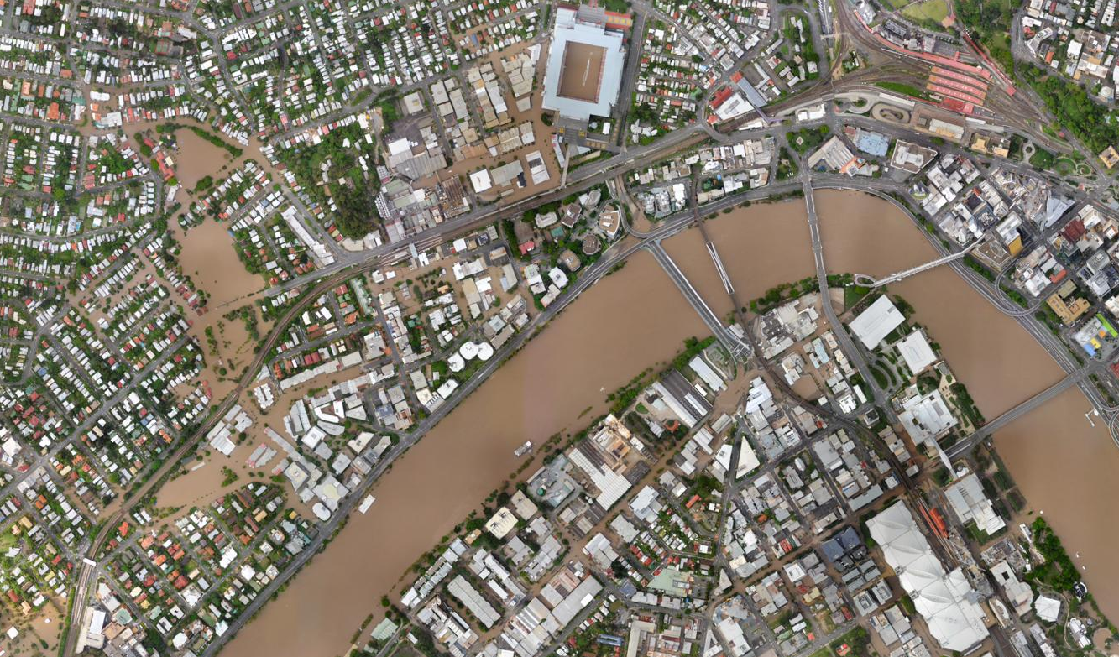
… just in time!
13 Jan 2011

Slide 11
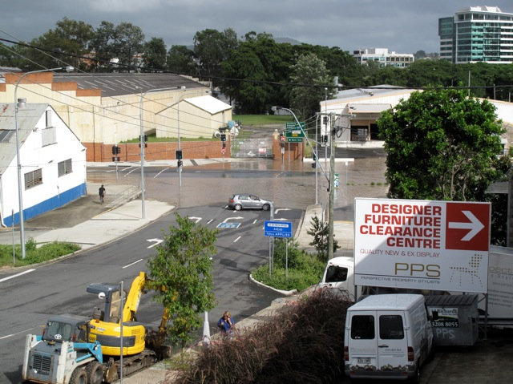
High and Dry! ☺

Slide 12
Corporate Support - BCP
BCP in 2011:
  Ongoing scenario testing
  Comprehensive review of flood response
  Implement improvements
  Increase resilience
  Audit of revised BCP for new premises

Slide 13
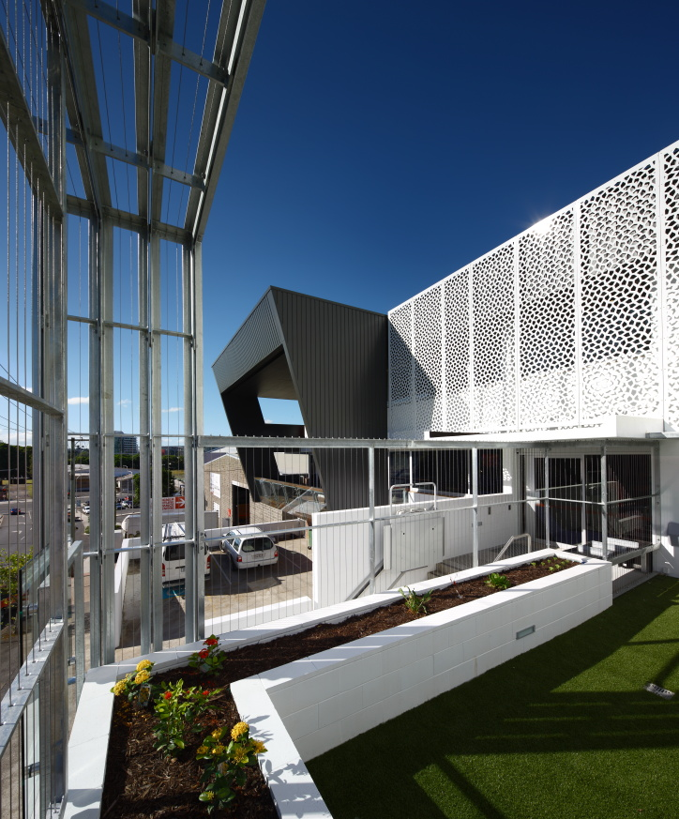
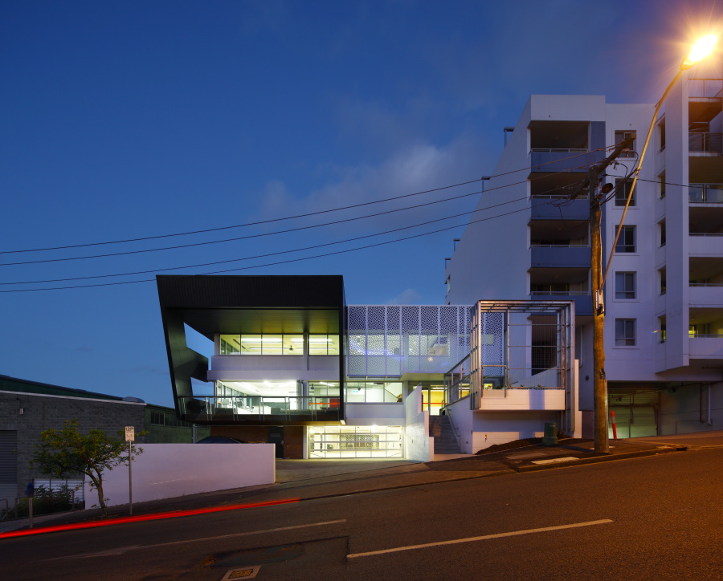
Corporate Support –
Office Relocation
  New Office for APNIC

Slide 14
Corporate Support –
Office Relocation
New Office for APNIC
  Refurbishment of existing building
    On time, within budget
    Improved redundancy
    Investment in future cost savings
  Relocation
    Moved over weekend of 18/19 December 2010
    Open for business 20 December 2010
  Old premises
    60% surrendered to new tenant

Slide 15
Corporate Support –
Operational Plan
2012 Operational Plan
  Full planning process incorporating:
    Member Survey findings
    Strategic guidance from Executive Council
    Internal Organizational workshops
    Analysis of External Environment
  Plan will:
    Establish Activity Plan for 2012/13
    Align individual, team and organizational priorities

Slide 16
ISIF Update
Why invest in ISIF
ISIF at a glance
How to support ISIF for 2011

Slide 17
Why Invest in ISIF?
To maintain and diversify support for ICT and Internet related research & development.
To support regional research that can help Internet growth in our region.
To facilitate networking and information building throughout the Internet community.
http://isif.asia

Slide 18
ISIF at a glance
ISIF small grants have been awarded to 19 projects totalling AUD 675,000
    Thailand (1), India (4), Sri Lanka (5), Pakistan (1), Vietnam (2), Indonesia (1), Nepal (2), The Philippines (1), Timor Leste/Australia (1) and Bhutan (1).
    Funding from: IDRC, APNIC, ISOC, DotAsia
2010 workshop on administrative and reporting procedures. 23-25 November 2010, Brisbane
2009 final reports and outputs distributed on a Creative Commons license
2010 interim reports under review

Slide 19

How to Support ISIF for 2011
Your funding will support:
More projects per cycle
One funding cycle a year
Tailored workshops for grants recipients’ needs
In-depth publications
Promotion and dissemination of grant recipients outcomes to encourage use and adoption

Slide 20
Thank You!

