Slide 1
MPLS Scale to 100k endpoints with resiliency and simplicity
Clarence Filsfils
Distinguished Engineer
Seamless MPLS Architecture
draft-leymann-mpls-seamless-mpls-02
Notes:
Good morning. The topic of my talk is MPLS and Simplicity. What do I mean by this?
I think it is clear that MPLS has been been very successful in the last 10 years. I think it is clear that it will be successful in the next 10 years. It will expand towards access/aggregation and transport networks.
I think that a key reason for the past success is the IP/MPLS control plane: ISIS/OSPF/BGP/LDP/RSVP and the tight integration between IP and MPLS. I think that IP/MPLS Control Plane will be a key reason for the success of MPLS in the next 10 years. I would like to highlight this in my keynote.
IP/MPLS Control Plane provide powerful attributes that will support the expansion of the MPLS technology deployment. This is what I would like to explain through this keynote.

Slide 2
Outline
Packet traffic will dominate
MPLS expansion to Access/Aggregation
Simplicity
Scale
Resilience
Flexibility

Slide 3
Packet traffic will dominate
IP services growth rates : 40% globally, nearer 100% for mobile
All aspects of wireline and mobile solutions moving towards packet
Packet traffic is the main driver for DWDM upgrades today/future
Two aspects to packets: L2 transport and L3 routing
L3 edge and content is extending further out into the network
Packet switching and transport technology
are converging from a cost perspective
Stat Mux is a key requirement in building
cost effective packet networks

Slide 4
MPLS expansion
MPLS deployment in the core is a vast success
  L3VPN, MPLS TE FRR, L2VPN
MPLS deployment in the access/aggregation
  Scale
  Resilience
  Service Flexibility
  Simplicity

Slide 5

Simplicity
“Simplicity is prerequisite for reliability”
Edsger Dijkstra
"Simplicity is the ultimate sophistication"
Leonardo da Vinci
Simplicity to minimize OPEX
SLA
OPEX / Complexity
Notes:
Requirement influences complexity
“We target <50msec” vs “We must have <50msec”
“We must have 50msec resilience” and “we must have disjoint paths from A to B”

Slide 6
Scale and Resilience with Simplicity
100k edge nodes
  An edge node may have an LSP to any other edge node
  Simplicity: only requires provisioning on the involved edge node
50msec Protection
  Simplicity: no operator involvement, router optimization which automatically provides 50msec protection
    BGP PIC and LFA FRR
See “Seamless MPLS: Integrating Access and Aggregation into a single MPLS network”,
N. Leymann, DT

Slide 7
Reference Model
PE11
PE21
ABR11
ABR21
D1
D2
PE12
PE22
ABR12
ABR22
L1
L2
L1
1k Nodes / Core
10k Nodes / Aggregation
100k Nodes / Access

Slide 8
Scaling the Access Nodes
PE11
PE21
ABR11
ABR21
D1
D2
PE12
PE22
ABR12
ABR22
L1
L2
L1
100k Nodes / Access

Slide 9
LDP Downstream on Demand
1.1.1.1
PE11
0/0
D1
0/0
PE12
Default Static Route
IP/MPLS control plane
Access node remains extremely simple
  no IGP, no BGP
Notes:
Upon being provisioned with a PW to a.b.c.d, D1 sends an LDP DoD Request to its default gateways
PE11 & PE12 are part of the dynamic ip/mpls control plane and hence have a route/lsp to a.b.c.d
PE11 & PE12 provide an LDP DoD label binding to D1
D1 has an end-to-end LSP to a.b.c.d

Slide 10
LDP Downstream on Demand
Service Provisioning
Service Provisioning
Port P xconnect 1.1.1.1
1.1.1.1
PE11
LDP DoD Request (1.1.1.1)
D1
LDP DoD Request (1.1.1.1)
PE12
IP/MPLS control plane
No service provisioning anywhere else
Notes:
Upon being provisioned with a PW to a.b.c.d, D1 sends an LDP DoD Request to its default gateways
PE11 & PE12 are part of the dynamic ip/mpls control plane and hence have a route/lsp to a.b.c.d
PE11 & PE12 provide an LDP DoD label binding to D1
D1 has an end-to-end LSP to a.b.c.d

Slide 11
LDP Downstream on Demand
1.1.1.1
PE11
LDP DoD Reply (L=21)
D1
LDP DoD Reply (L=31)
PE12
IP/MPLS control plane
No service provisioning anywhere else
Notes:
Upon being provisioned with a PW to a.b.c.d, D1 sends an LDP DoD Request to its default gateways
PE11 & PE12 are part of the dynamic ip/mpls control plane and hence have a route/lsp to a.b.c.d
PE11 & PE12 provide an LDP DoD label binding to D1
D1 has an end-to-end LSP to a.b.c.d

Slide 12
LDP Downstream on Demand
1.1.1.1
PE11
D1
PE12
IP/MPLS control plane
Notes:
Upon being provisioned with a PW to a.b.c.d, D1 sends an LDP DoD Request to its default gateways
PE11 & PE12 are part of the dynamic ip/mpls control plane and hence have a route/lsp to a.b.c.d
PE11 & PE12 provide an LDP DoD label binding to D1
D1 has an end-to-end LSP to a.b.c.d

Slide 13
LDP Downstream on Demand
Access node is extremely simple
  No IGP, no BGP
Access node may have an LSP towards any other node
Access node only knows the labels it needs
Simple and Scaleable
Leverage existing technology (simplicity)

Slide 14
Scaling the IP/MPLS Control Plane
PE11
PE21
ABR11
ABR21
D1
D2
PE12
PE22
ABR12
ABR22
L1
L2
L1
1k Nodes / Core
10k Nodes / Aggregation

Slide 15
Divide and Conquer
To scale, introduce a layer of hierarchy
  BGP
Possible thanks to key innovation: BGP PIC
  Scale-Independent BGP FRR
  Simple: default router behavior

Slide 16
IGP ~ K entries
Redist core ABR into L1
Redist static into L1
PE11
PE21
ABR11
ABR21
D1
Nothing or only summary
D2
PE12
PE22
ABR12
ABR22
L1
L2
L1
Notes:
No ISIS route is propagated from L1 to L2
or a few summaries covering all the r2r subnets in the L1 region
Only the core ABR’s are propagated from L2 to L1
plus potentially a few summaries covering all the r2r subnets in other regions
Static Routes to DSLAM’s are redistributed into L1

Slide 17
BGP 3107 ~ 100K entries
iBGP3107
PE21 and D2 via ABR21
PE11
PE21
iBGP3107
PE21 and D2 via ABR21
ABR11
ABR21
D1
D2
PE12
PE22
ABR12
ABR22
L1
L2
L1
IGP/LDP Label
BGP3107 Label
Service Label
Each IGP area has routes for that area only + routes to core ABR’s ( ~1k prefixes)
LDP labels used to traverse each area and reach core ABR’s
BGP labels used by PEs and ABRs to reach PE’s in remote areas
Service (e.g., PW) labels used by Pes
Add-Path

Slide 18
IGP FRR: Loop-Free Alternate (LFA)
D1
C
S
F
D2
E
IGP route D1
  Primary Path: via F
  Backup Path: via C because C’s primary path is not via S
IGP route D2
  Primary Path: via F
  Backup Path: via E because E’s primary path is not via S

Slide 19
LFA Benefits
Simple
  the router computes it automatically
<50msec
  pre-computed, pre-installed, enabled on link down in a prefix independent manner
  Leverage Hierarchical dataplane FIB
Link and Node Protection
Deployment friendly
  no IETF protocol change, no interop testing, incremental deployment

Slide 20
LFA Constraint
Topology dependent
  availability of a backup path depends on topology
  S has no LFA for dest D1
B
C
S
F
D1

Slide 21
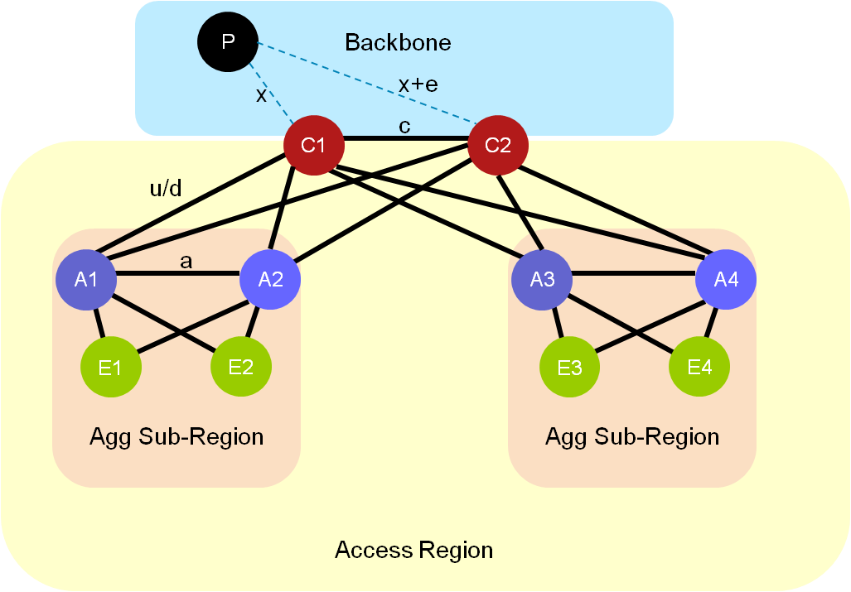
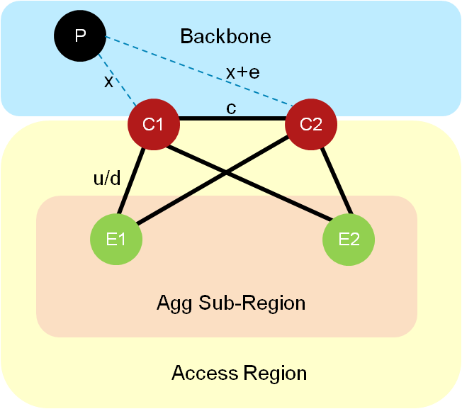
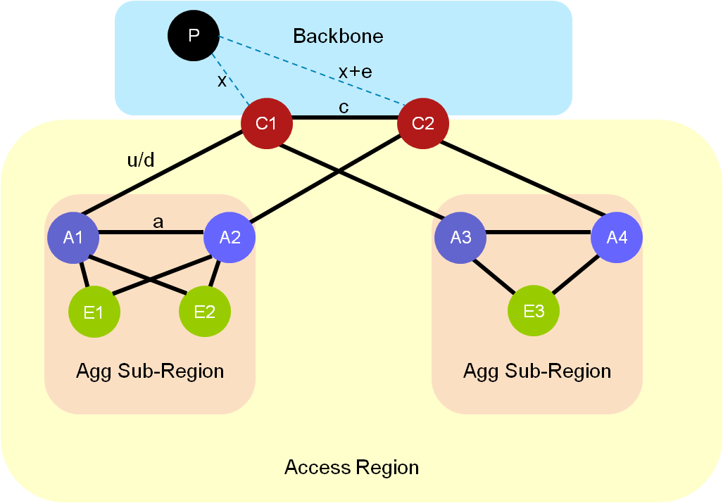
Access/Aggregation Topologies
100% link and node protection
99% link and node protection
See draft-filsfils-lfa-applicability-00

Slide 22
BGP Prefix-Independent Protection (PIC)
50msec protection
Prefix-Independent
Default behavior, entirely automated computation
No operator involvement
Simple
PE3
Cust1
PE1
Cust2
PE2

Slide 23
BGP PIC
x00msec Protection
Prefix-Independent
Default behavior, entirely automated computation
No operator involvement
Simple
PE3
Cust1
PE1
Cust2
PE2

Slide 24
Service Flexibility
PWI
PWI
Service and Network Architecture are decoupled – No boundary
Simplicity leads to OPEX optimization
  MPLS as single packet transport technology
  uniform end-to-end service protection at scale
See “Flexible Service Edge Architecture”, Le Faucheur
Notes:
Let’s compare with an ethernet access and MPLS aggregation.
1) Two provisioning acts to get the DSLAM talking to the network.
Configure the DSLAM VLAN and then configured the ingress PE device.
The proposed design requires one provisioning act at each end
2) Complex OAM, protocol and protection interaction between at Ethernet / IP/MPLS boundary.
The proposed design has no complex protocol / protection mechanisms that need to be synchronised.
3) Its common to use the same vlanids on multiple DSLAMs. This means the IP/MPLS boundary device needs to sort this issue.
This design sorts this out at the individual level DSLAM.

Slide 25
Conclusion
Packet traffic will dominate
Innovations support 100k edge nodes in an mpls network with 50msec protection and simplicity
Simplicity to minimize OPEX
  Operational Convergence
  Plug&Play 50msec Protection
  Service Flexibility/Velocity
Notes:
Network infrastructures need to be optimized for packets
MPLS is a great packet technology

Slide 26
Backup
Strictly Confidential

Slide 27
Service Mirroring Applicability
Service Mirroring or PIC
PIC Required
PIC Required

Slide 28
Service Mirroring Complexity
Operator Configuration Intensive
  Catastrophic service impact if misconfigured
Restrictive Assumptions
  small applicability
Does not replace the need for BGP PIC
  Additional Technology

