Slide 1


KISA IP Team in 2010
Mar, 2010
Billy MH Choen @ Korea Internet & Security Agency

Slide 2







KISA IP Team
Development and Management of Internet Address Resources
IR Standardization
IPv6 Promotion
IP/AS Management
Standardization
IPv6 project, IPv6 network
IP/AS Member services
Forum and Association
Awareness for IPv6
Policy & System
2
6
4

Slide 3
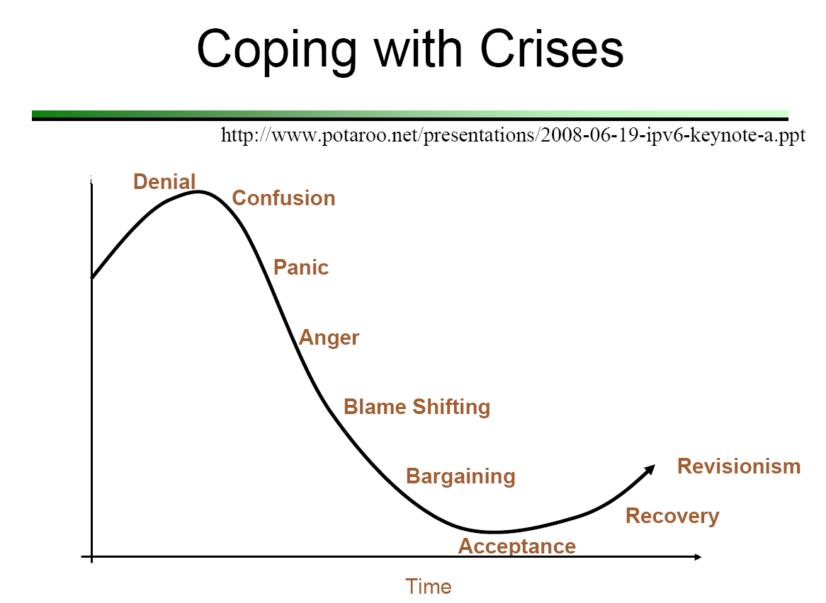
Where are we standing?

Slide 4






Analysis
IPv6 Soft Landing
Global IPv4 Exhaustion
New IP management policy for post IPv4 exhaustion
New IP fee schedule for post IPv4 exhaustion
Publicity for multi-stakeholders
Political
Economic
Social
Technological
Last /8
APNIC , NIR, members
New fee schedule
IPv6 fee
NRO 10% Campaign
UN MDG
New technology
(IPTV, Smart phone …)
end-to-end connection
(Limits of NAT, DHCP)
Wireless Internet
Infrastructure
Wireless Internet
Infrastructure

Slide 5
Policy and publicity
Raising
Awareness
To strengthen local publicity for IPv4 exhaustion and IPv6 needs in stages
- ISPs Equipment Vender, CP … End user (Company)
To keep pace with global scheme for IPv4 exhaustion and IPv6 promotion
IP management Policy
To revise and develop the current local IP management policy
- local IPv4 management & IPv6 promotion within Korea
- service for members in post IPv4 exhaustion era, ex) RPKI, IRR etc.
IP fee schedule
To revise and develop the current local IP fee schedule
- PAF Tier based
NRO 10 % Campaign
Jan. 2010.
G20
Nov. 2010.
IPv4 Exhaustion
Sept. 2011

Slide 6
IPv6 Promotion
ISPs
No investment
No needs for
IPv6 service
No needs to provide IPv6 environment
Vicious circle
End users
Public companies
Private companies
No investment
Not able to use
IPv6 based services

Slide 7
IPv6 Promotion
ISP
Investment
IPv6 Promotion projects with portal & news sites
First, public side
Needs for IPv6 service
IPv6 ready environment
Encourage investment
IPv6 readiness
Virtuous circle
ISP’s IPv6 deployment plan
Awareness for IPv6 needs
Public companies
Private companies
End users
Use IPv6 based services
Investment

Slide 8
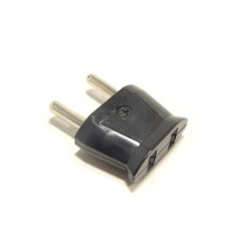
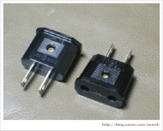
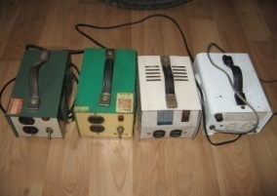
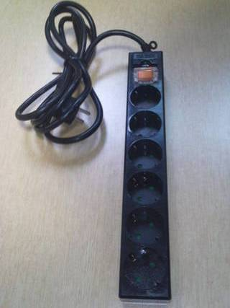
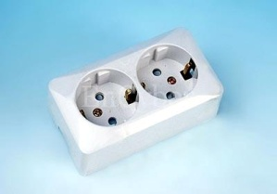

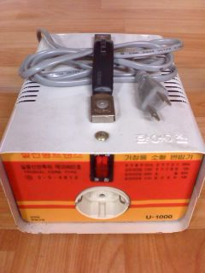
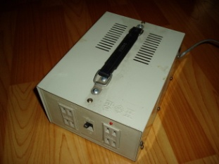

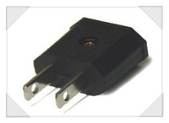
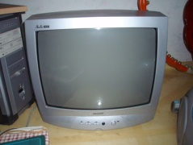
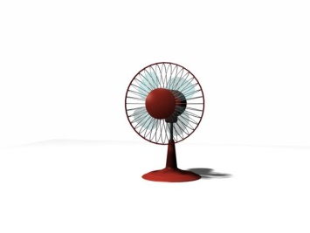
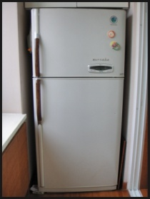
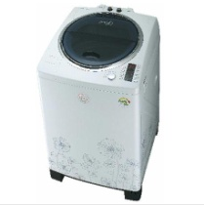
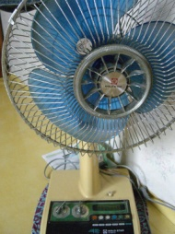
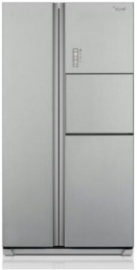
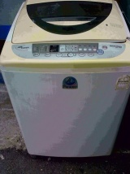


IPv6 Promotion
110V
110V / 220V
220V
KEPOC
Home
Appliance

Slide 9
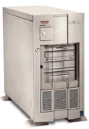
IPv6 Promotion
IPv4 only
IPv4 / IPv6
IPv6 only
ISP
ISP
ISP
ISP
ISP
IPv4
IPv4/IPv6
IPv4
IPv6
Translator
IPv4
IPv4/IPv6
IPv6
IPv6
Public
Private
IPv4
IPv4/IPv6
IPv6
IPv6
서버
PC
서버
PC
서버
PC
서버
PC

Slide 10




IPv6 Promotion
ISP
ISP
Overseas network
IX
IX
ISP
ISP
ISP
IPv4/IPv6 dual
ISP
ISP
ISP
IPv4 only
PC1
PC2
DNS
WEB
Mail
PC1
PC2
DNS
WEB
Mail
PC1
PC2
DNS
WEB
Mail
IPv4 only
IPv4/IPv6 dual
IPv4 only

Slide 11
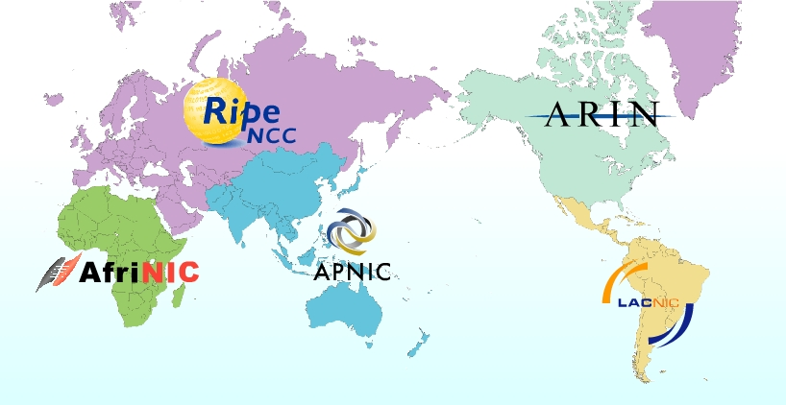


Any Qs?

